Slide 1

English Vocabulary

Slide 2

The Alphabet: A-Z

Slide 3
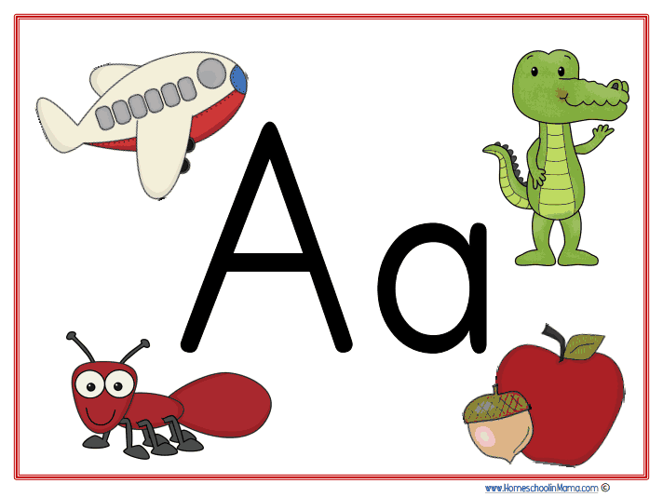
Letter

Slide 4
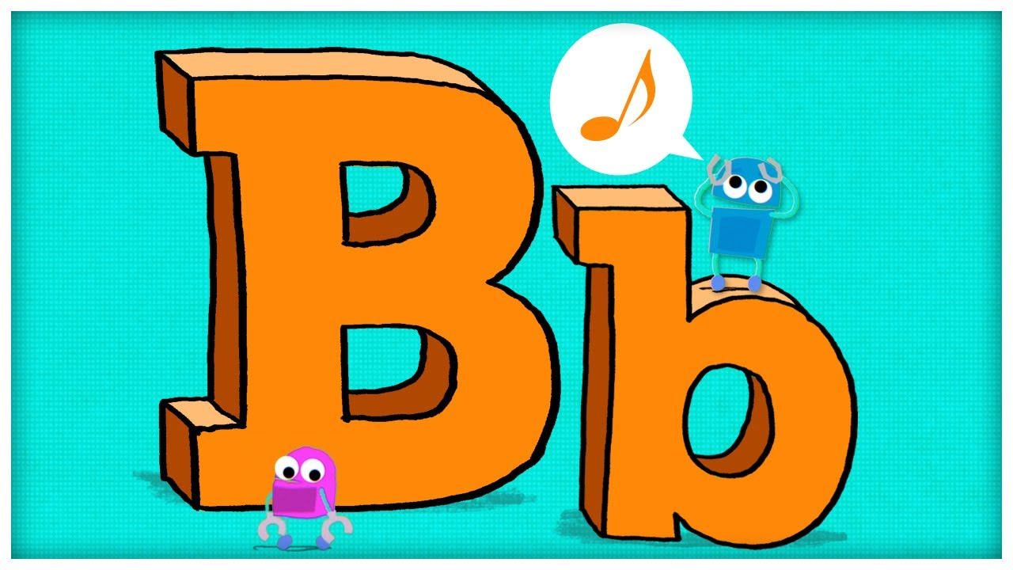
Letter

Slide 5
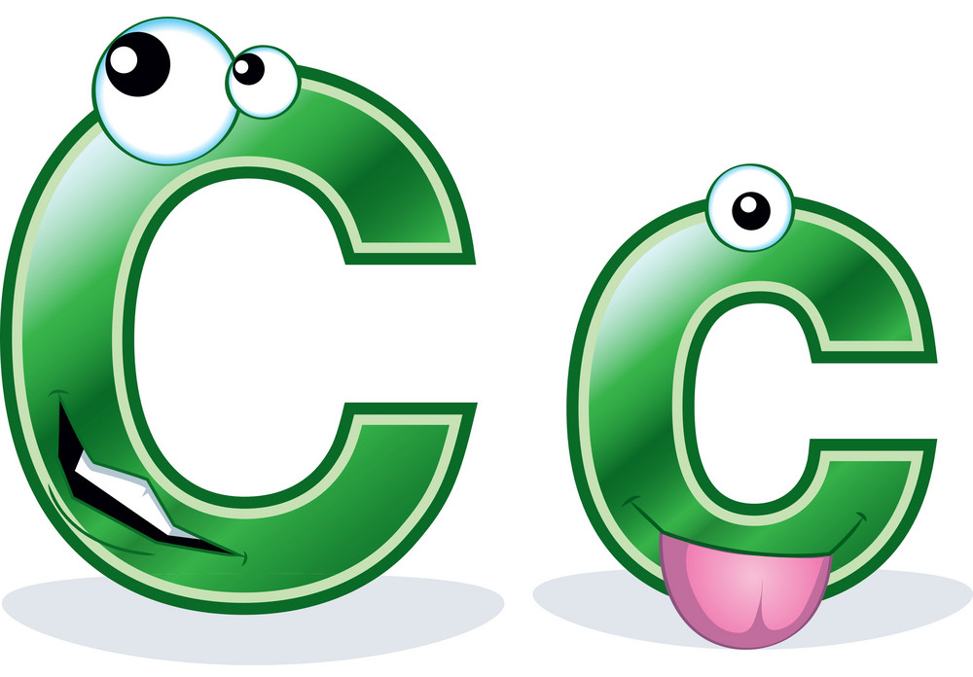
Letter A

Slide 6
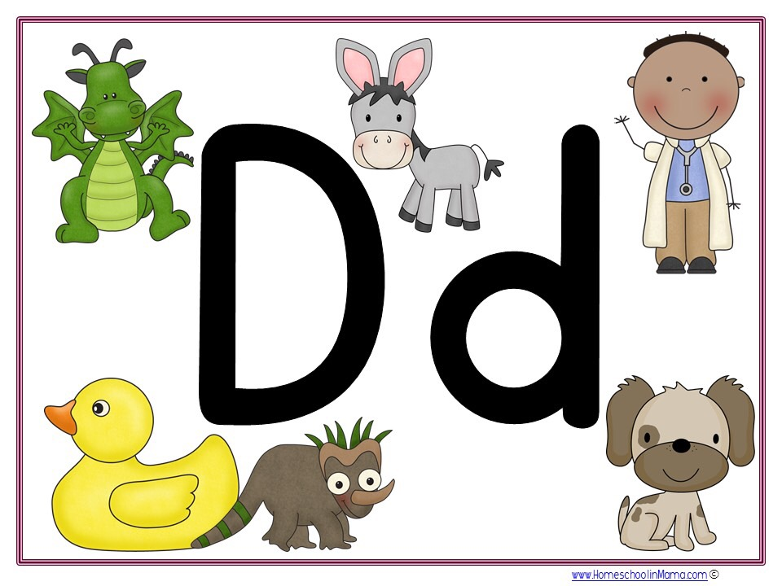
Letter

Slide 7
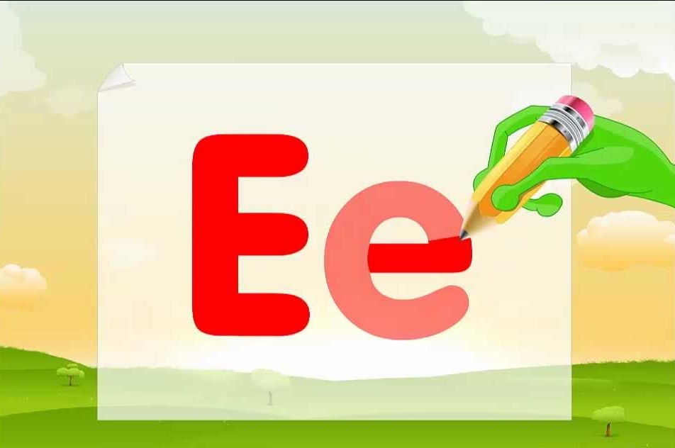
Letter

Slide 8
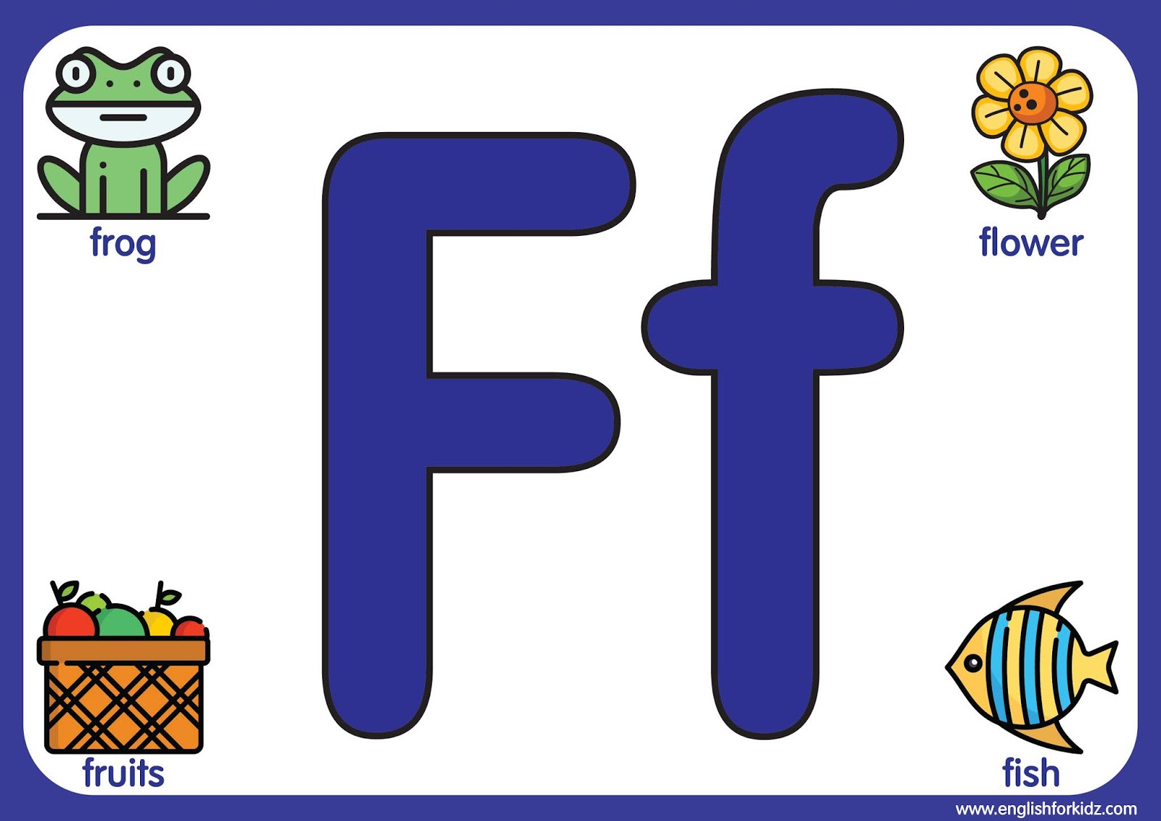
Letter

Slide 9
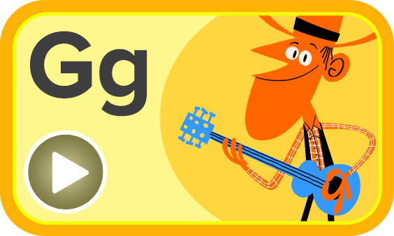
Letter

Slide 10
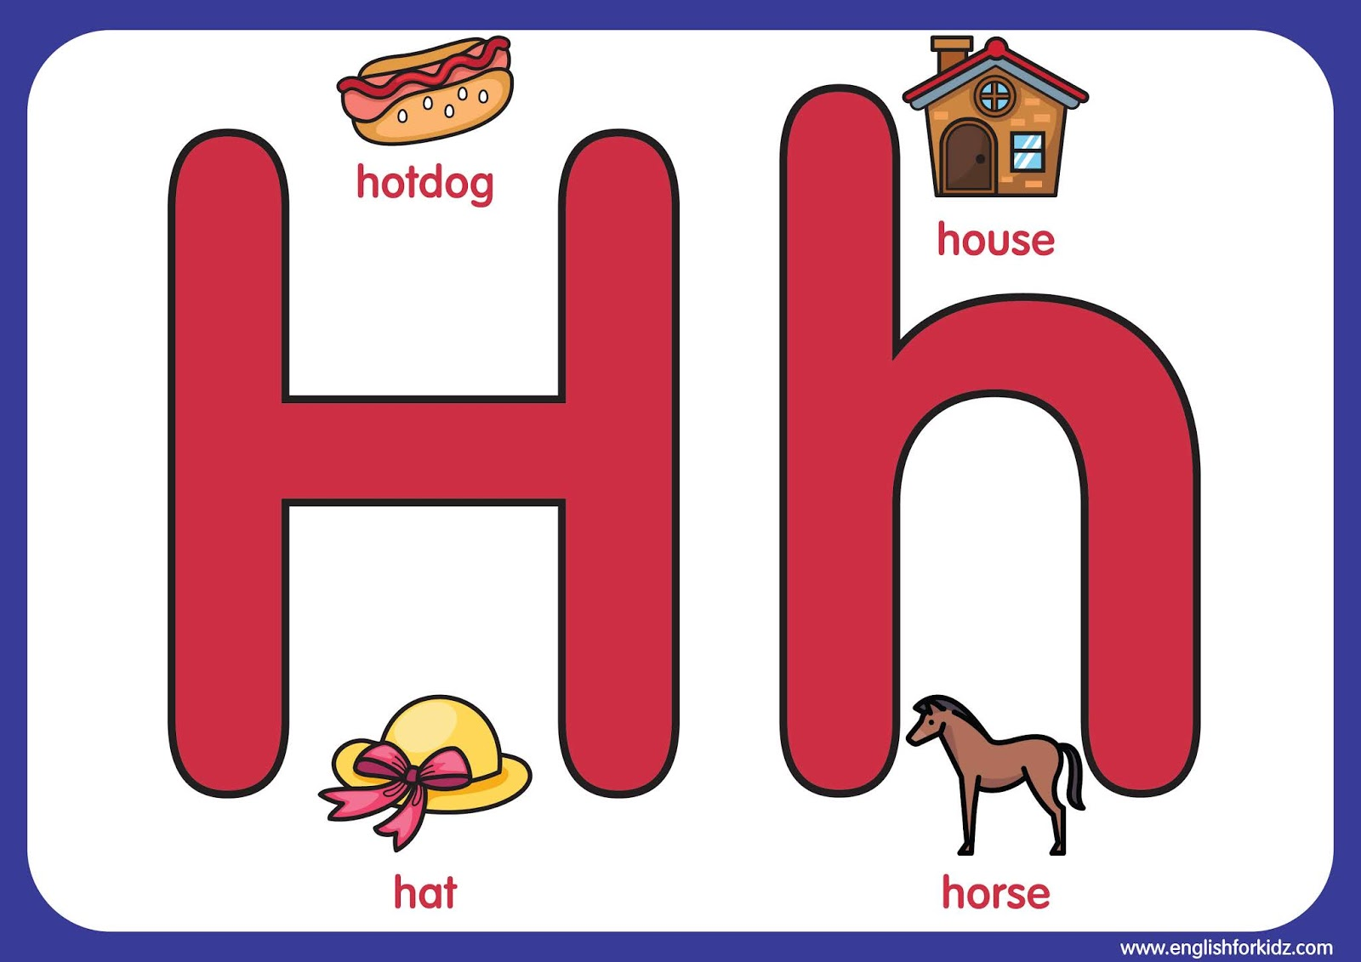
Letter

Slide 11

Letter

Slide 12

Letter

Slide 13

Letter

Slide 14
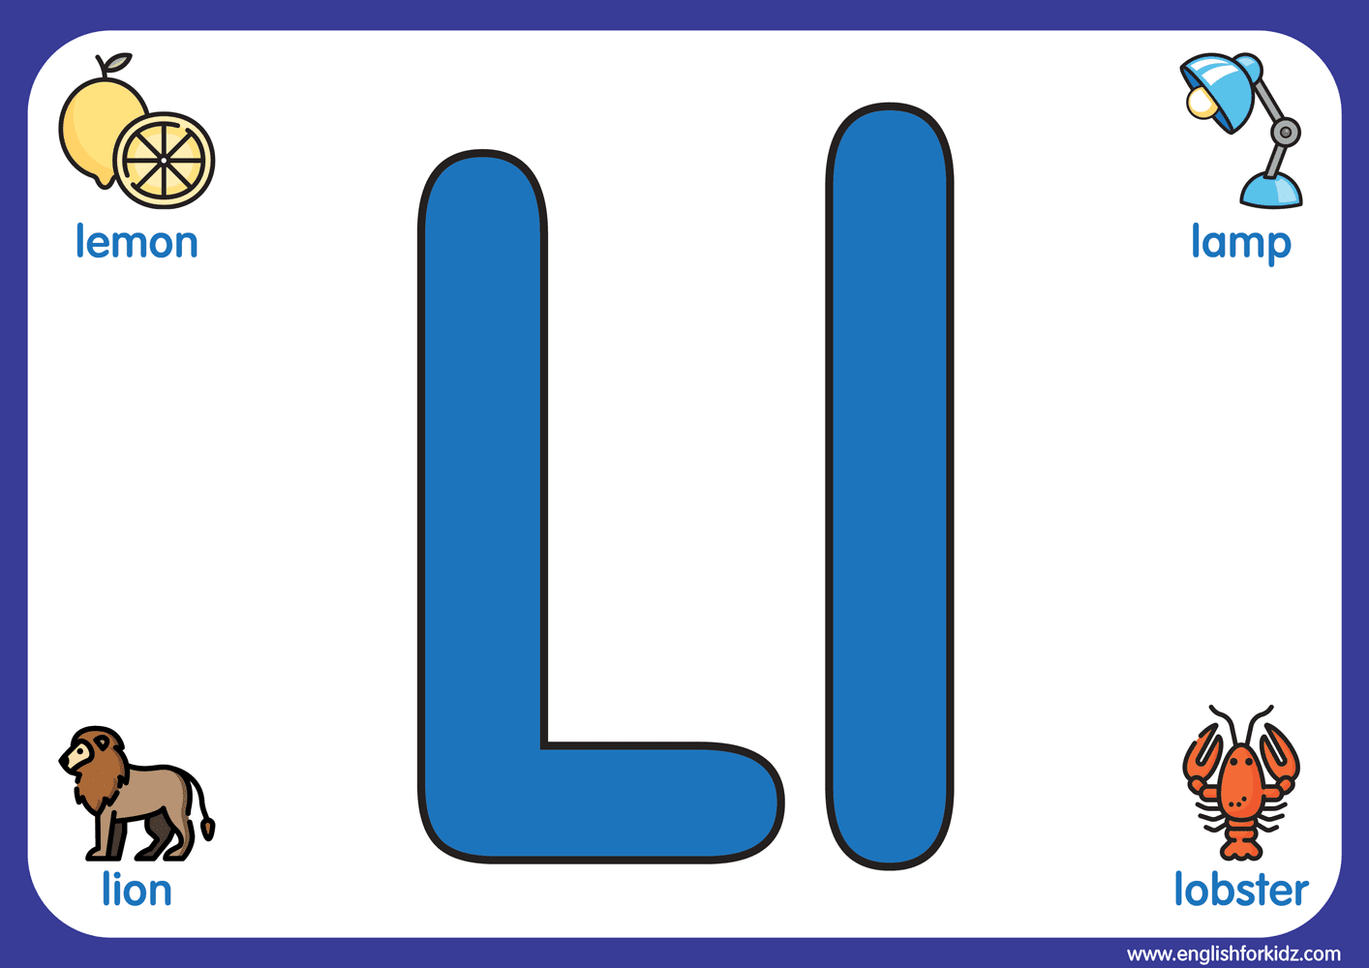
Letter

Slide 15

Letter

Slide 16
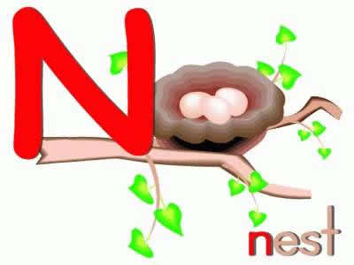
Letter

Slide 17

Letter

Slide 18
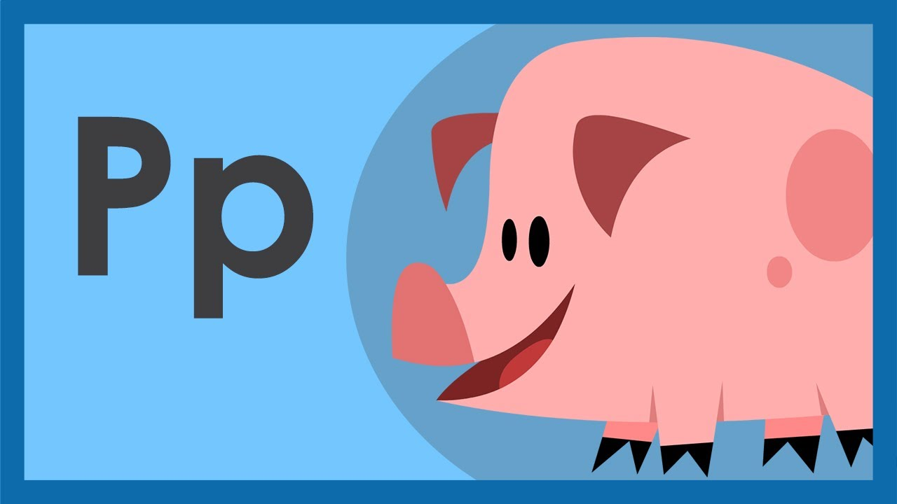
Letter

Slide 19
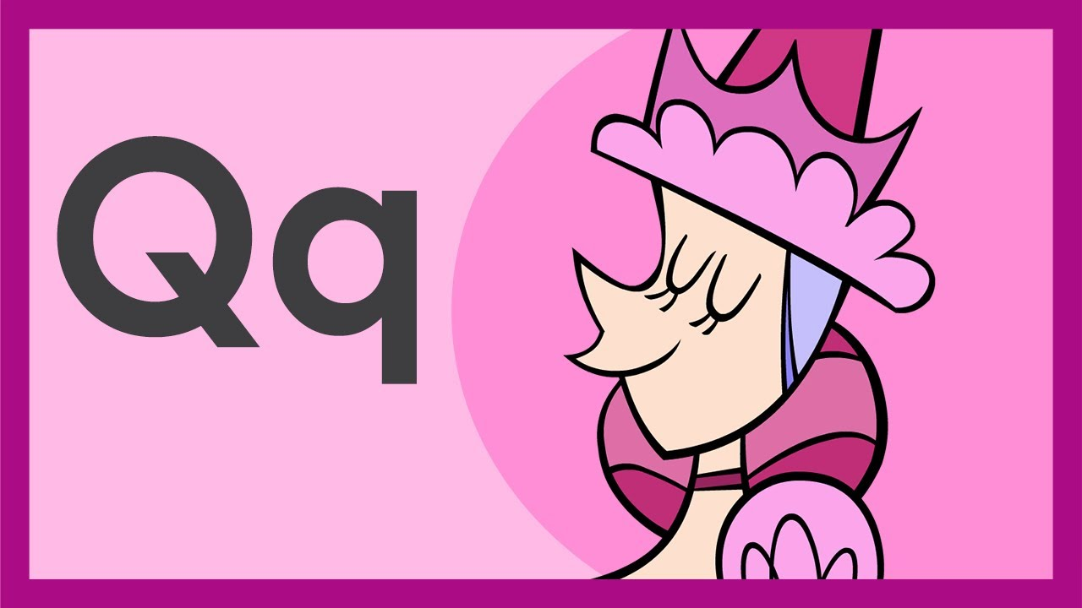
Letter

Slide 20
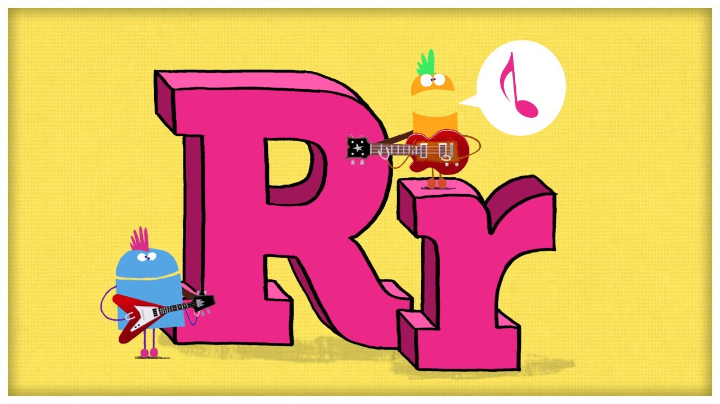
Letter

Slide 21

Letter

Slide 22
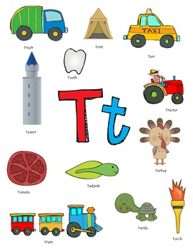
Letter

Slide 23

Letter

Slide 24
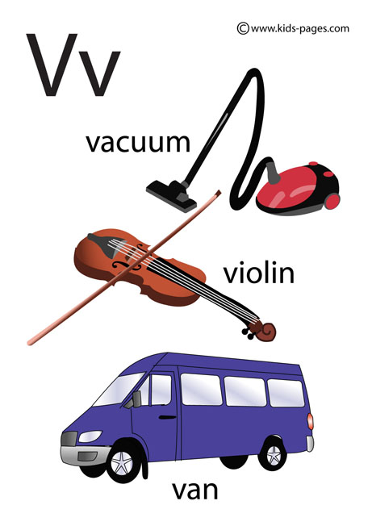
Letter
Vv

Slide 25

Letter

Slide 26
Letter
Xx

Slide 27

Letter

Slide 28

Letter

