Slide 1

English Vocabulary

Slide 2
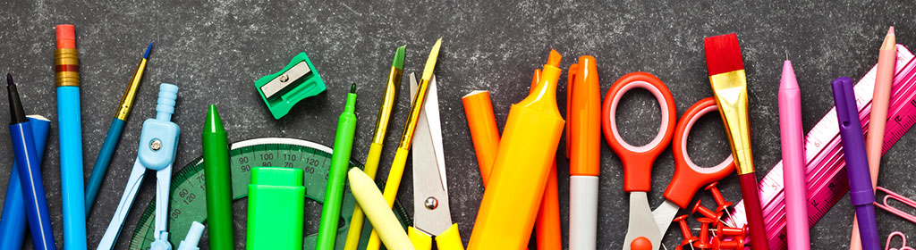
Unit One: School
Part 1

Slide 3
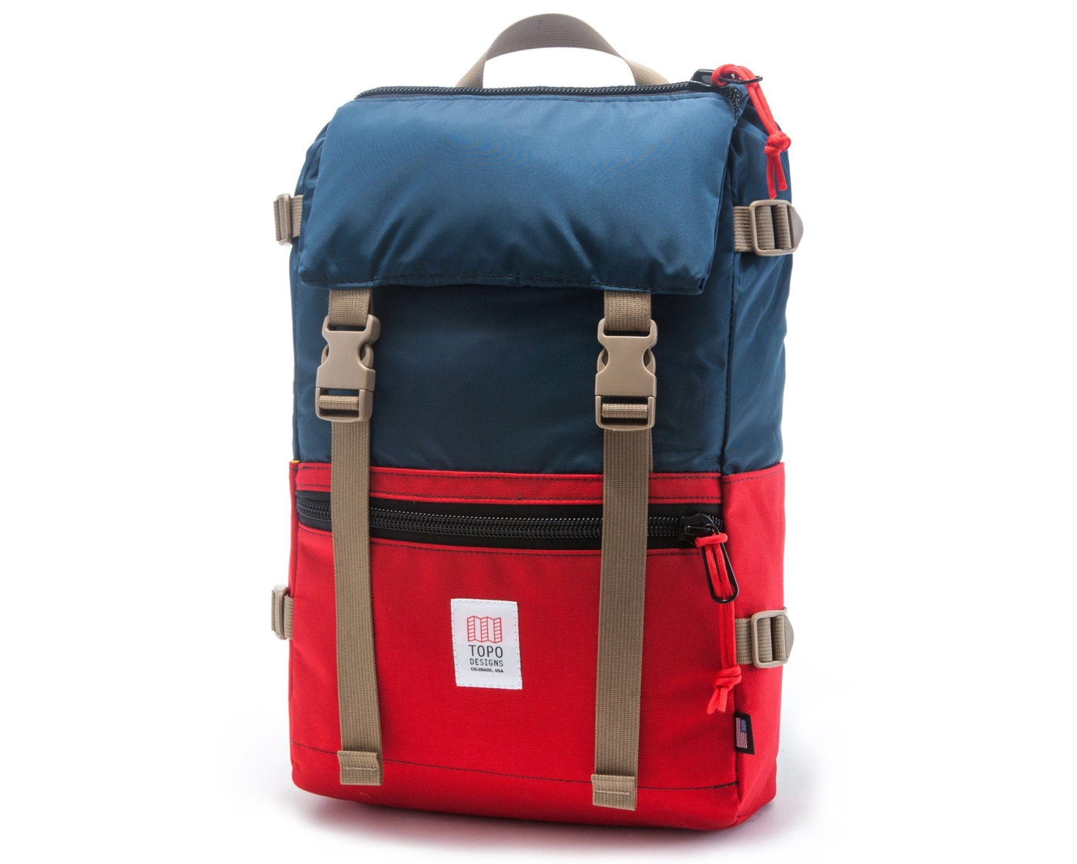
Backpack

Slide 4
Black

Slide 5
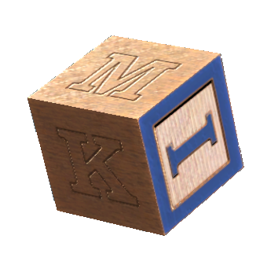
Block

Slide 6

Book

Slide 7
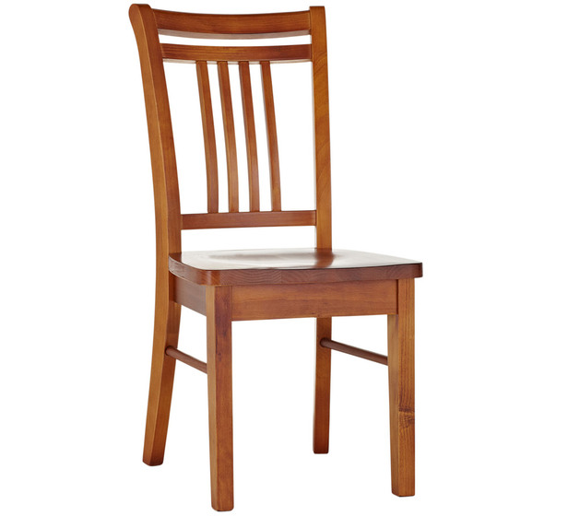
Chair

Slide 8

Circle

Slide 9

Class

Slide 10
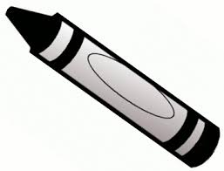
Crayon

Slide 11
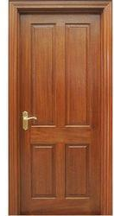
Door

Slide 12
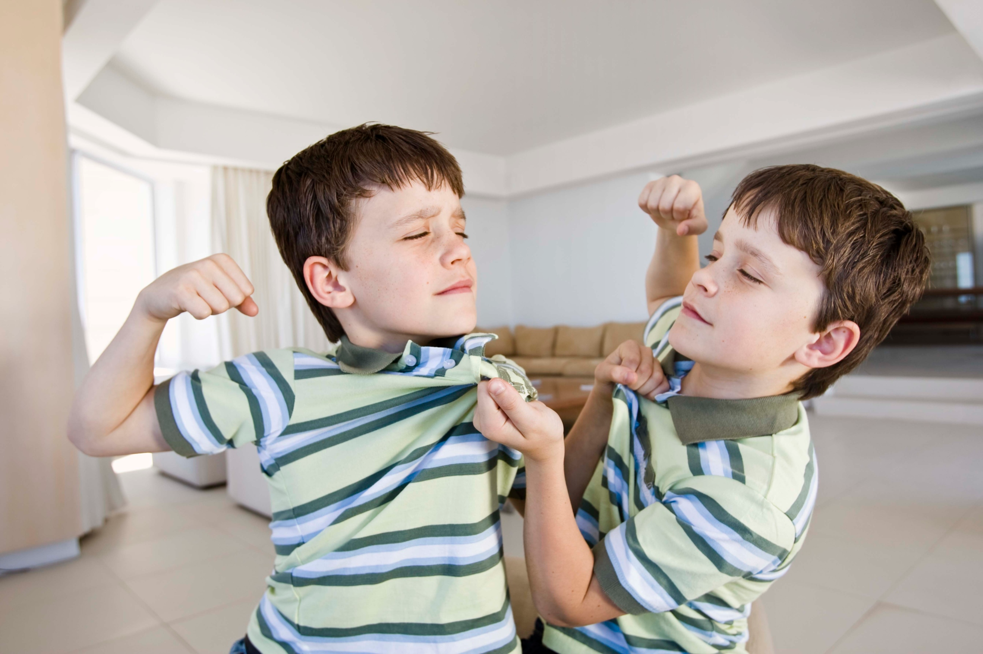
Fight

Slide 13
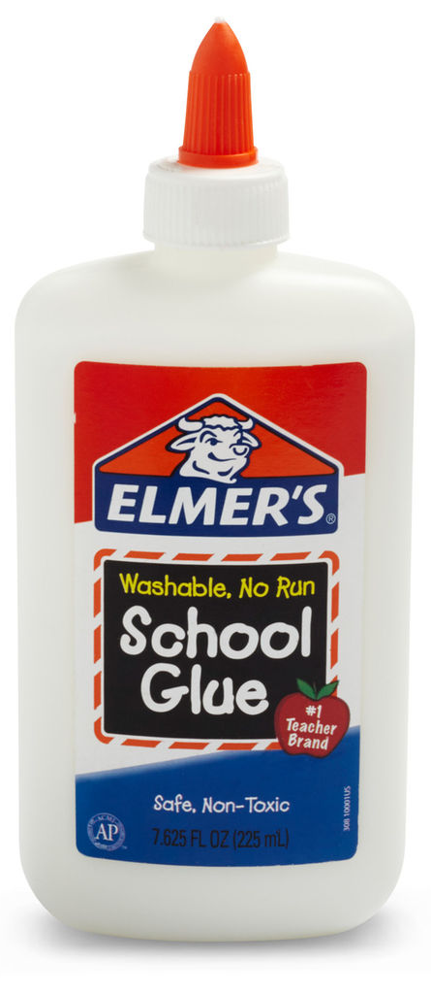
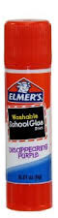
Glue

Slide 14
Gray

Slide 15
Green

Slide 16
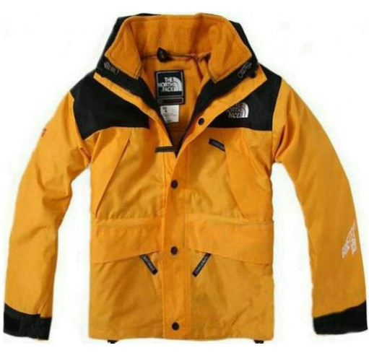
Jacket

Slide 17
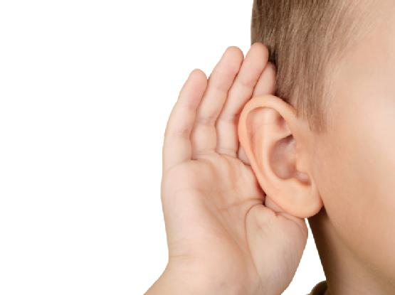
Listen

Slide 18
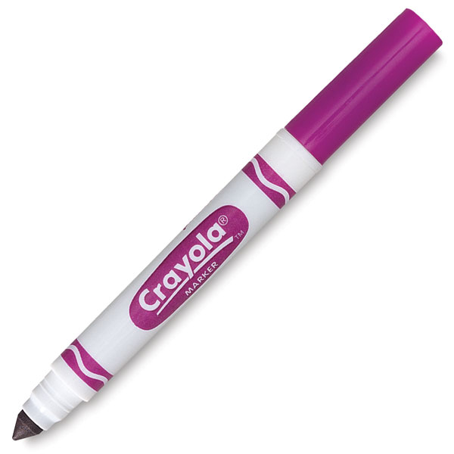
Marker

Slide 19
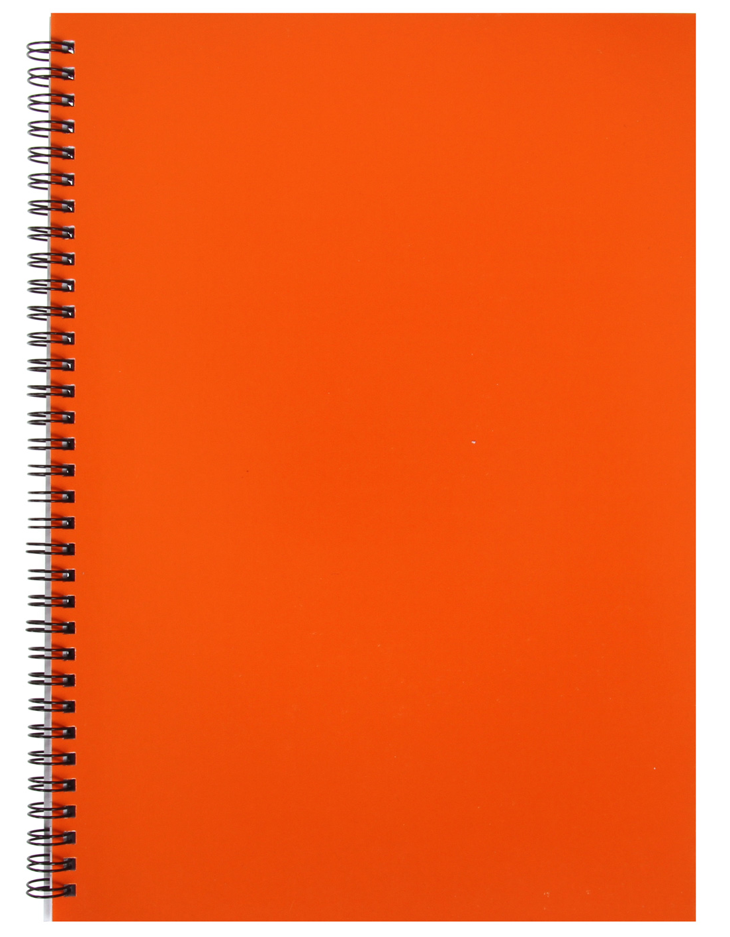
Notebook

Slide 20
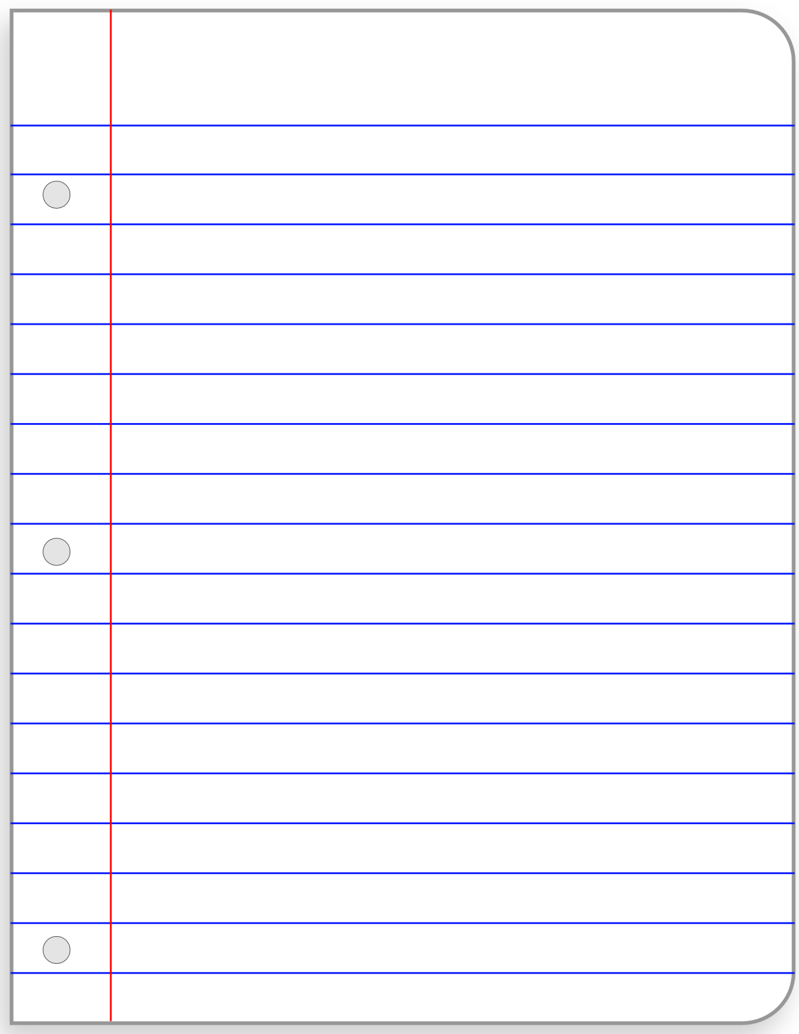
Paper

Slide 21
Pink

Slide 22
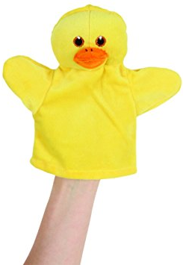
Puppet

Slide 23
Purple

Slide 24

Puzzle

Slide 25
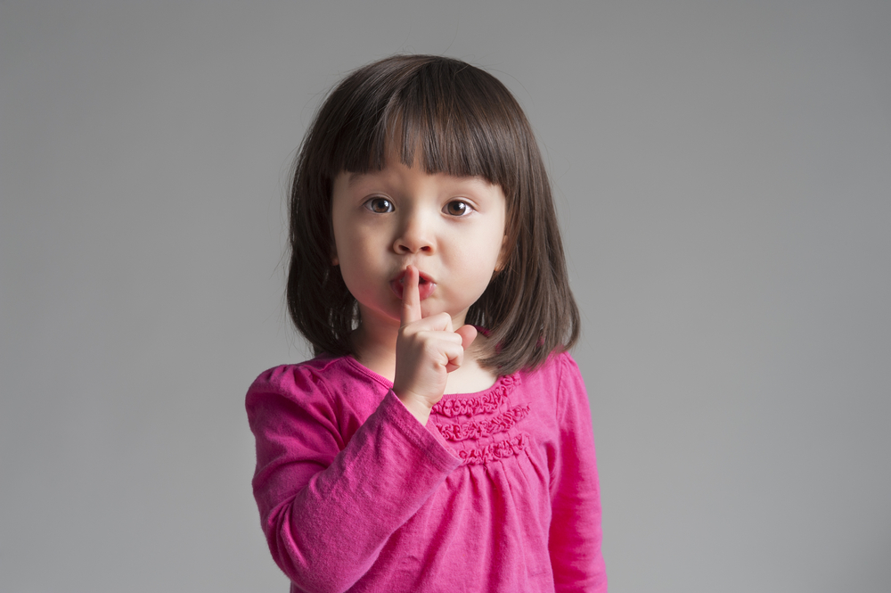
Quiet

Slide 26
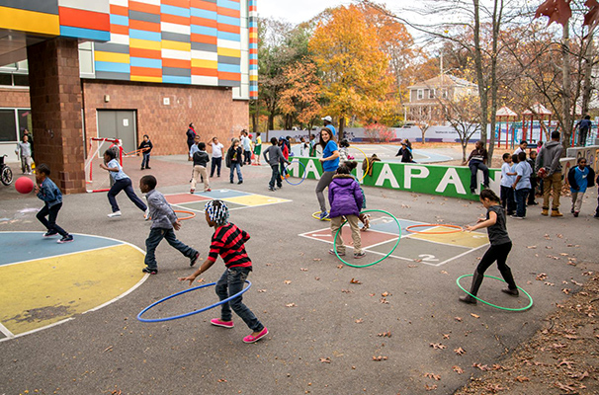
Recess

Slide 27

Rectangle

Slide 28
Red

Slide 29

Run

Slide 30
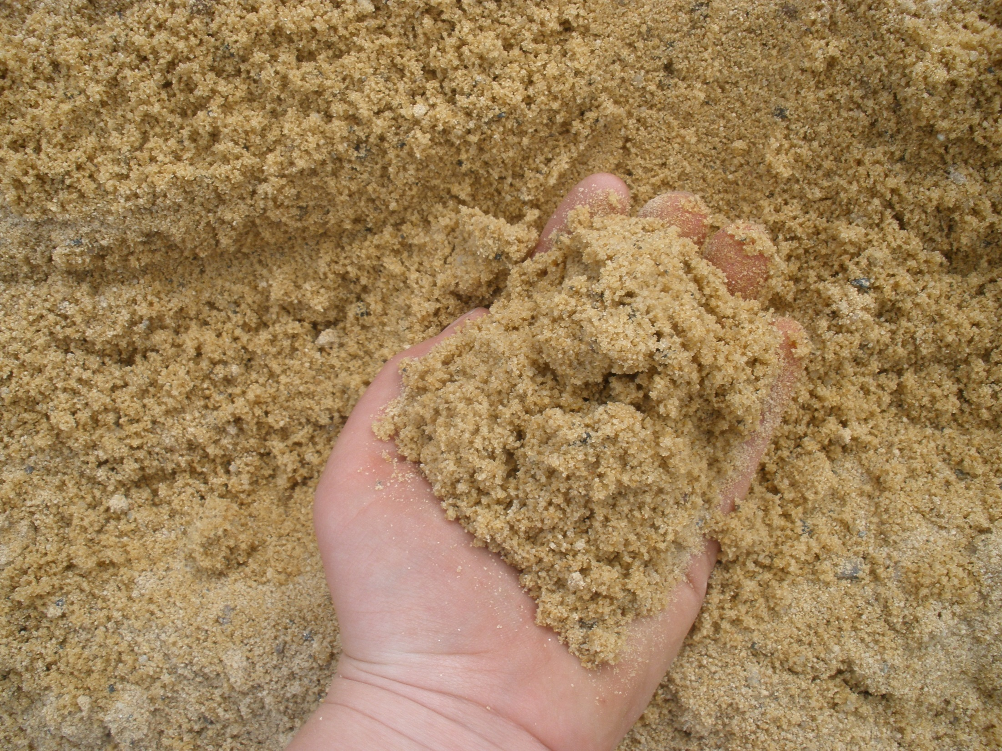
Sand

Slide 31
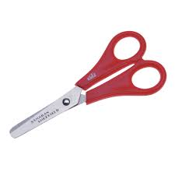
Scissors

Slide 32

Silence

Slide 33

Sing

Slide 34

Sticker

Slide 35

Yellow

Slide 36

White

Slide 37
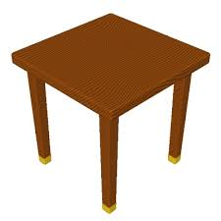
Table

Slide 38

One

Slide 39

Two

Slide 40

Three

Slide 41

Four

Slide 42

Five

Slide 43

Six

Slide 44

Seven

Slide 45

Eight

Slide 46

Nine

Slide 47

Ten

