Slide 1

English Vocabulary

Slide 2

Unit One: School
Part 3

Slide 3

Copy

Slide 4
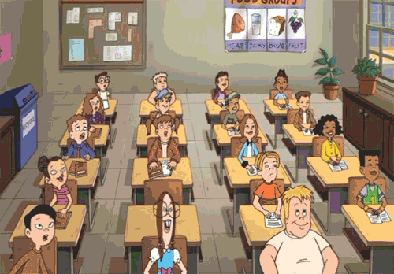
Classmates

Slide 5

Group

Slide 6
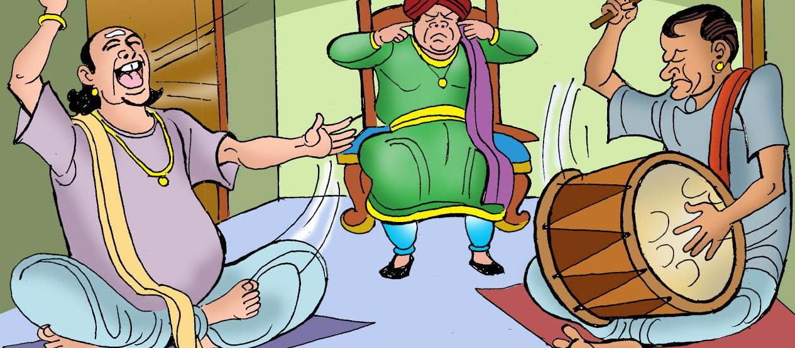
Noisy

Slide 7

Page

Slide 8

Read

Slide 9
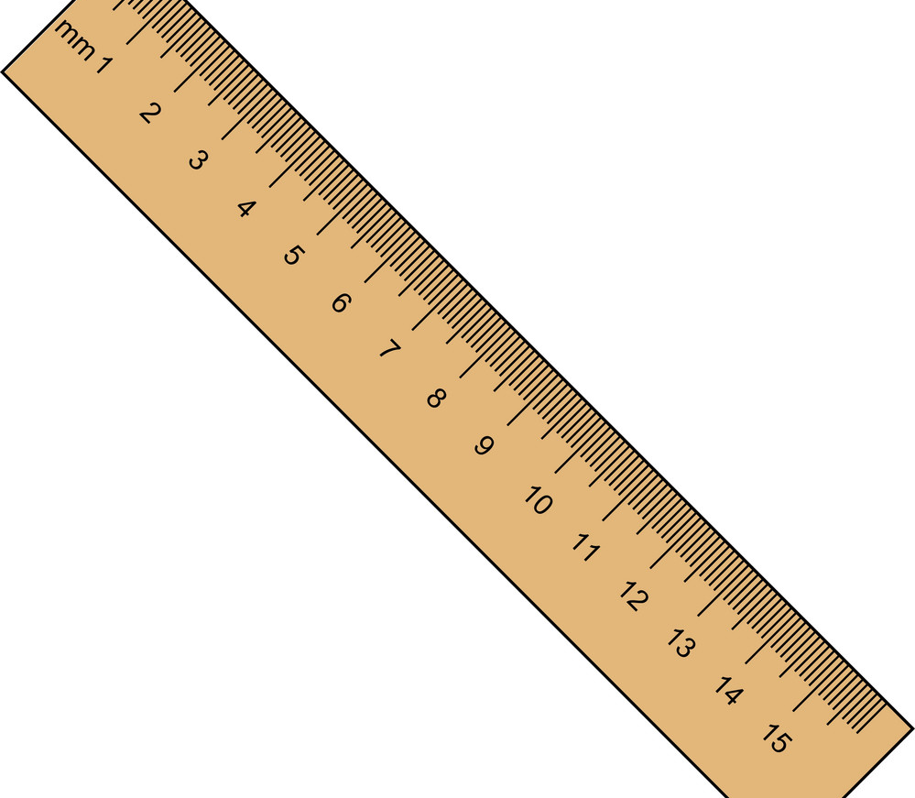
Ruler

Slide 10

Shape

Slide 11
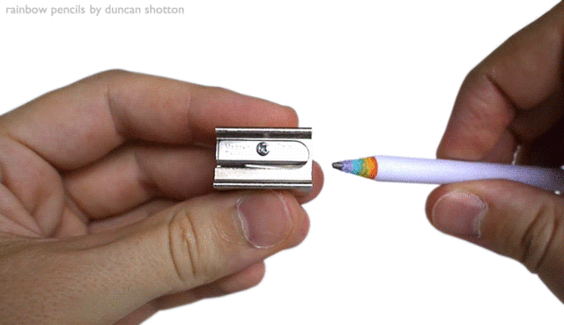
Sharpener

Slide 12


Speak

Slide 13

Student

Slide 14

Teacher

Slide 15
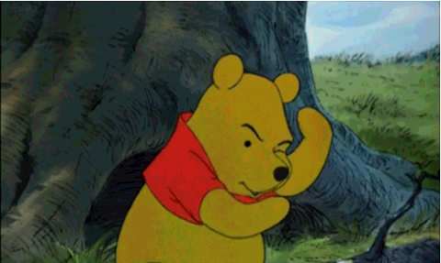
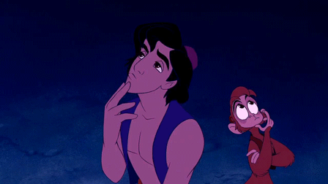
Think

Slide 16

Thirty

Slide 17

Wall

Slide 18

Zero

Slide 19
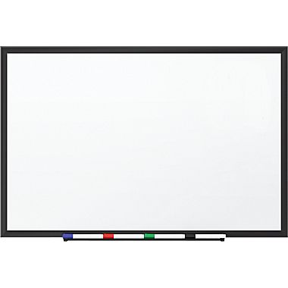
Whiteboard

