Slide 1

English Vocabulary

Slide 2

Unit One: School
Part 5

Slide 3
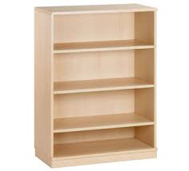

Shelf

Slide 4

Silly

Slide 5

Third

Slide 6

Underline

Slide 7

Workbook

Slide 8
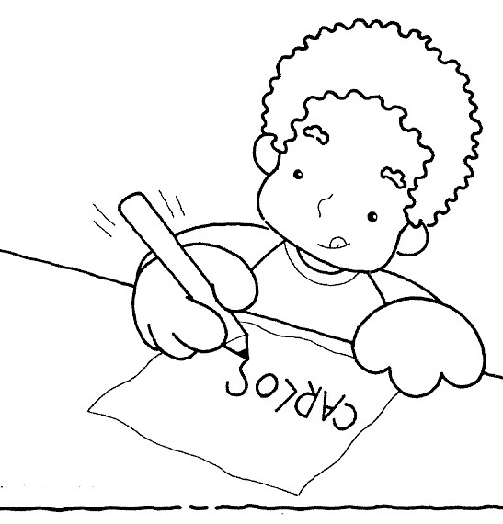
Write

Slide 9

Yell

Slide 10
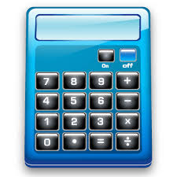
Calculator

Slide 11

Checkmark

Slide 12

Dictionary

Slide 13

Folder

Slide 14
One Hundred
100

