Slide 1

English Vocabulary Beginners

Slide 2
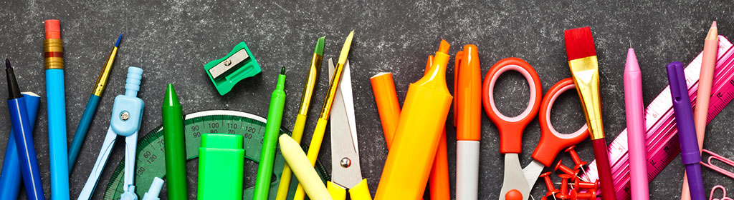
Unit One: School
Part 6

Slide 3
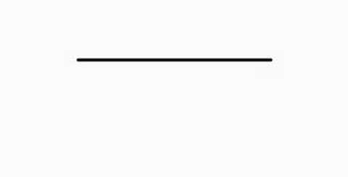
Line

Slide 4

List

Slide 5
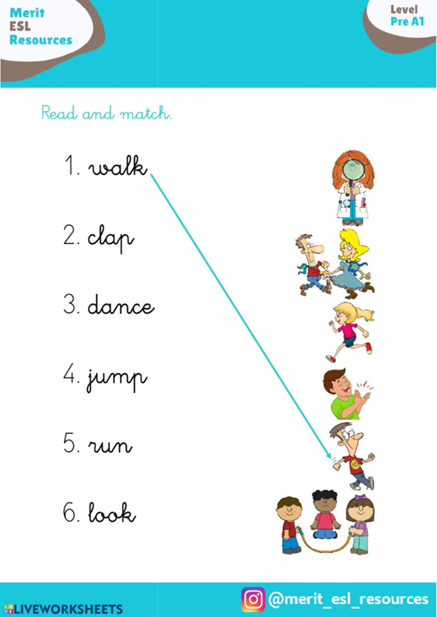
Match

Slide 6
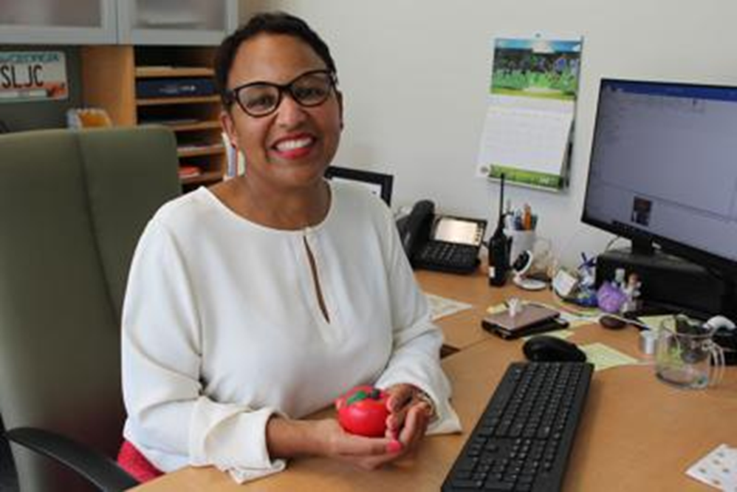
School principal

Slide 7
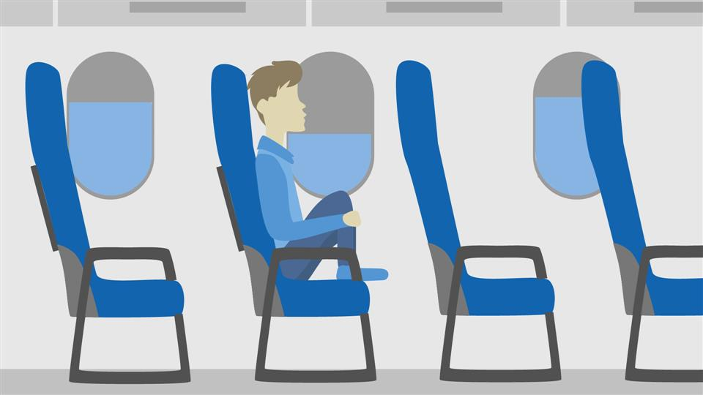
Seat

Slide 8

Thousand

Slide 9

Welcome

Slide 10

Highlighter

Slide 11

Magazine

Slide 12
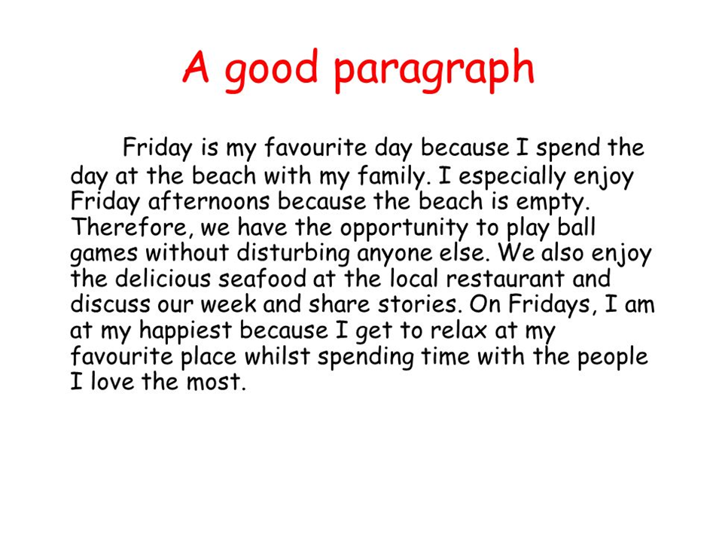
Paragraph

Slide 13

Tough

