Slide 1

English Vocabulary

Slide 2
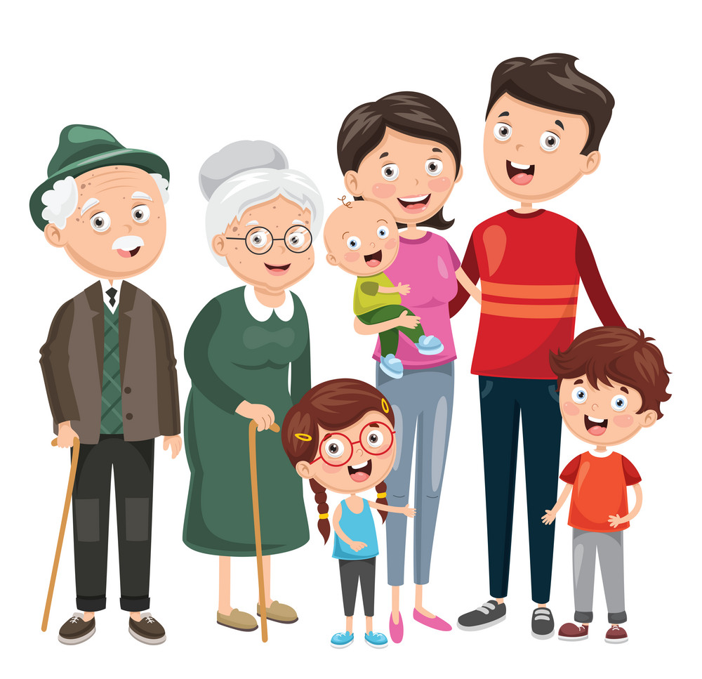
Unit
Two: Family
Part 1

Slide 3
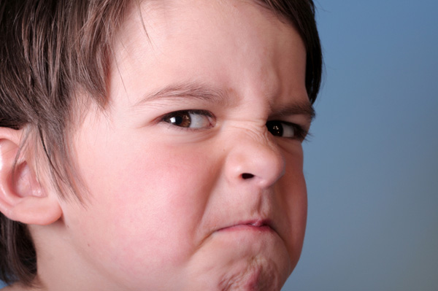
Angry

Slide 4
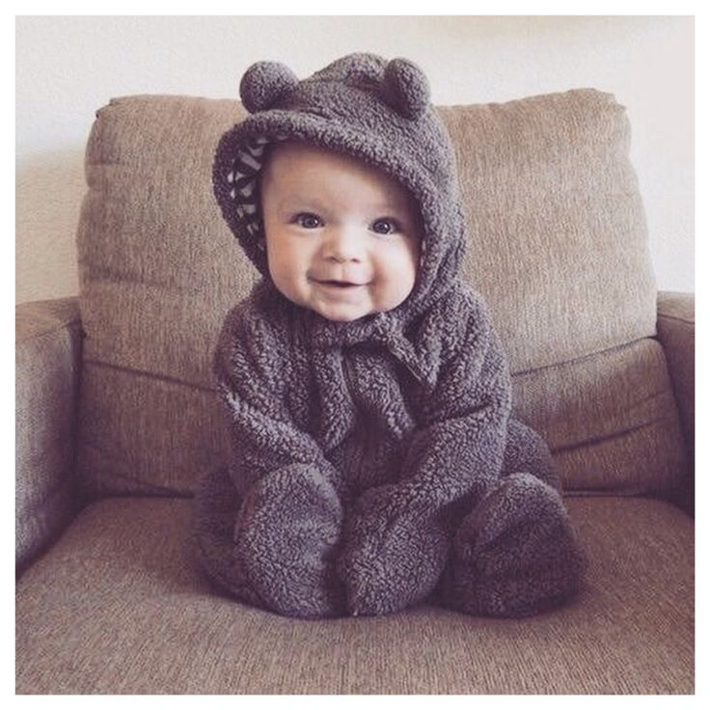
Baby

Slide 5
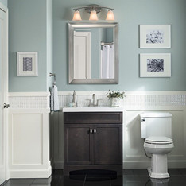
Bathroom

Slide 6
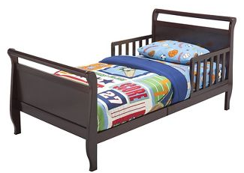
Bed

Slide 7

Boy

Slide 8
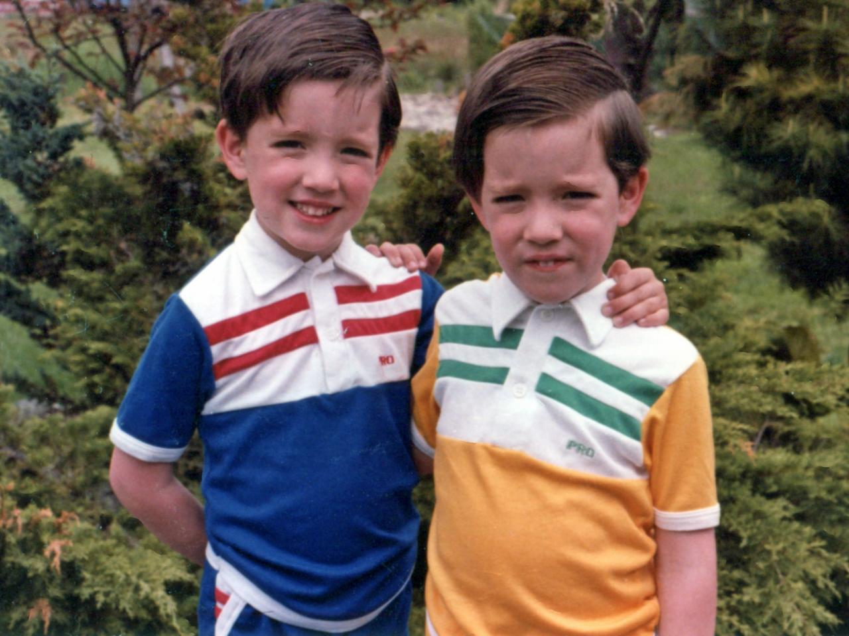
Brother

Slide 9

Cry

Slide 10
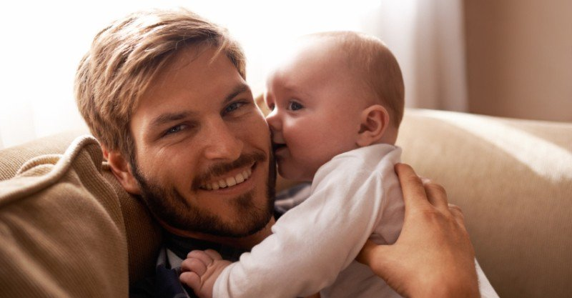
Dad / Father / Daddy

Slide 11

Dirty / Clean

Slide 12

Family

Slide 13
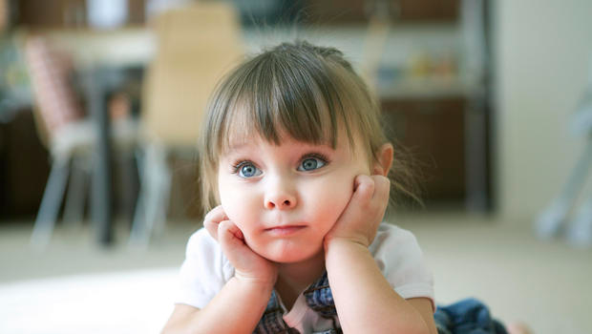
Girl

Slide 14

Happy

Slide 15

Love

Slide 16

Miss

Slide 17
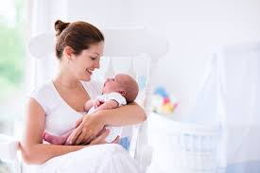
Mom / Mommy / Mother

Slide 18

Sad

Slide 19
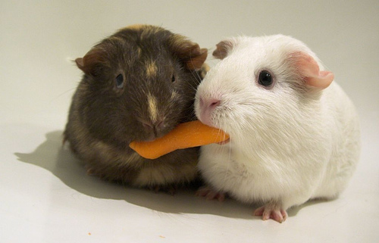
Share

Slide 20
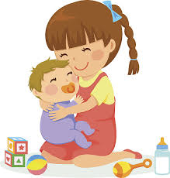
Sister

Slide 21
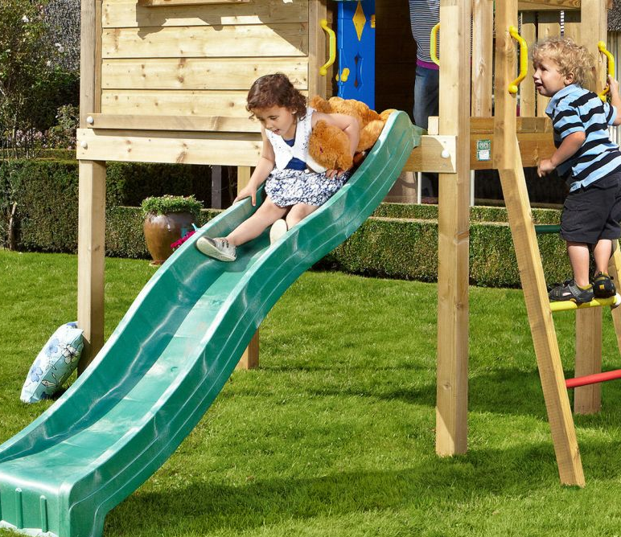
Slide

Slide 22
Son

Slide 23
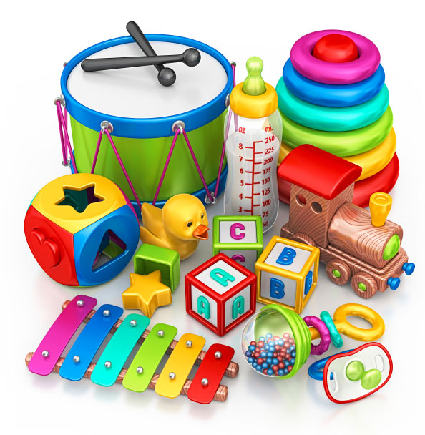

Toys

