Slide 1

English Vocabulary

Slide 2
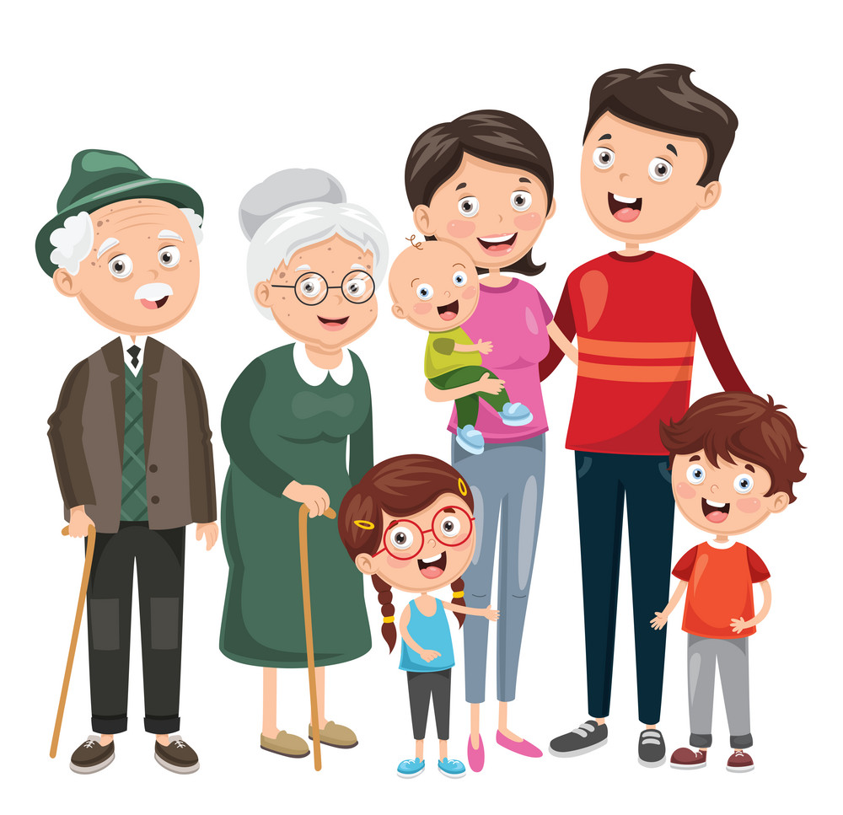
Unit
Two: Family
Part 2

Slide 3

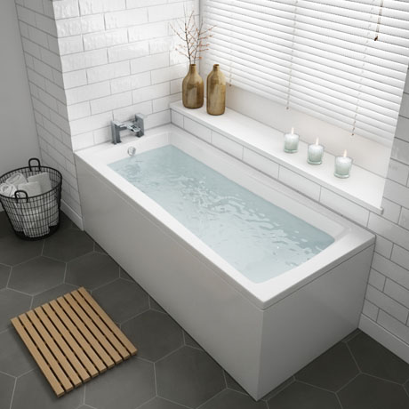
Bath

Slide 4

bedroom

Slide 5
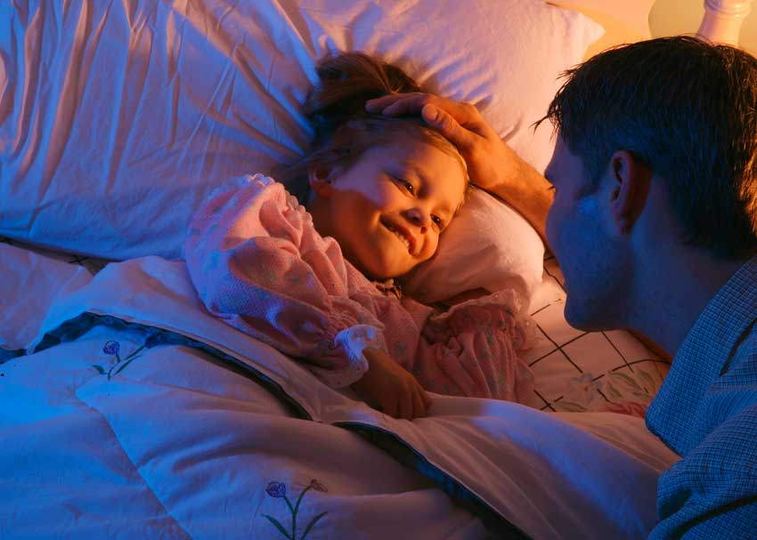
bedtime

Slide 6
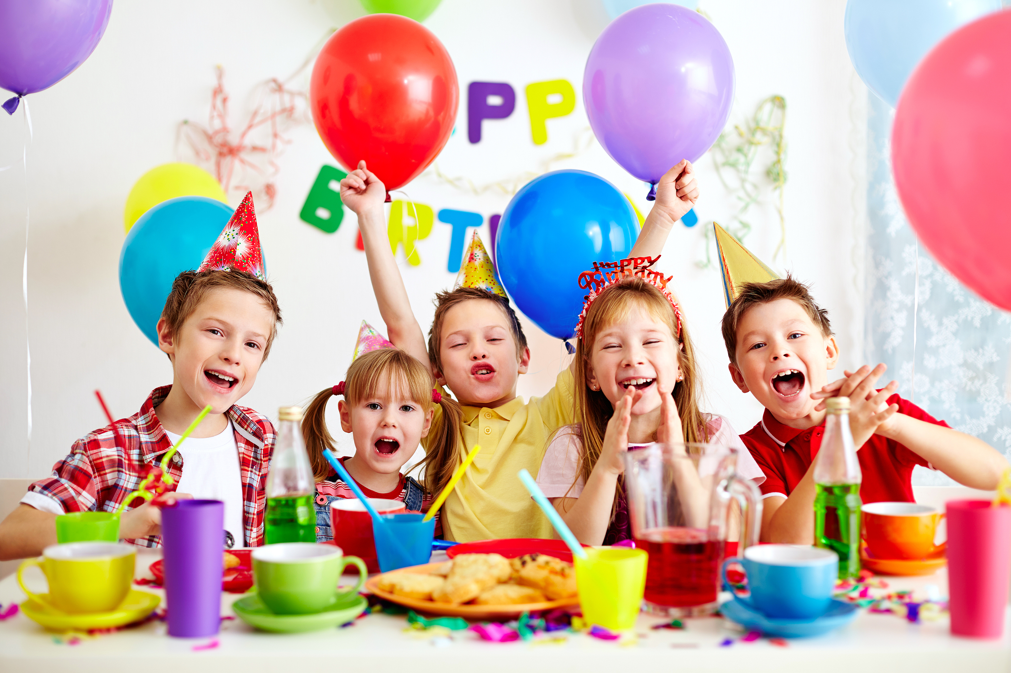
birthday

Slide 7

Brush

Slide 8
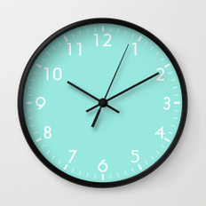
Clock

Slide 9
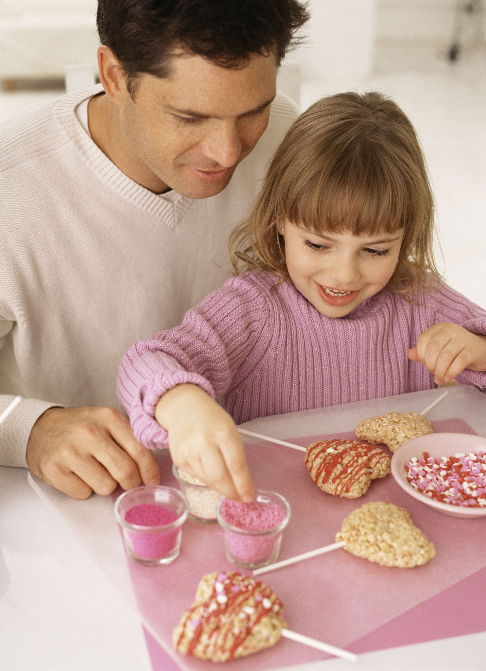
Daughter

Slide 10
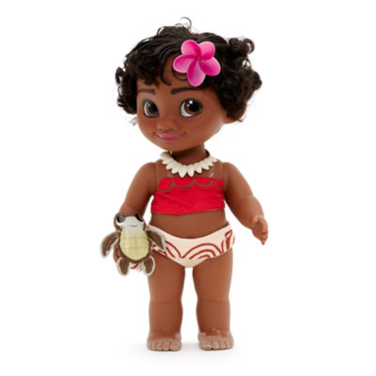
Doll

Slide 11

Friends

Slide 12

Gift (present)

Slide 13

Grandma / Grandpa

Slide 14

lonely

Slide 15

man

Slide 16

men

Slide 17
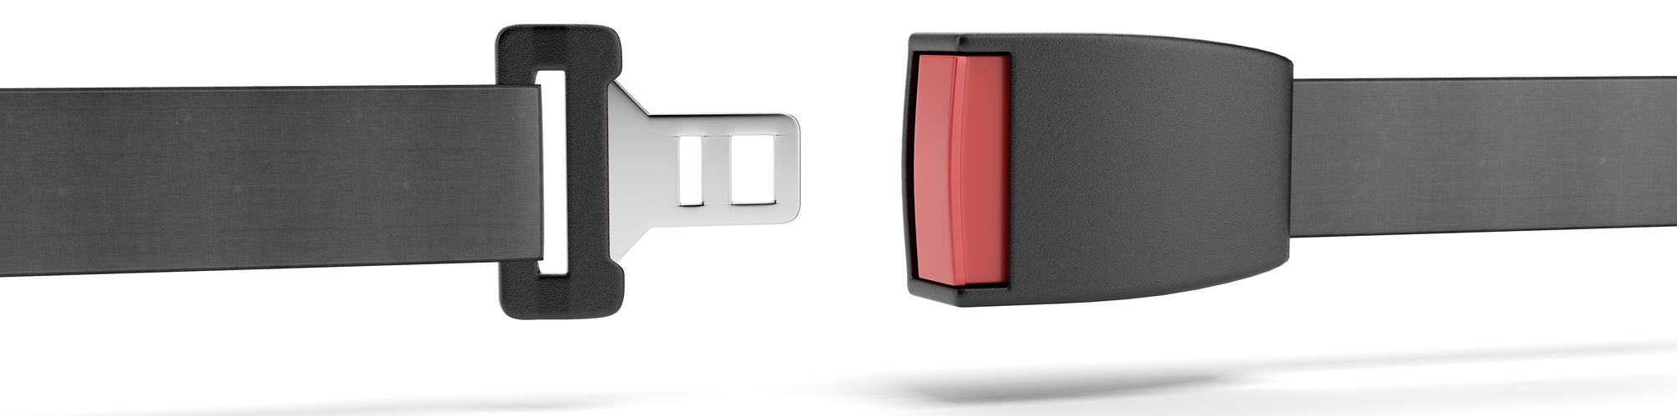
seatbelt

Slide 18
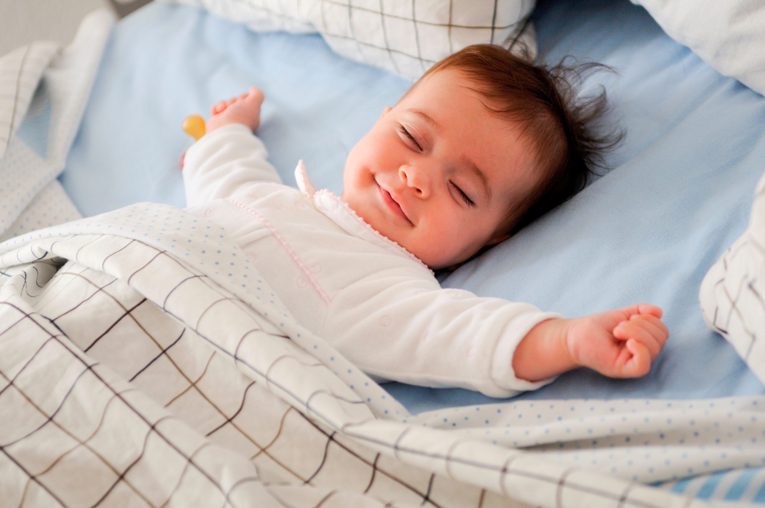
Sleep

Slide 19
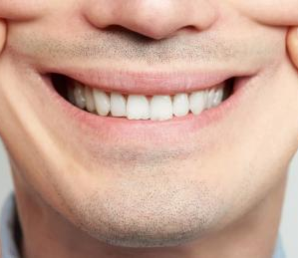
Smile

Slide 20
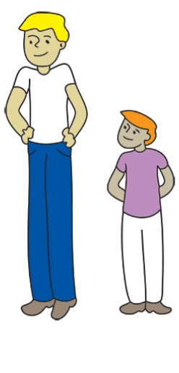
tall

Slide 21
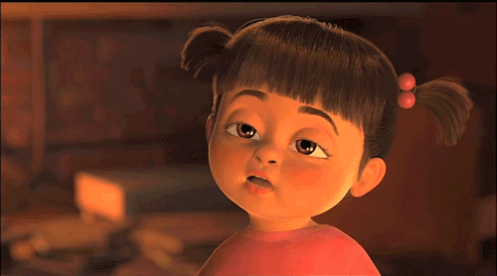
Tired

Slide 22
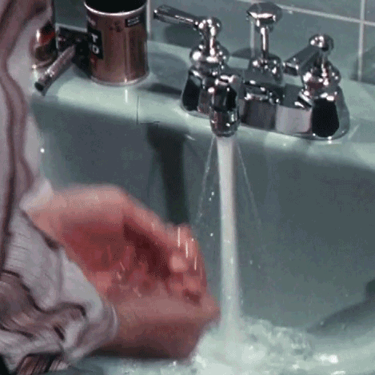
Wash

Slide 23
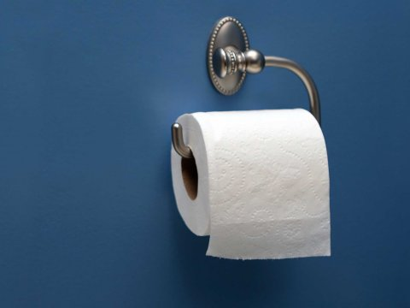
Toilet paper

Slide 24

Strong Weak

Slide 25

woman

Slide 26
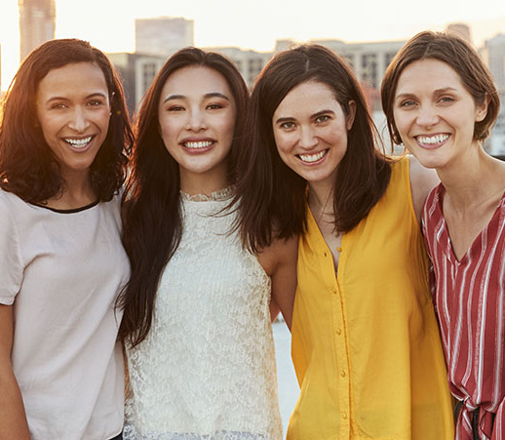
Women

Slide 27

Eleven

Slide 28

Twelve

Slide 29

Thirteen

Slide 30

Fourteen

Slide 31

Fifteen

Slide 32

Sixteen

Slide 33

Seventeen

Slide 34
Eighteen
18

Slide 35

Nineteen

Slide 36

Twenty

