Slide 1

English Vocabulary Beginners

Slide 2
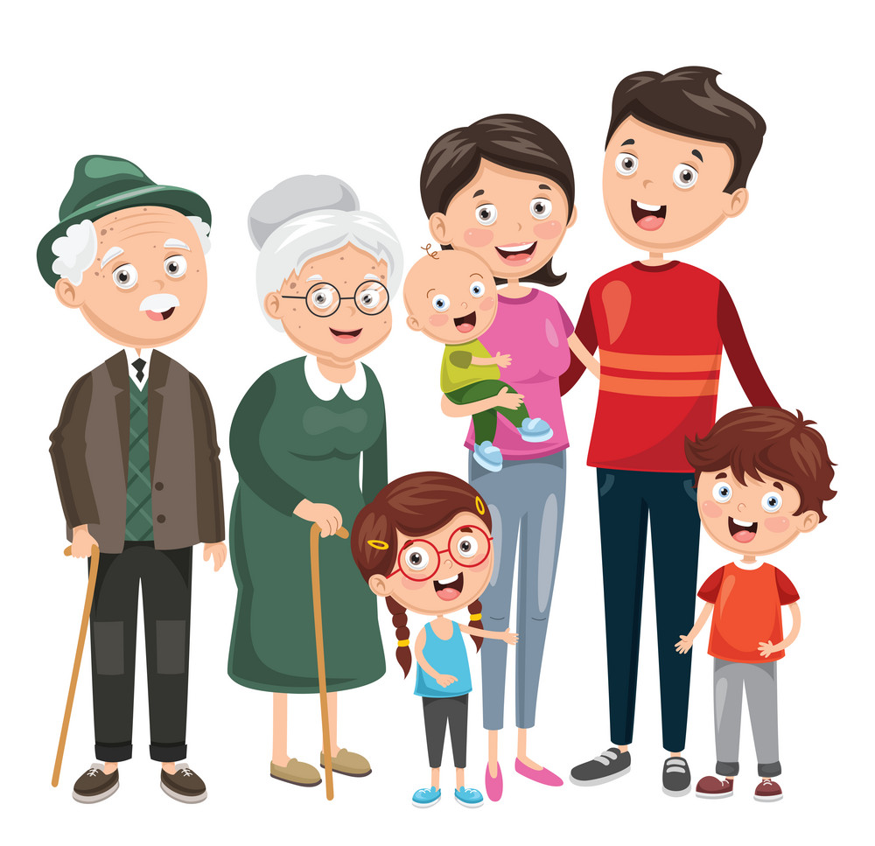
Unit
Two: Family
Part 3

Slide 3

Aunt
aunt
mother

Slide 4

Bored

Slide 5
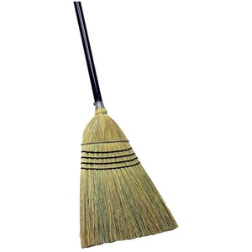

Broom

Slide 6
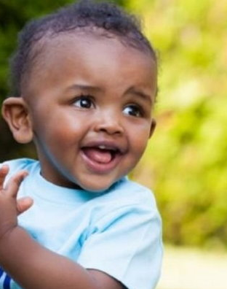
Child

Slide 7

Dustpan

Slide 8
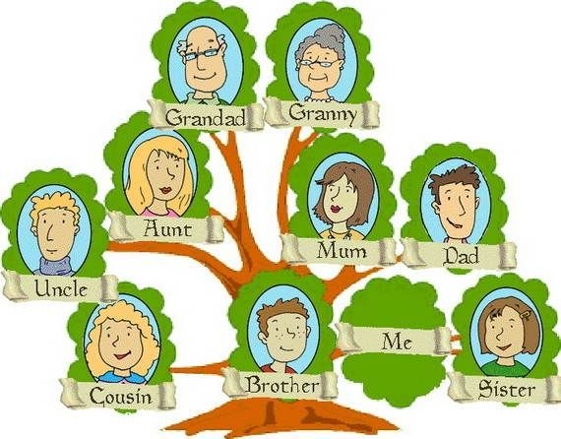
Family tree

Slide 9
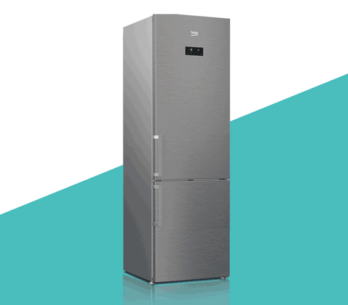
Fridge / Refrigerator

Slide 10

Hug

Slide 11
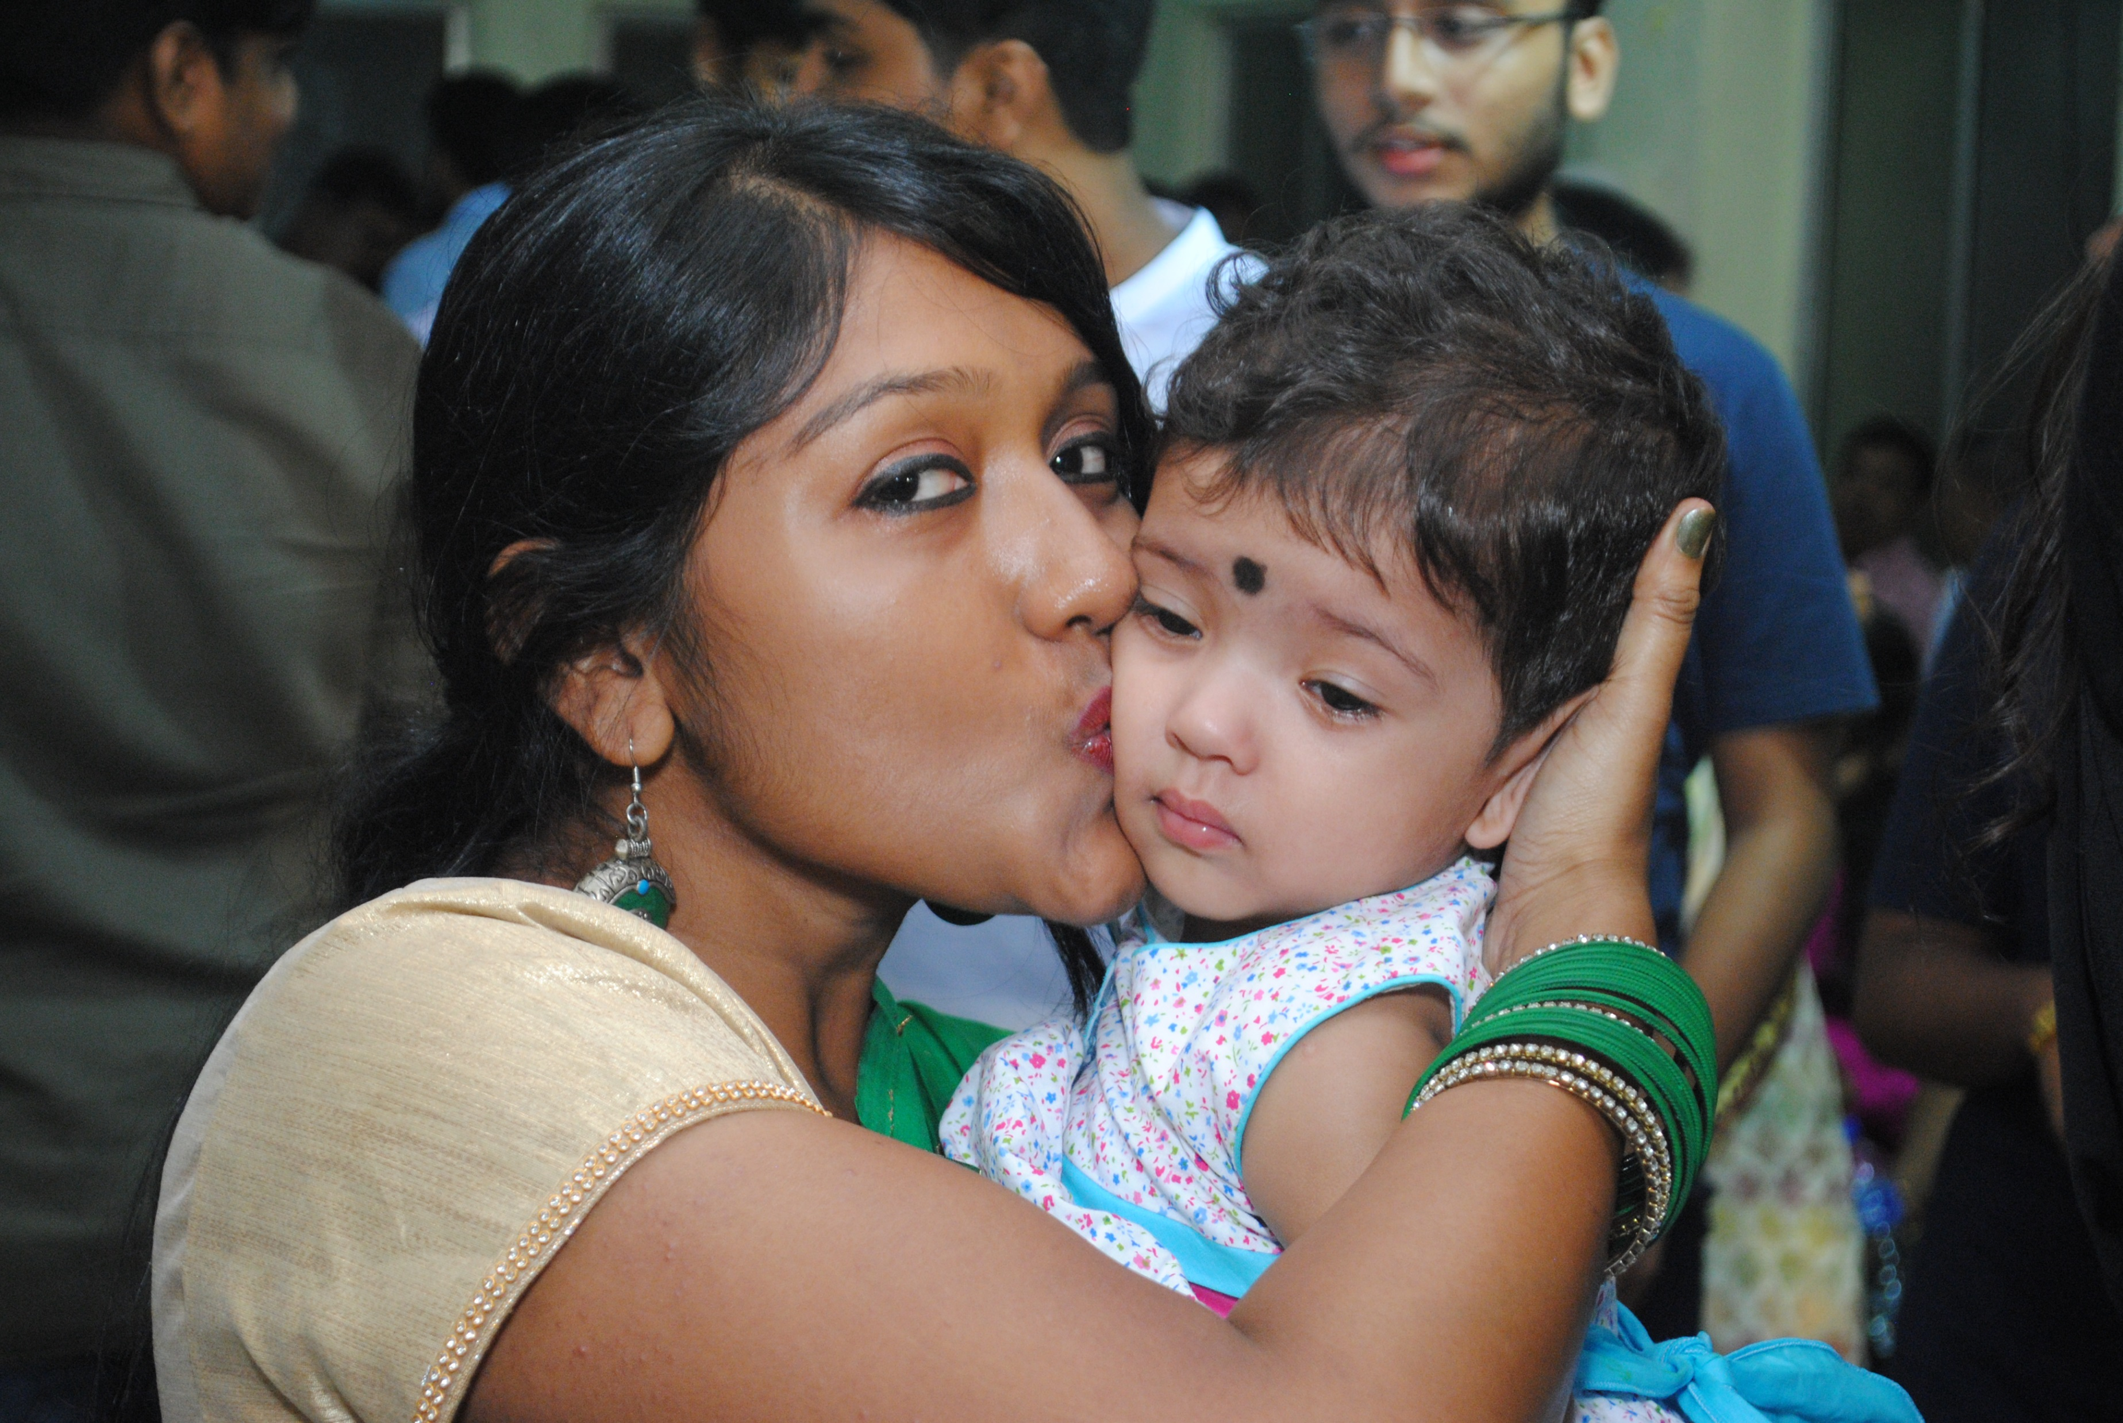
Kiss

Slide 12

Laugh

Slide 13


Mop

Slide 14
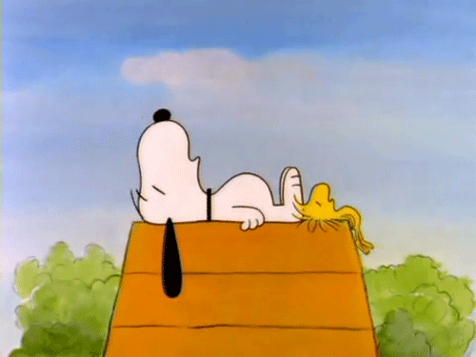
Nap

Slide 15
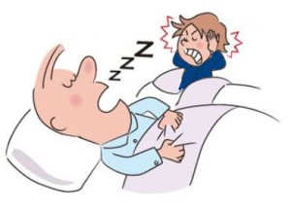
Snore

Slide 16

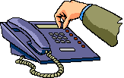
Telephone

Slide 17

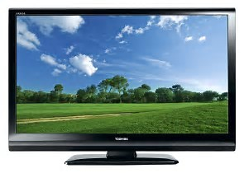
Television

Slide 18
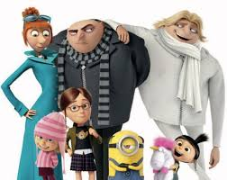
Uncle
uncle
father

Slide 19

Watch

Slide 20
Twenty one
21

Slide 21
Twenty two
22

Slide 22
Twenty three
23

Slide 23
Twenty four
24

Slide 24
Twenty five
25

Slide 25
Twenty six
26

Slide 26
Twenty seven
27

Slide 27
Twenty eight
28

Slide 28
Twenty nine
29

