Slide 1

English Vocabulary Beginners

Slide 2
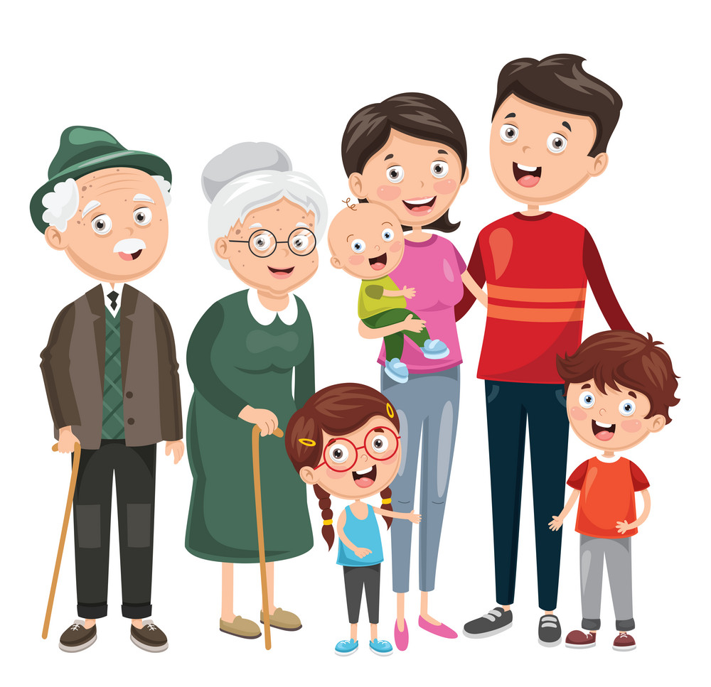
Unit
Two: Family
Part 4

Slide 3

Cell

Slide 4

Children

Slide 5

Couch

Slide 6

Drawers

Slide 7
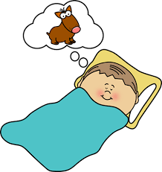
Dream

Slide 8
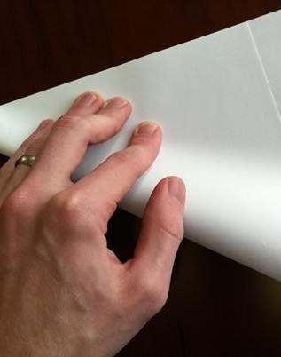
Fold

Slide 9
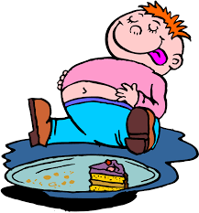
Full

Slide 10
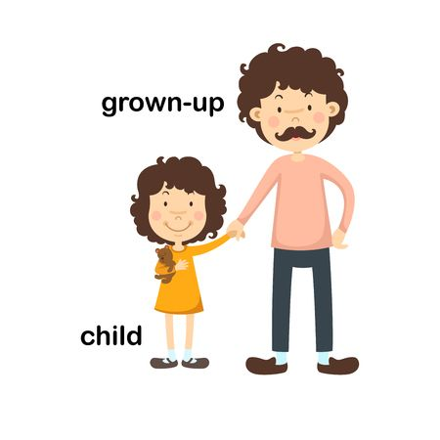
Grown up

Slide 11

Grumpy

Slide 12

Home

Slide 13

Husband

Slide 14
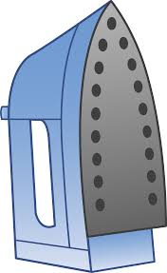
Iron

Slide 15
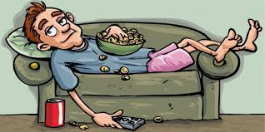
Lazy

Slide 16

Light

Slide 17

Lock

Slide 18
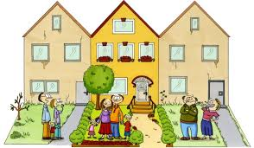
Neighbor

Slide 19
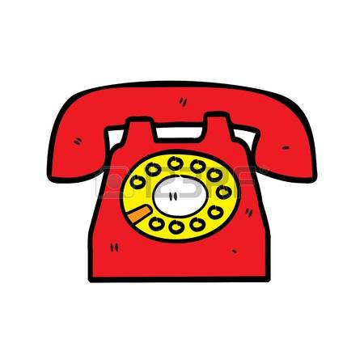
Phone

Slide 20
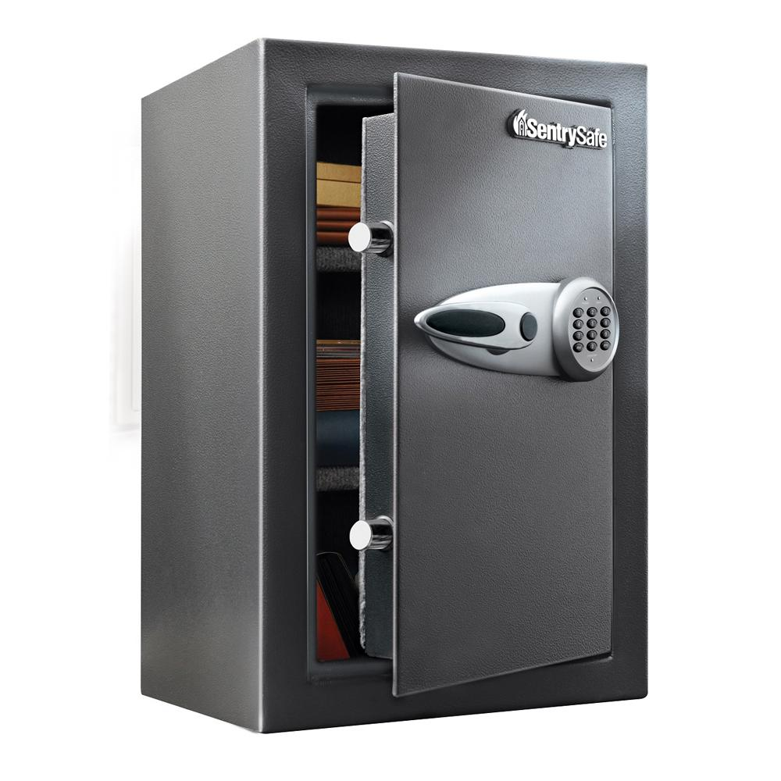
Safe

Slide 21

Temperature

Slide 22

Tooth

Slide 23

Wedding

Slide 24
Wife

