Slide 1

English Vocabulary Beginners

Slide 2
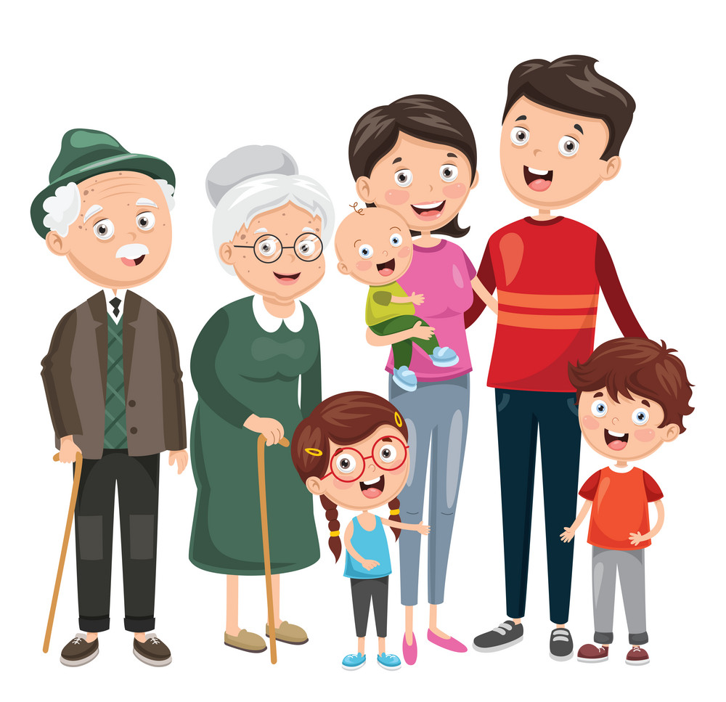
Unit
Two: Family
Part 5

Slide 3
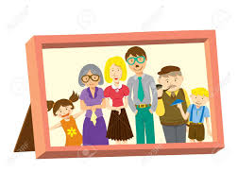
Picture

Slide 4
Photograph

Slide 5
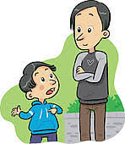
Adult

Slide 6
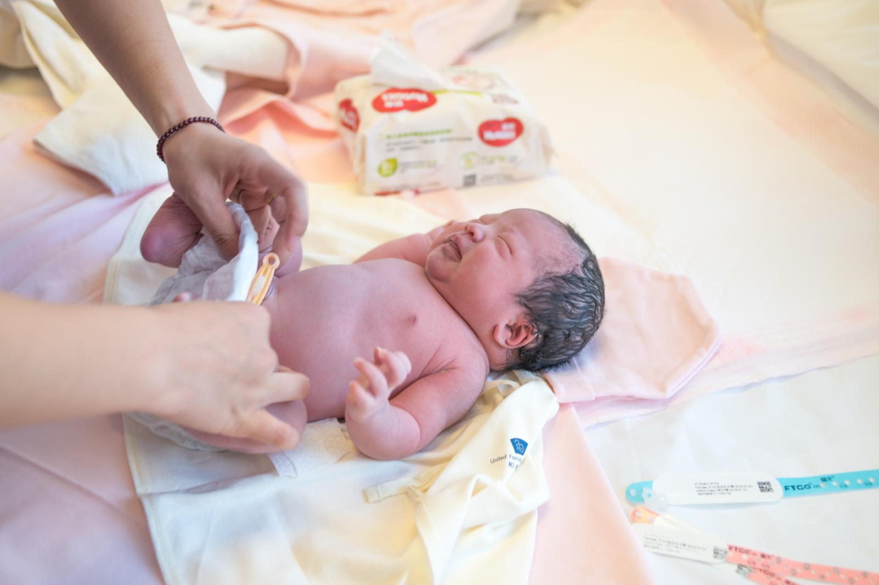
Born

Slide 7
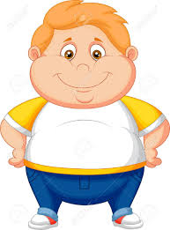
Fat

Slide 8

Female-Male

Slide 9

Glad

Slide 10
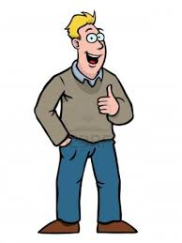
Person-Human

Slide 11

Key

Slide 12

Kids

Slide 13

Lamp

Slide 14
Last name
David García

Slide 15

Lightbulb

Slide 16
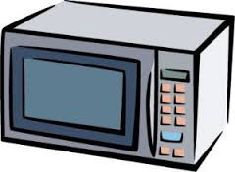
Microwave

Slide 17
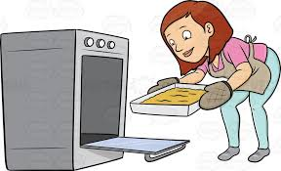
Oven

