Slide 1

English Vocabulary Beginners

Slide 2
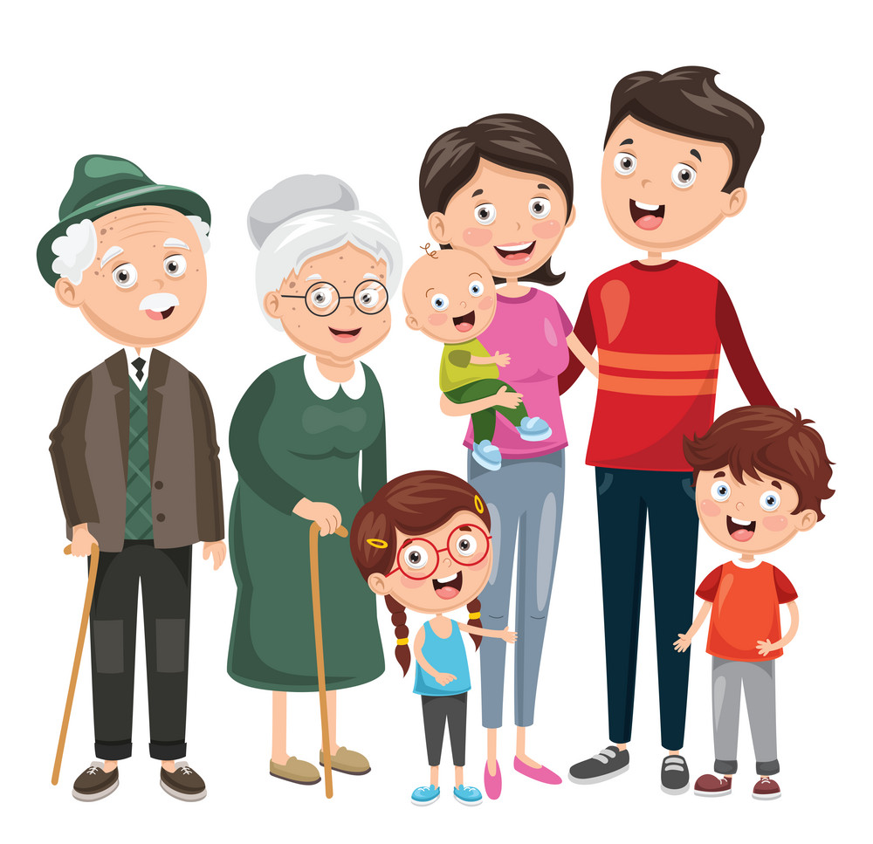
Unit
Two: Family
Part 6

Slide 3

Promise

Slide 4

Relatives

Slide 5

Scold

Slide 6
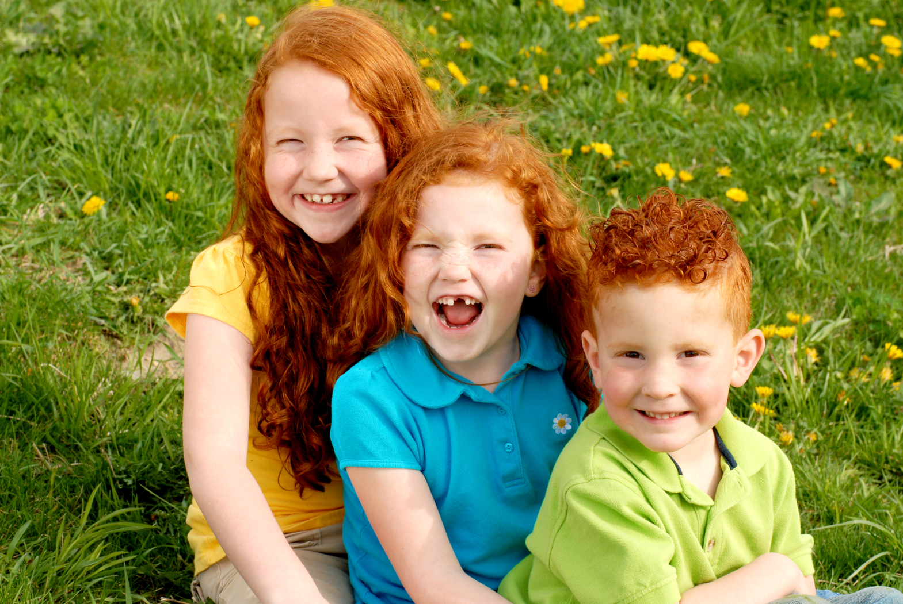
Siblings

Slide 7

Truth

Slide 8
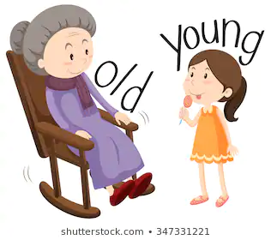
Young

Slide 9
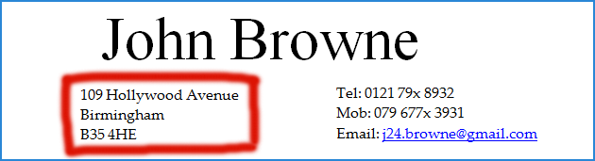
Address

Slide 10

Busy

Slide 11

Cranky

Slide 12

Forgive

Slide 13
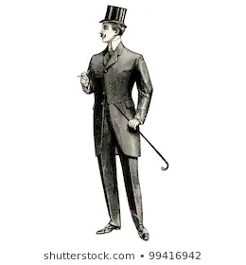
Gentleman

Slide 14
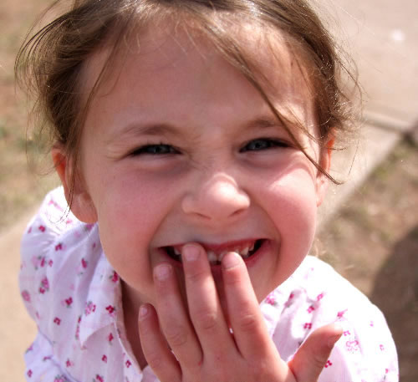
Giggle

Slide 15

Hobby

Slide 16
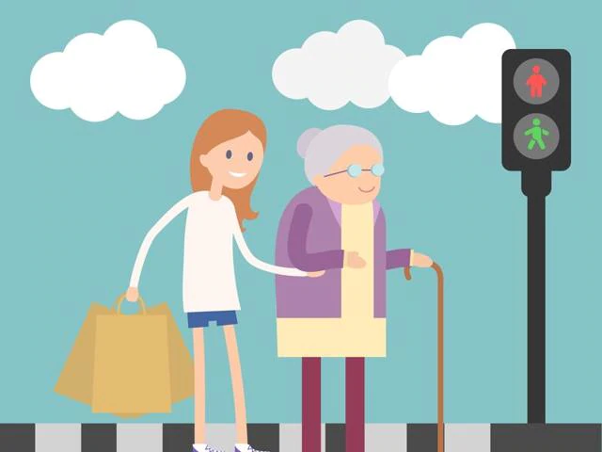
Kind

Slide 17
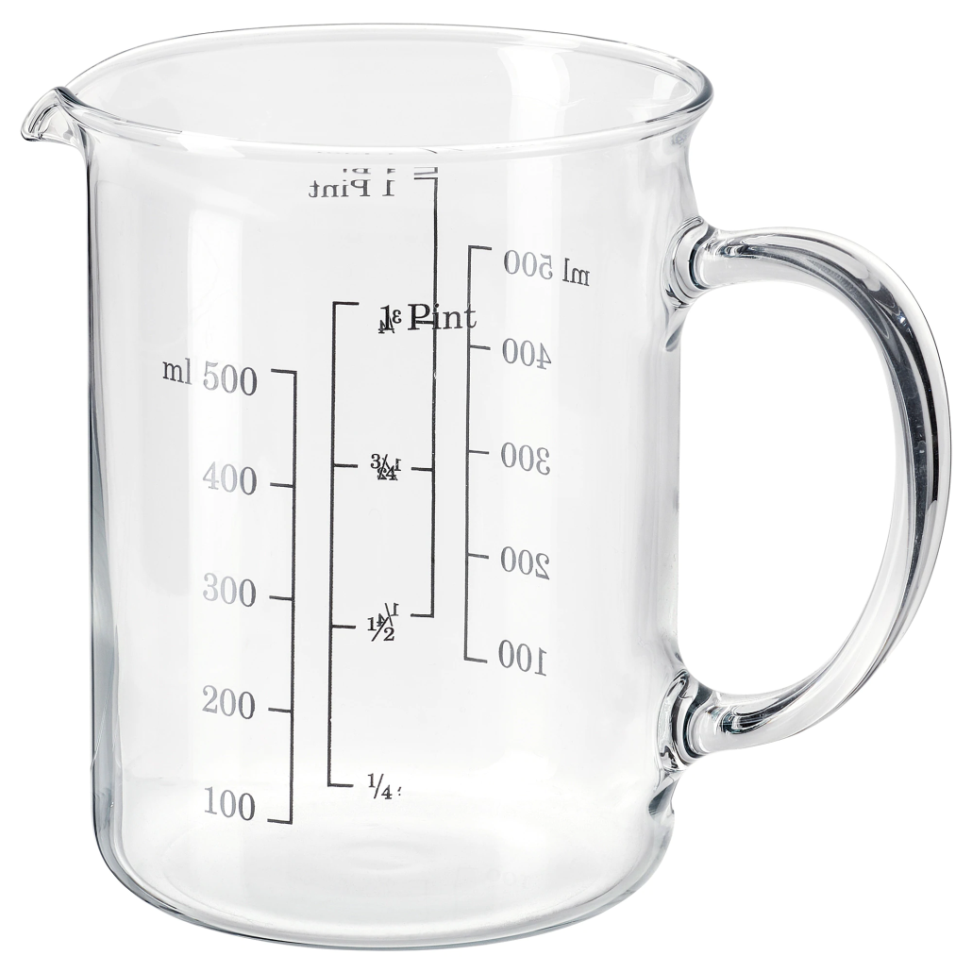
Measuring cup

Slide 18

Old

Slide 19

Parent

Slide 20
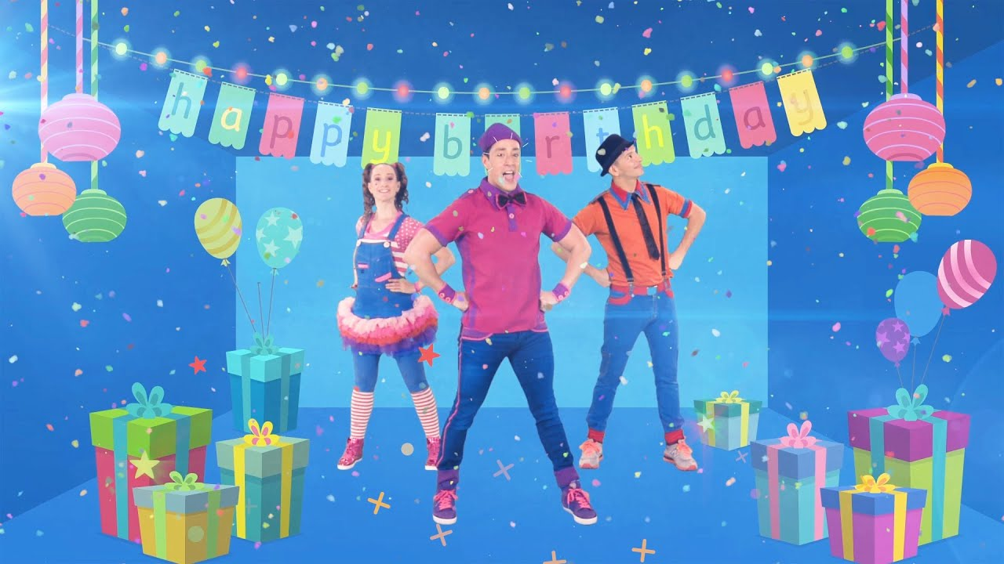
Party

Slide 21
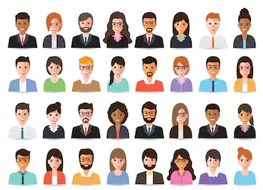
People

