Slide 1

English Vocabulary Beginners

Slide 2
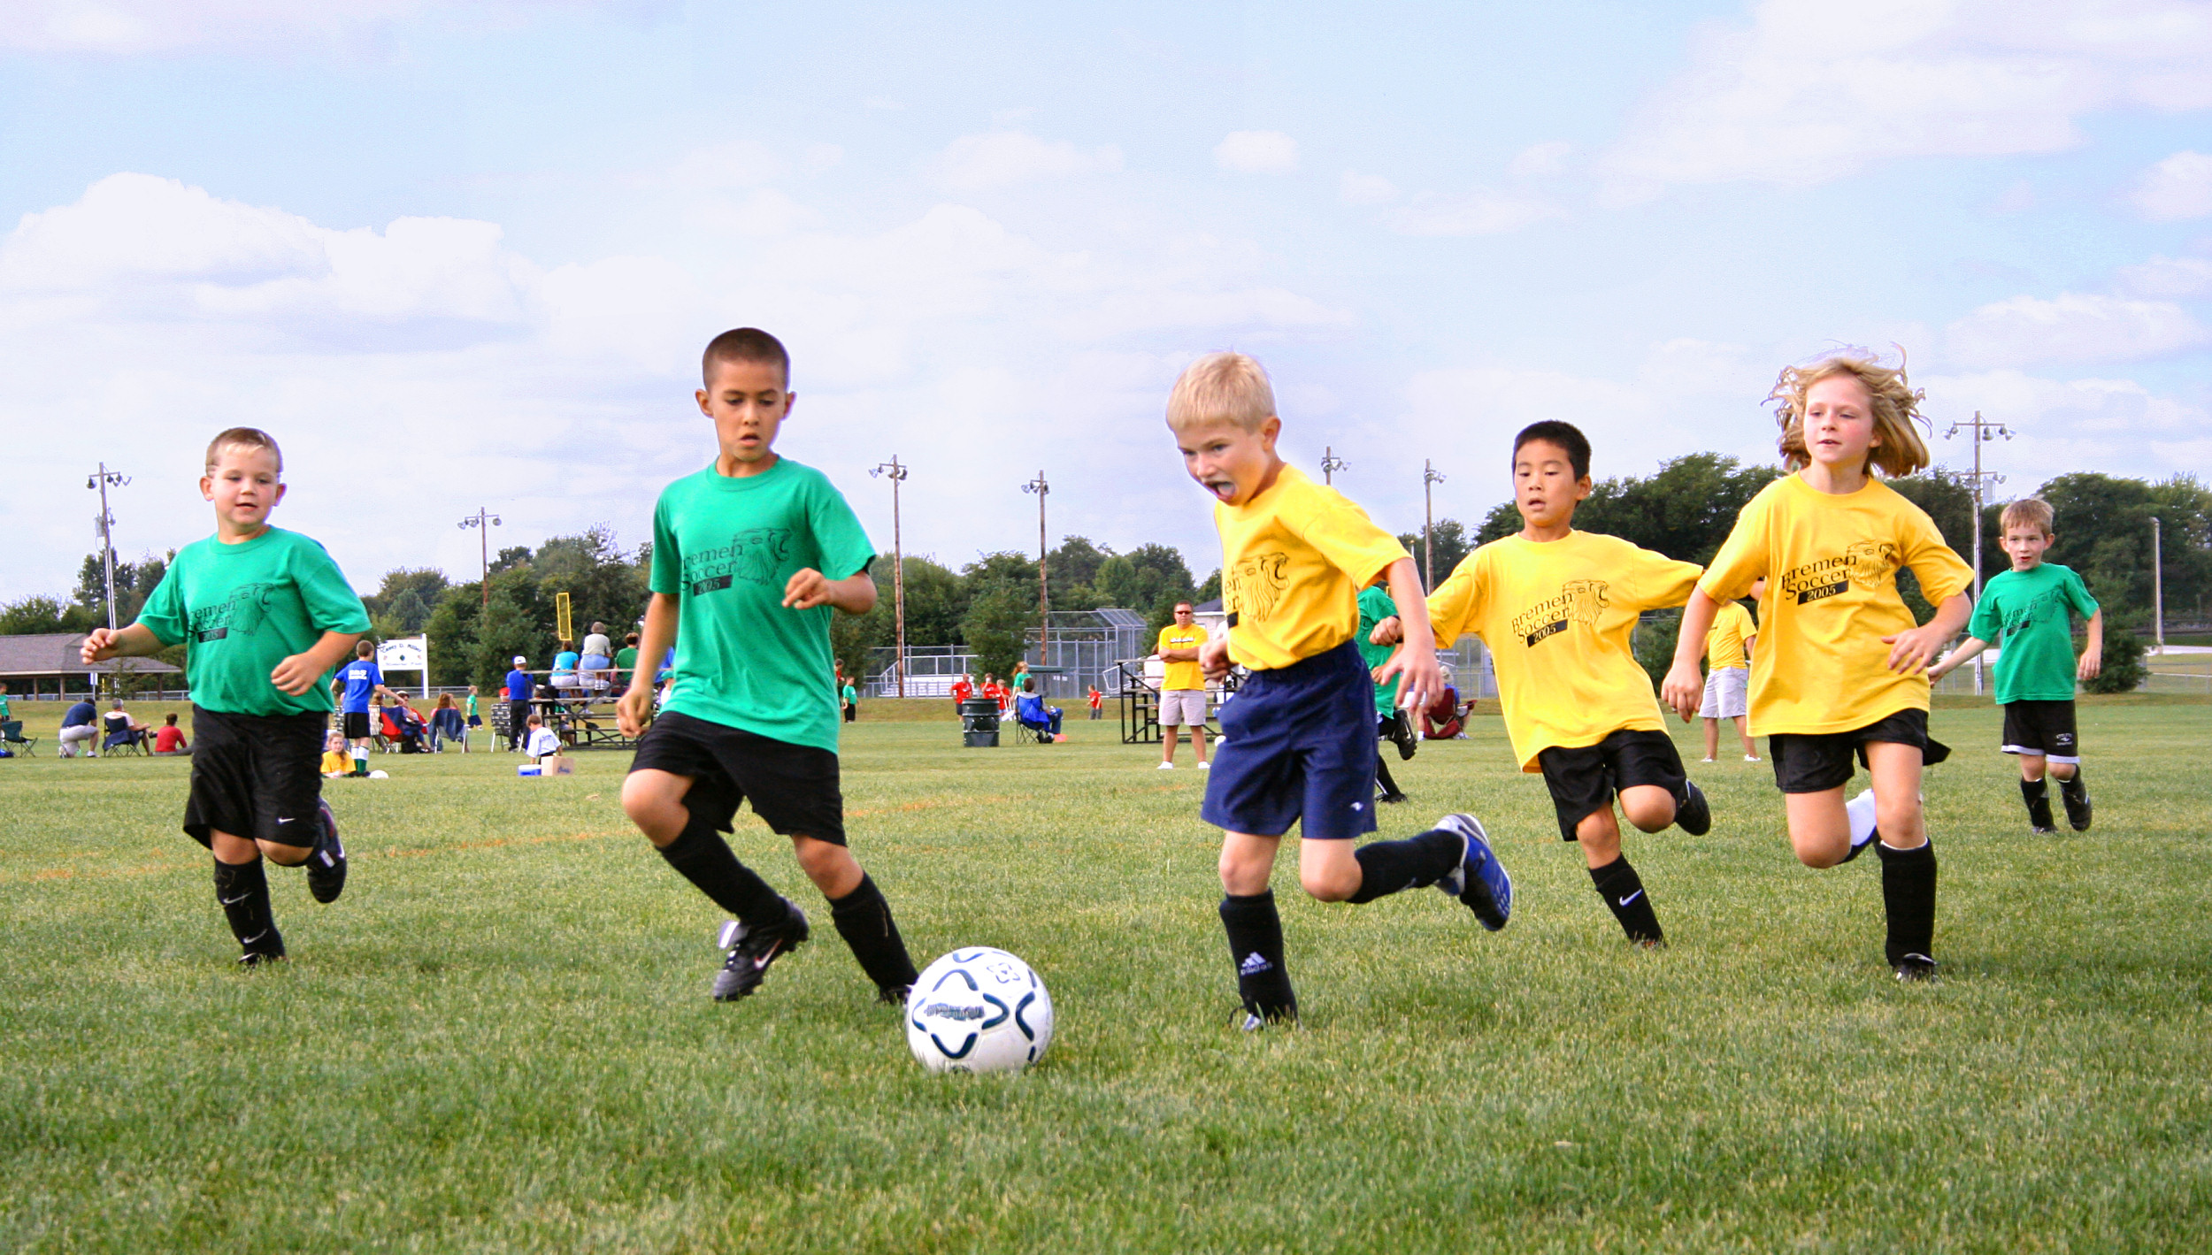
Unit Three: Sports, body parts and clothes
Part 5

Slide 3
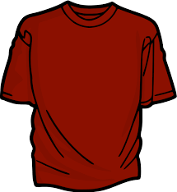
T-shirt

Slide 4
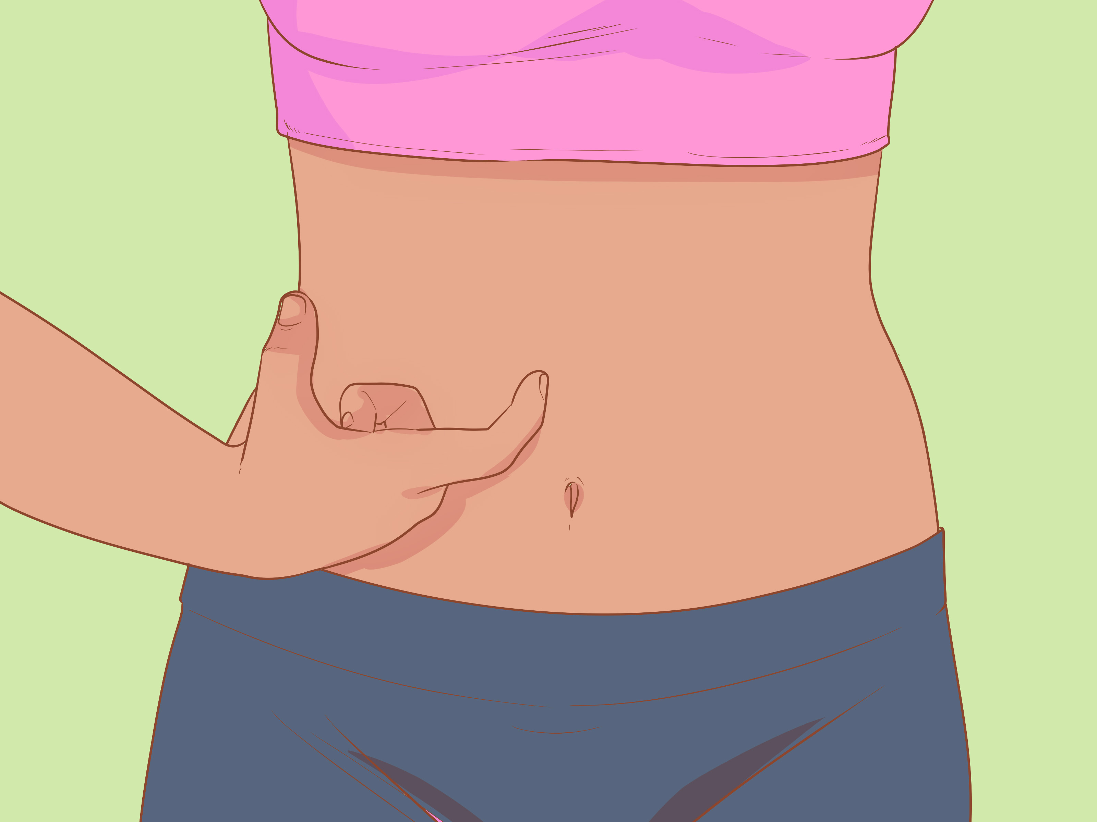
Waist

Slide 5

Blood

Slide 6
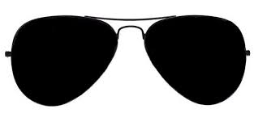

Eyeglasses/Sunglasses

Slide 7
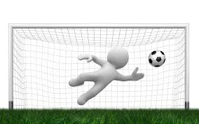
Goal

Slide 8
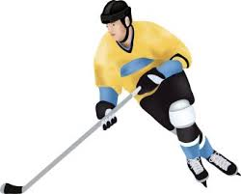
Hockey

Slide 9
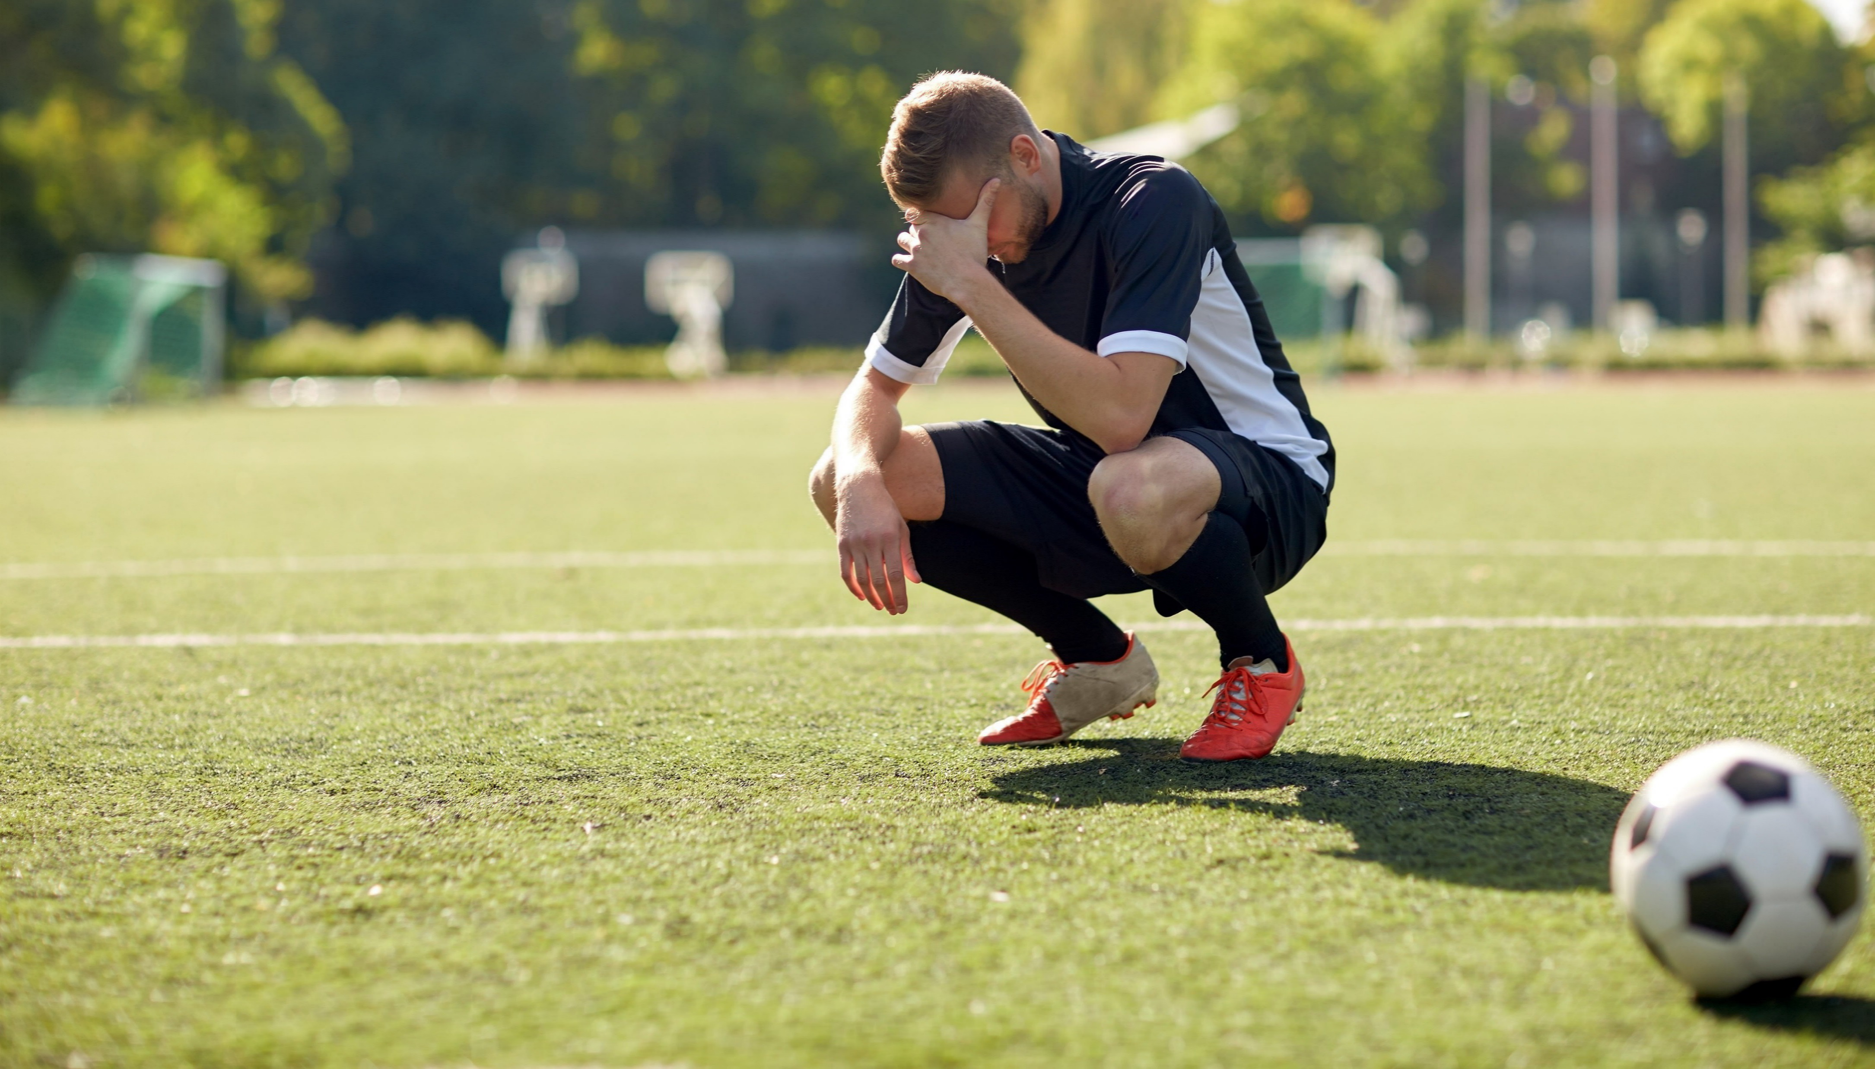
Lose

Slide 10
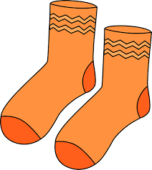
Pair

Slide 11

Rest

Slide 12

Ring

Slide 13

Shake

Slide 14
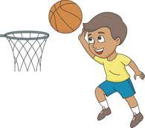
Shoot

Slide 15
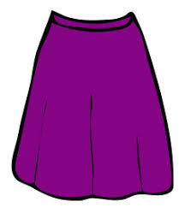
Skirt

Slide 16
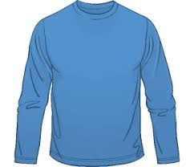
Sleeves

Slide 17
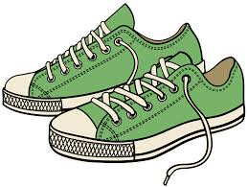
Sneakers

Slide 18
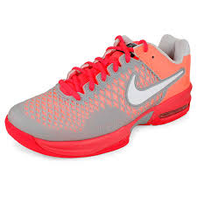
Tennis shoes

