Slide 1

English Vocabulary Beginners

Slide 2
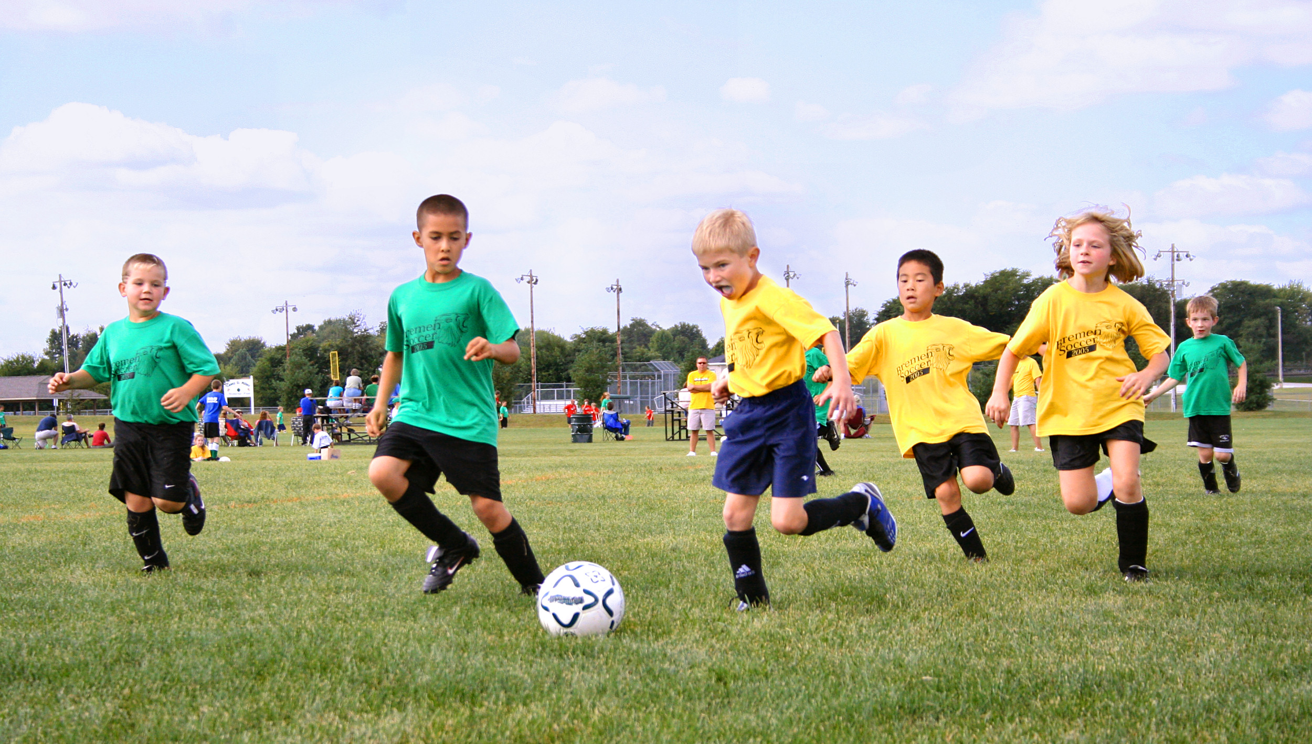
Unit Three: Sports, body parts and clothes
Part 6

Slide 3

Win

Slide 4

Wrong

Slide 5

Ability

Slide 6

Height

Slide 7
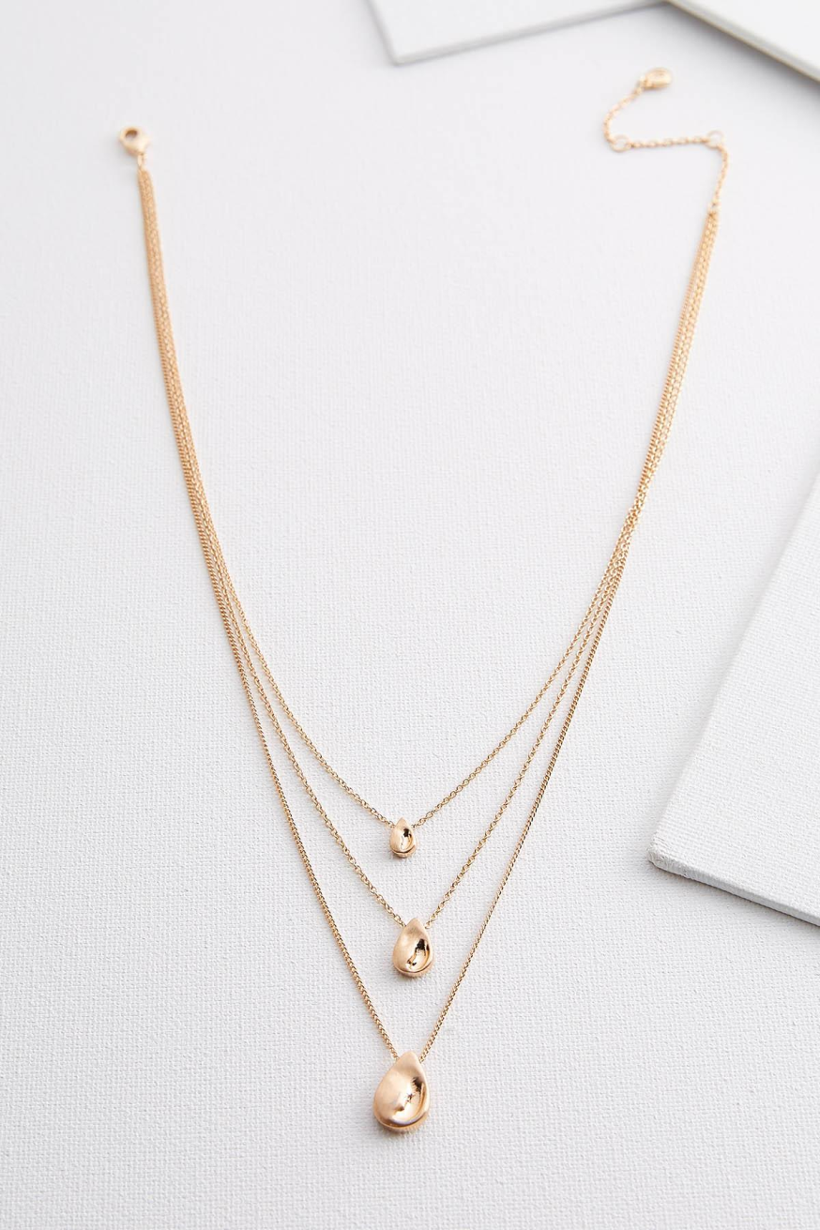
Necklace

Slide 8
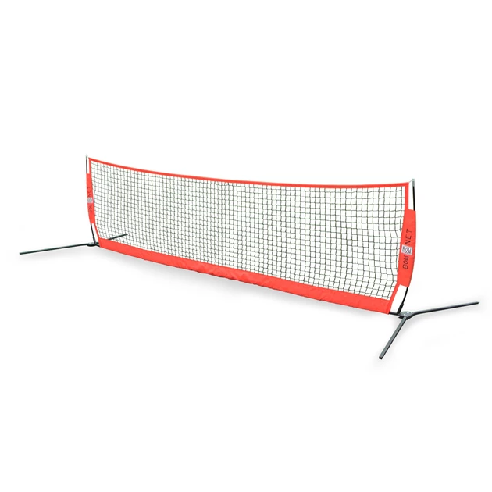
Net

Slide 9
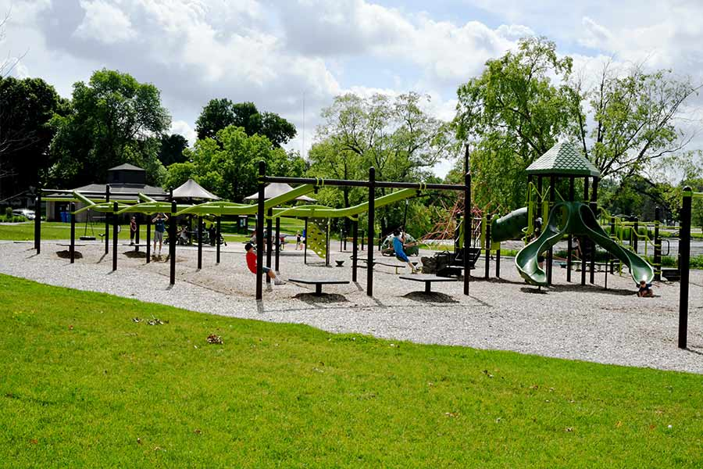
Park

Slide 10
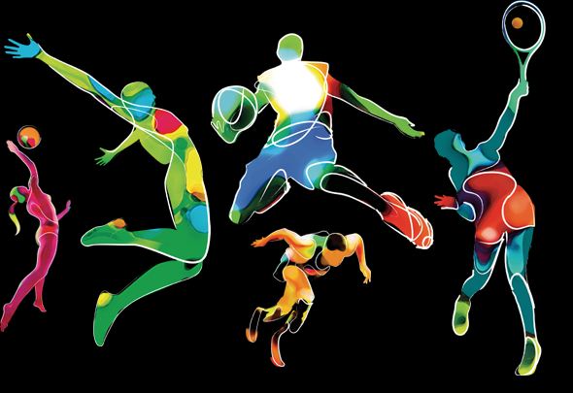
Sport

Slide 11
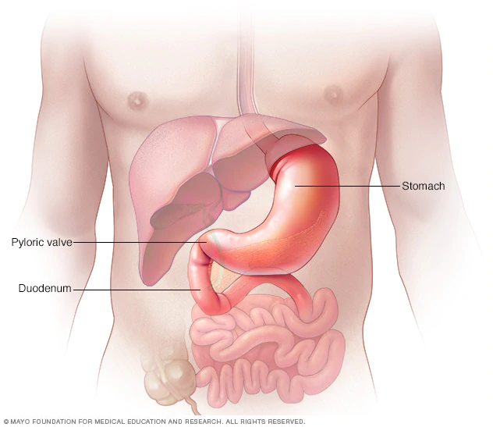
Stomach

Slide 12
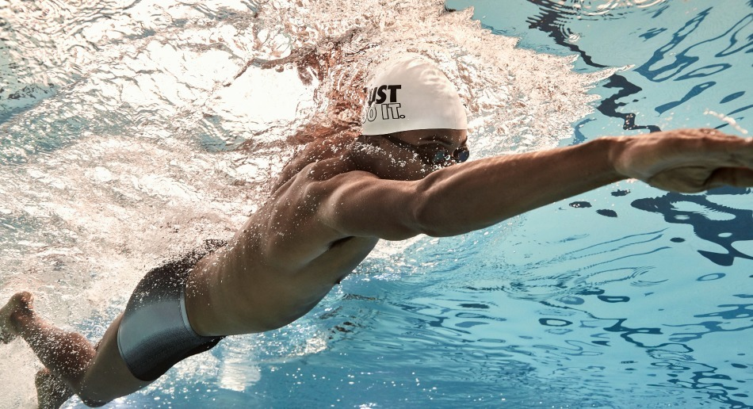
Swim

Slide 13
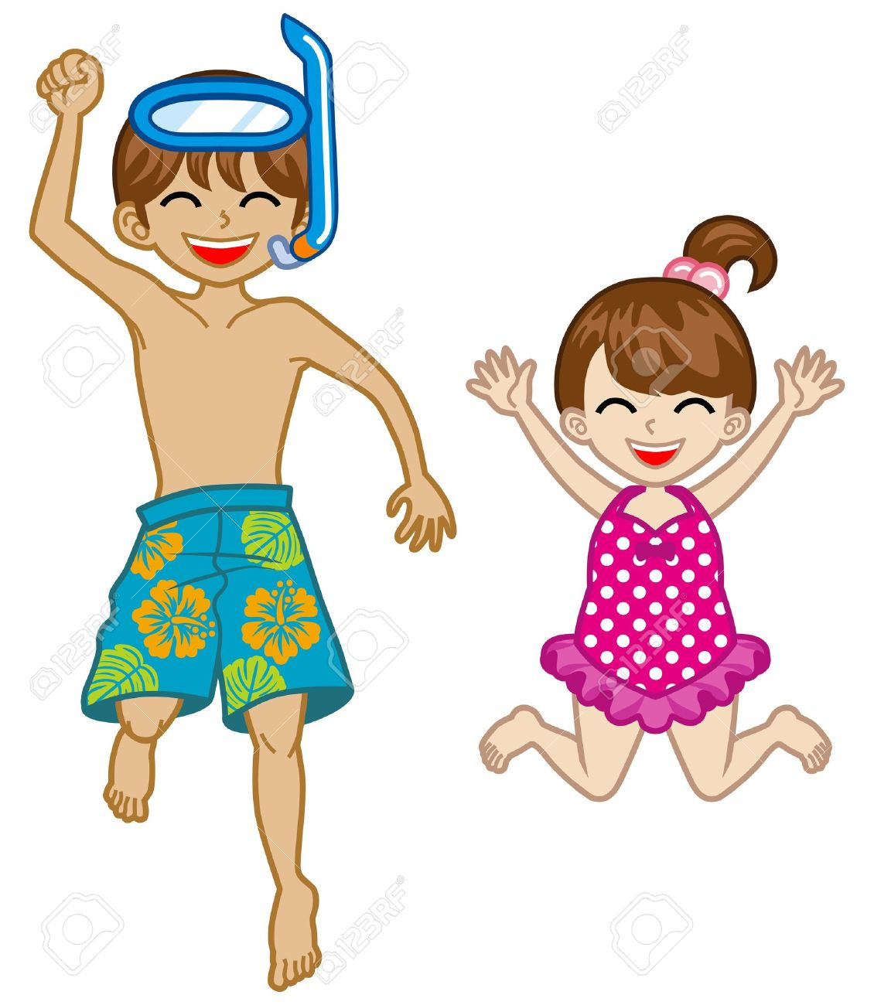
Swimsuit

Slide 14

Team

Slide 15

Top

Slide 16
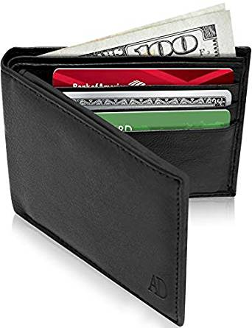
Wallet

Slide 17
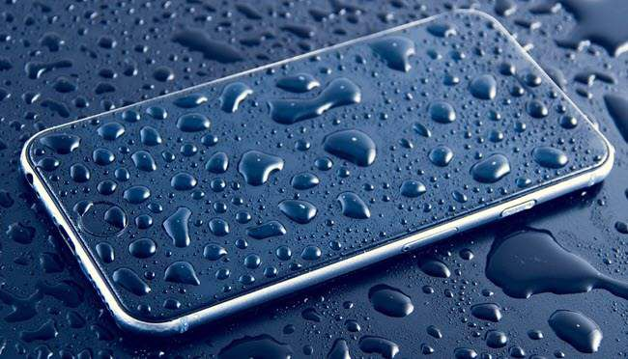
Wet

Slide 18
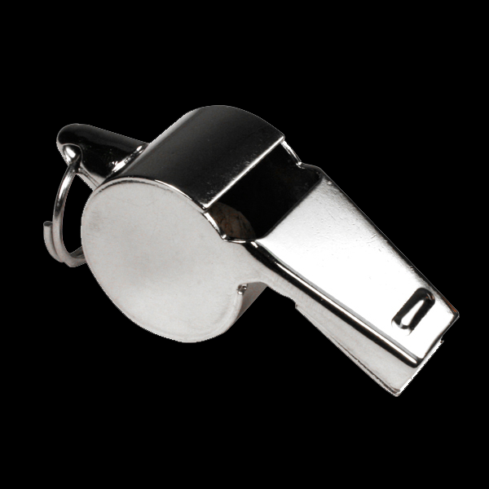
Whistle

