Slide 1

English Vocabulary Beginners

Slide 2
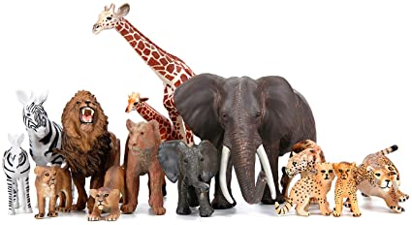
Unit four: Animals
Part 5

Slide 3
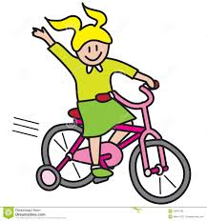
ride

Slide 4
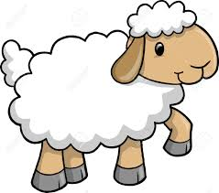
sheep

Slide 5
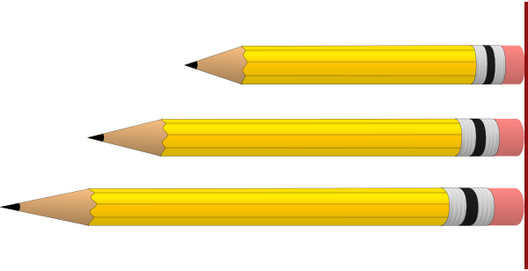
size

Slide 6
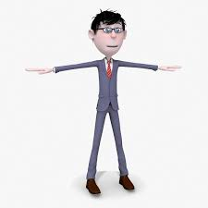
skinny

Slide 7
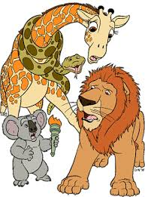
wild

Slide 8

wings

Slide 9
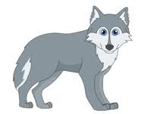
wolf

Slide 10

Above

Slide 11

Camera

Slide 12
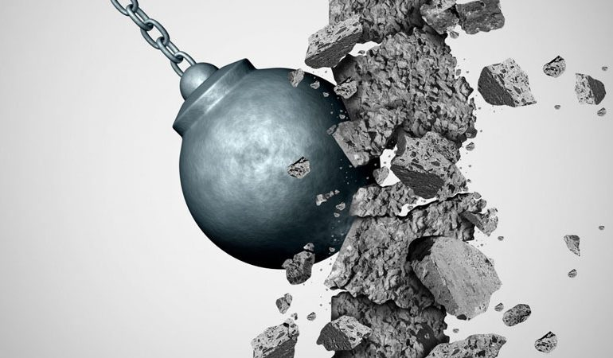
Destroy

Slide 13
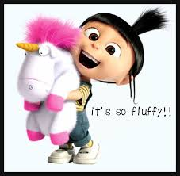
Fluffy

Slide 14

Last

Slide 15
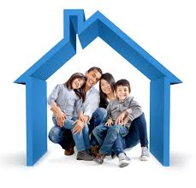
Live

Slide 16
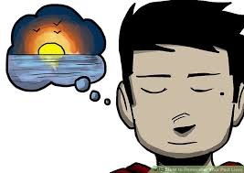
Memory

Slide 17

Protect

Slide 18
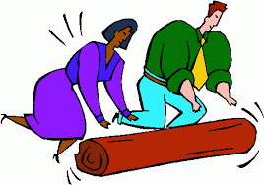
Roll

Slide 19

Spin

