Slide 1

English Vocabulary Beginners

Slide 2
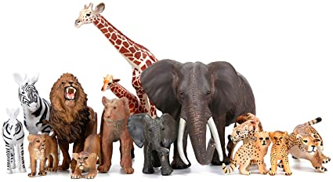
Unit four: Animals
Part 6

Slide 3

Spot

Slide 4
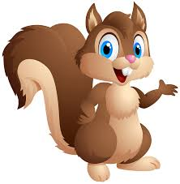
Squirrel

Slide 5

Starfish

Slide 6
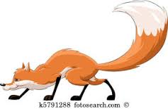
Tail

Slide 7
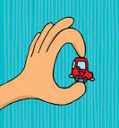
Tiny

Slide 8

Touch

Slide 9
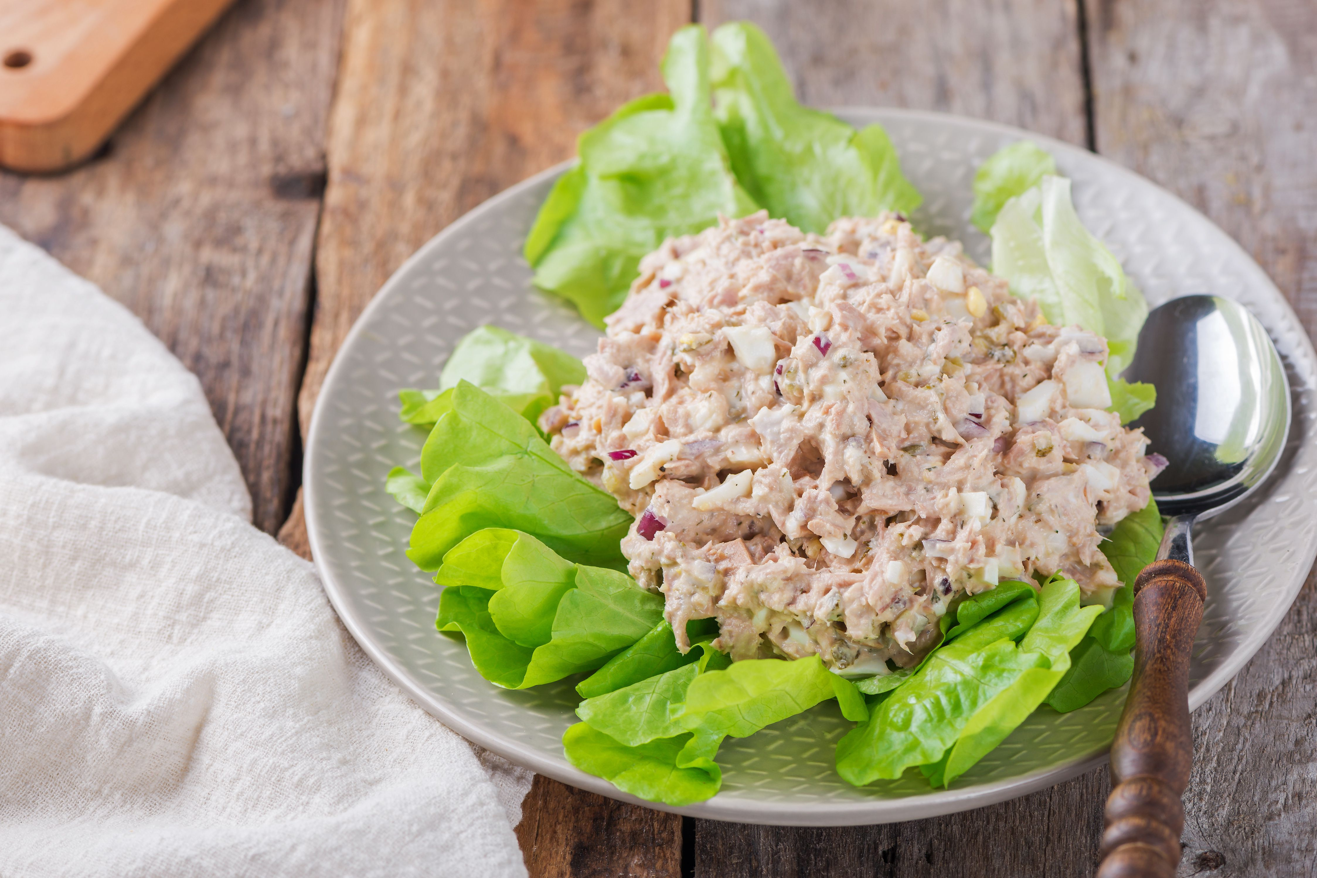
Tuna

Slide 10
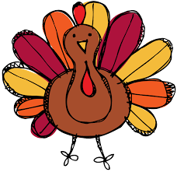
Turkey

Slide 11
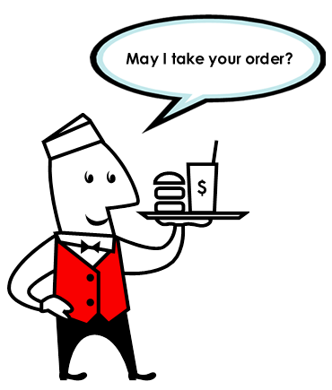
Order

Slide 12
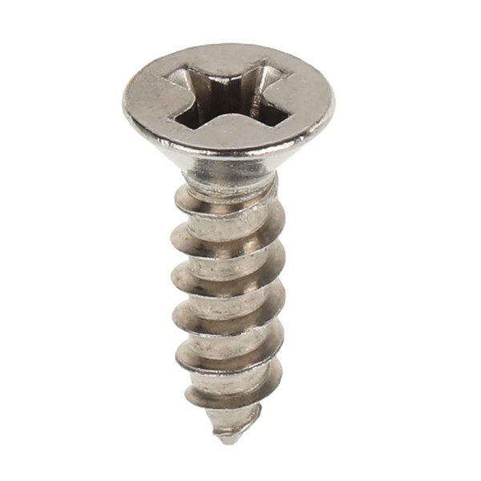
Screw

Slide 13
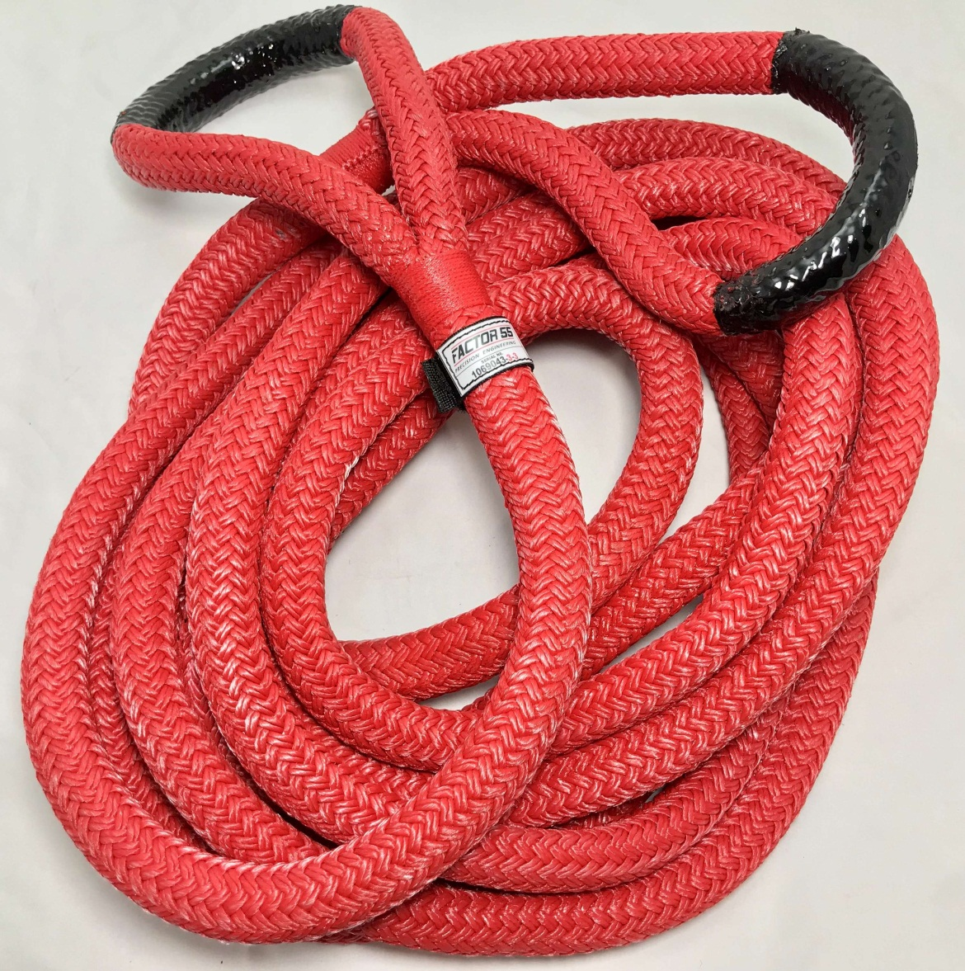
Rope

Slide 14

Side

