Slide 1

English Vocabulary

Slide 2
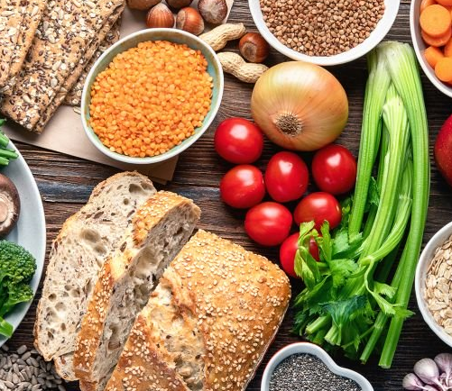
Unit Five: Food
Part 1

Slide 3
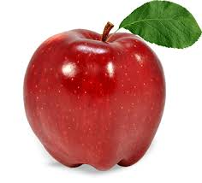
Apple

Slide 4
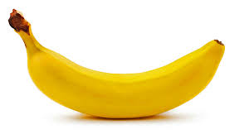
Banana

Slide 5

Bite

Slide 6

Bottle

Slide 7
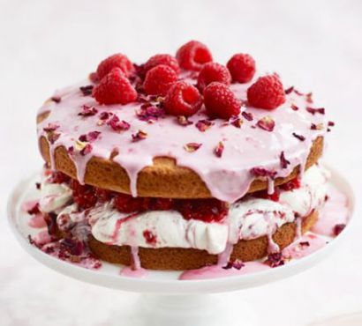
Cake

Slide 8
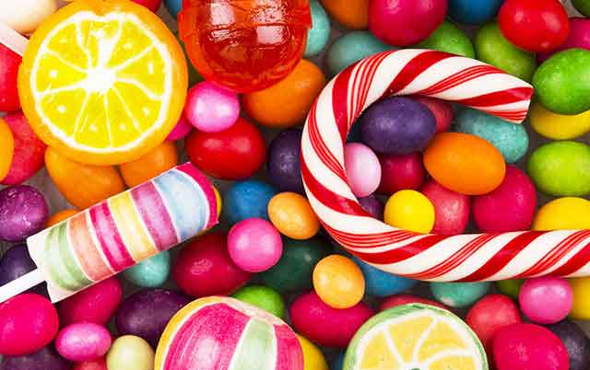
Candy

Slide 9

Cereal

Slide 10
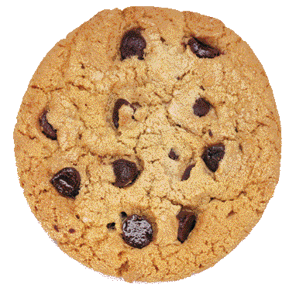
Cookie

Slide 11

Cut

Slide 12

Drink

Slide 13

Eat

Slide 14
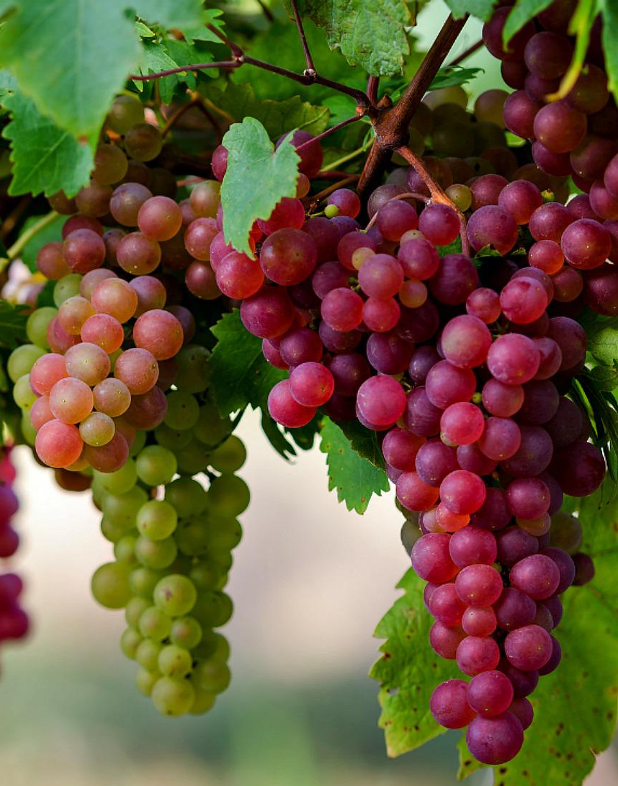
Grapes

Slide 15
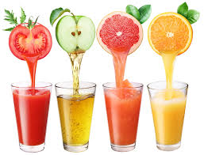
Juice

Slide 16

Lolipop

Slide 17
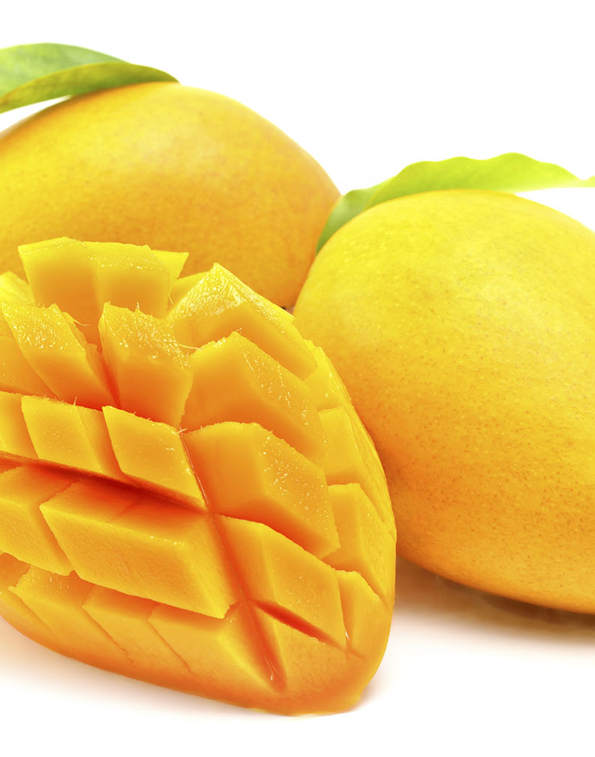
Mango

Slide 18
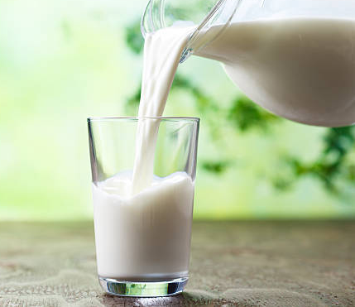
Milk

Slide 19
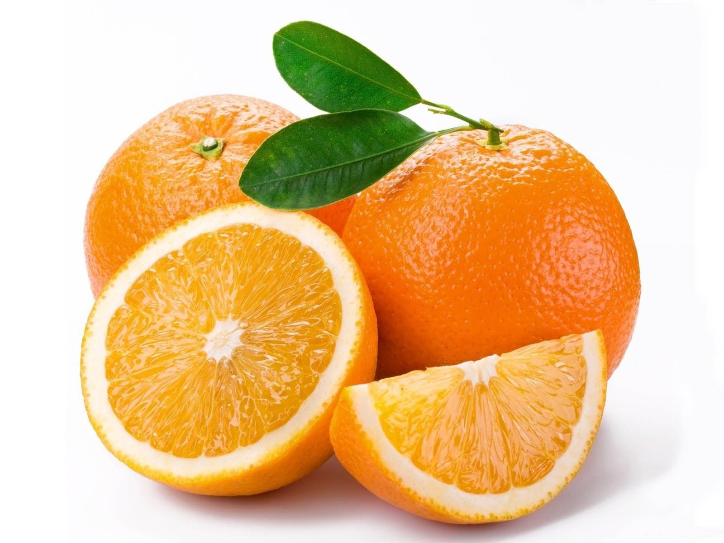
Orange

Slide 20
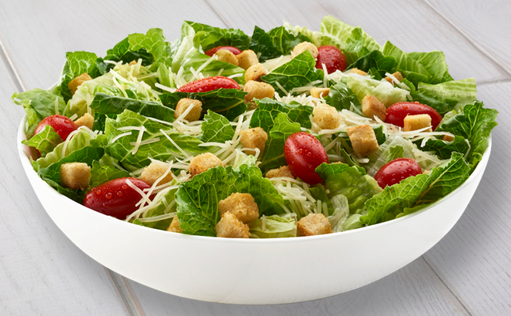
Salad

Slide 21
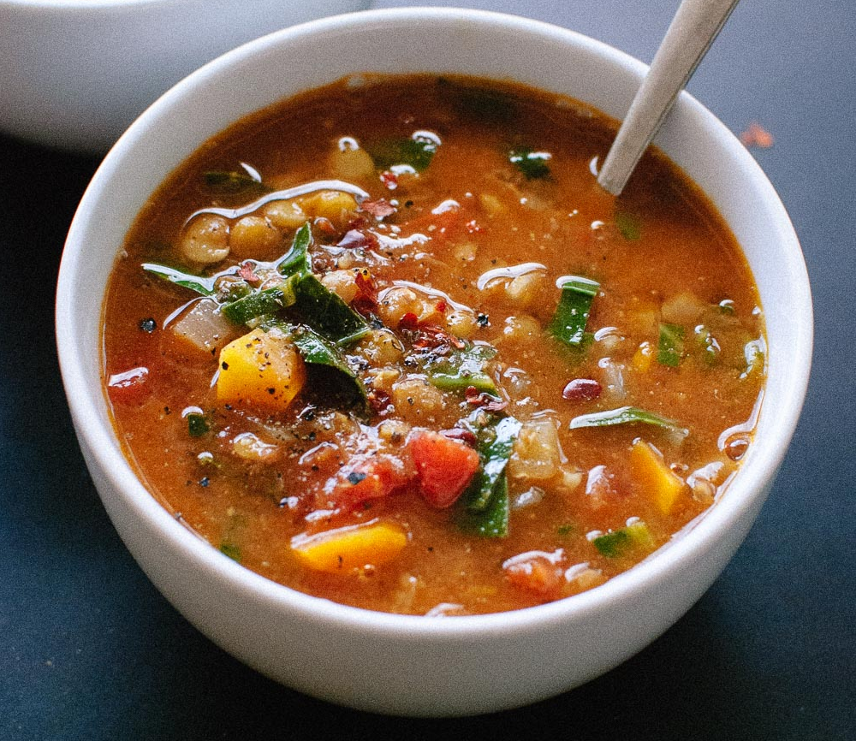
Soup

Slide 22
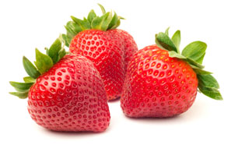
Strawberry

Slide 23

Water

Slide 24
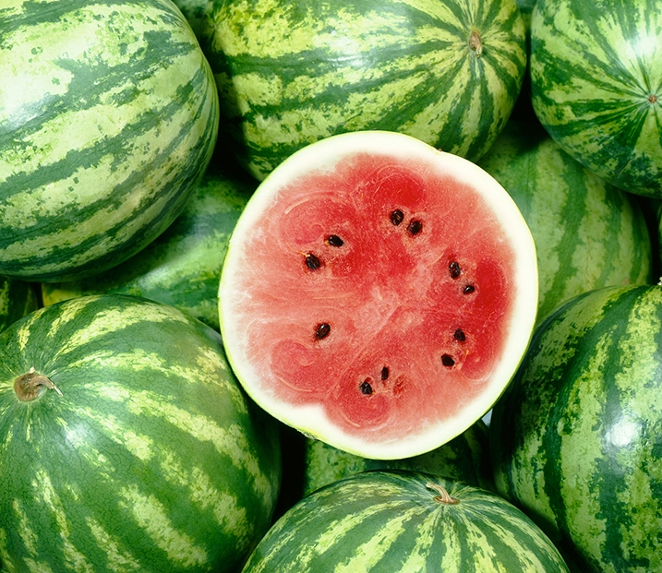
Watermelon

