Slide 1

English Vocabulary

Slide 2
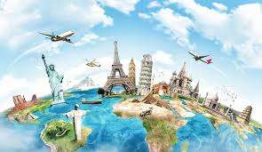
Unit six: Going places
Part 5

Slide 3
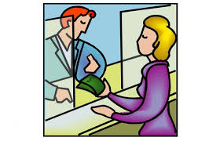
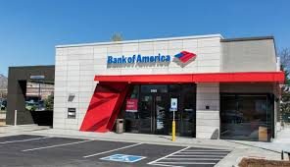
Bank

Slide 4

Beach

Slide 5

City

Slide 6
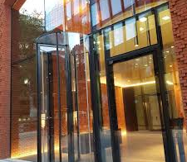
Entrance

Slide 7

Flag

Slide 8

Forest

Slide 9

Mail

Slide 10
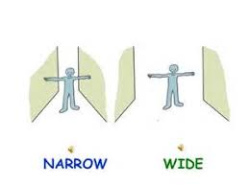
Narrow

Slide 11
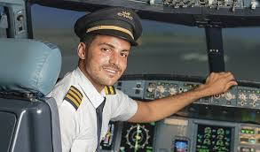
Pilot

Slide 12
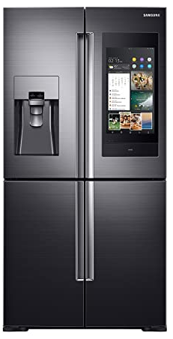
Refrigerator

Slide 13
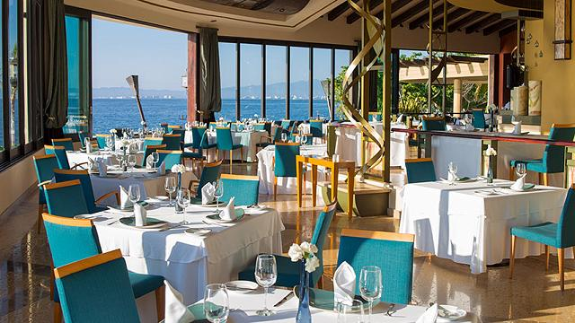
Restaurant

Slide 14
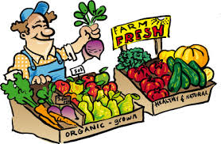
Sell

Slide 15
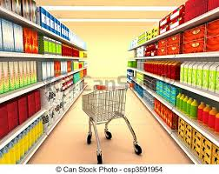
Supermarket

Slide 16
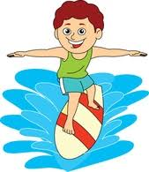
Surfing

