Slide 1

English Vocabulary Beginners

Slide 2
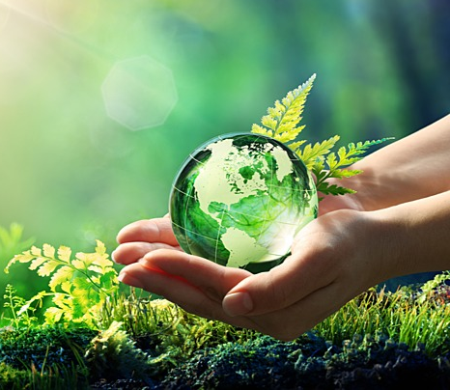
Unit seven: Environment
Part 1

Slide 3
Blue

Slide 4
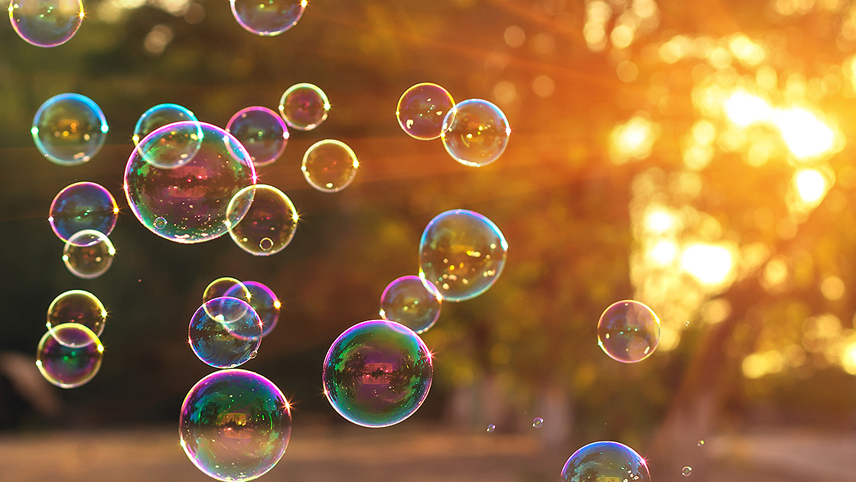
Bubbles

Slide 5
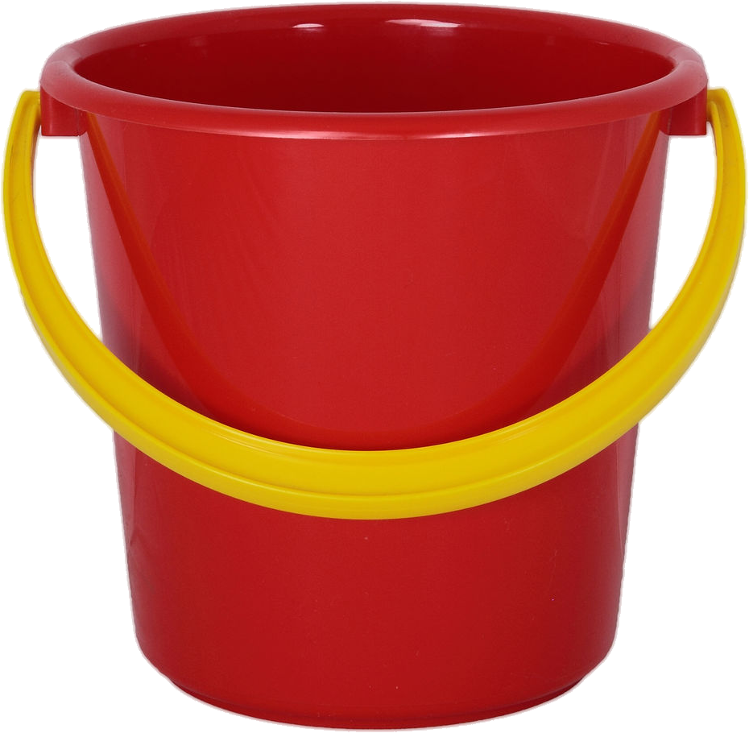
Bucket

Slide 6
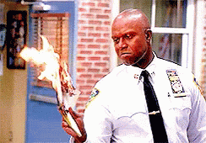
Burn

Slide 7

Cloud

Slide 8
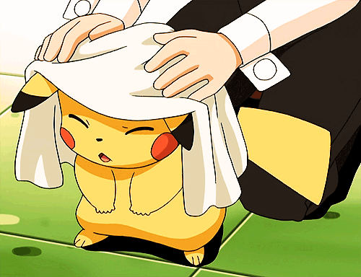
Dry

Slide 9
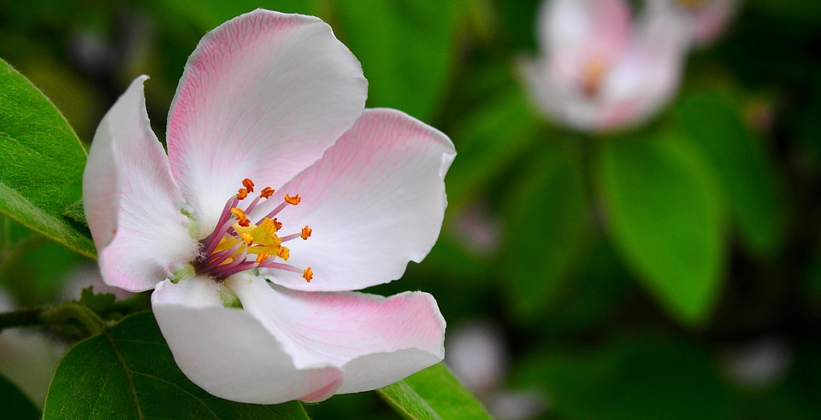
Flower

Slide 10
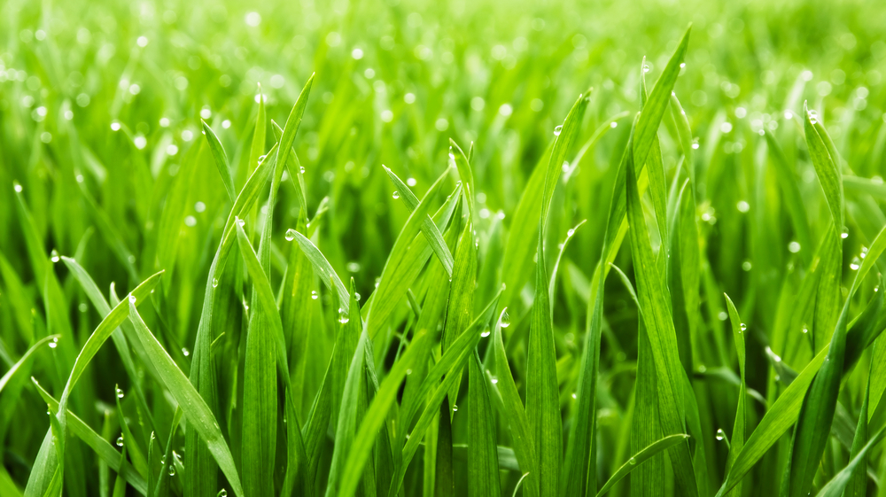
Grass

Slide 11
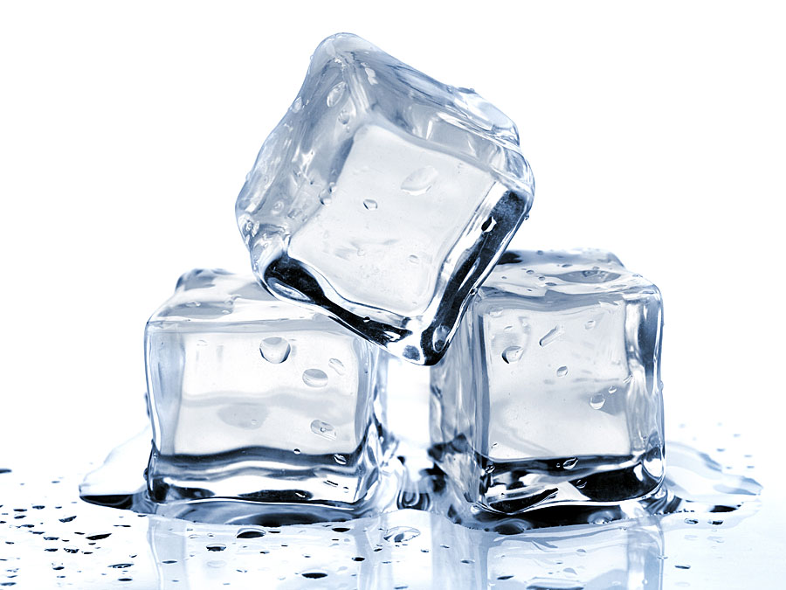
Ice

Slide 12
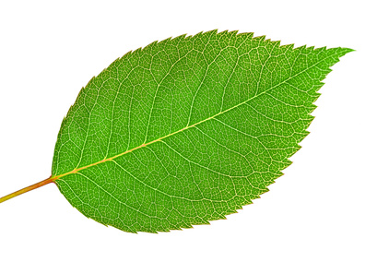
Leaf

Slide 13
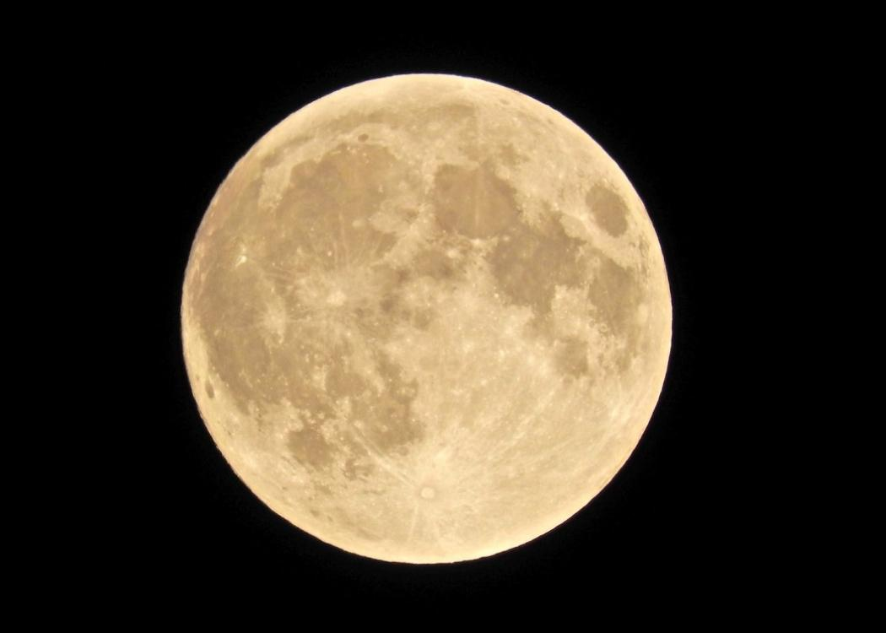
Moon

Slide 14
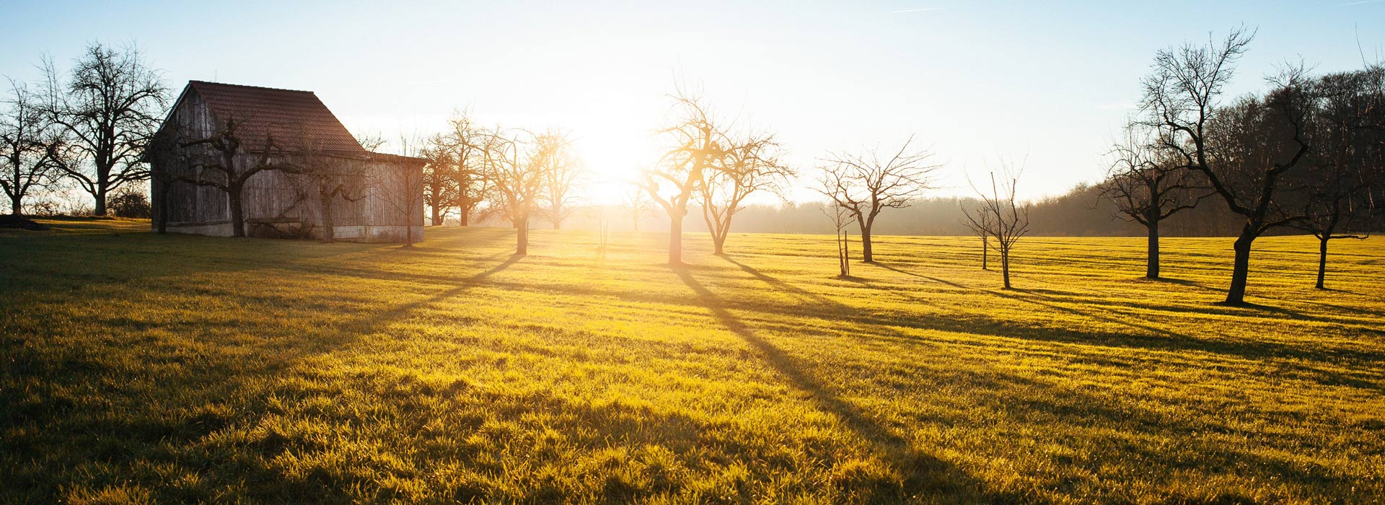
Morning

Slide 15
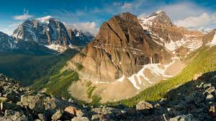
Mountain

Slide 16

Night

Slide 17
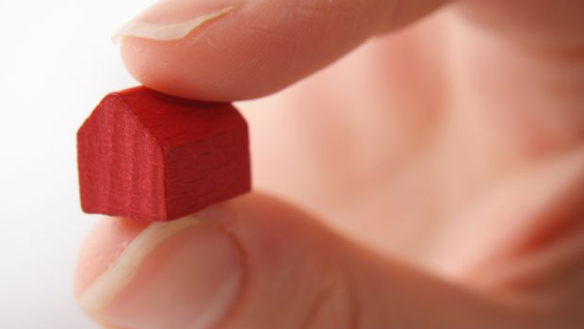
Small

Slide 18
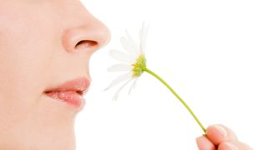
Smell

Slide 19

Star

Slide 20

Sun

Slide 21
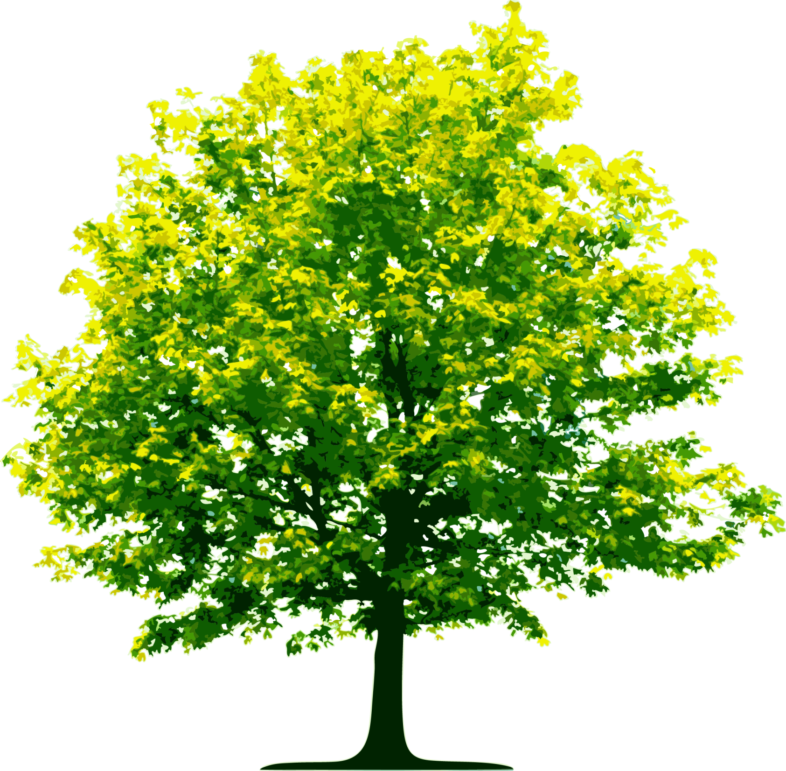
Tree

