Slide 1

English Vocabulary Beginners

Slide 2
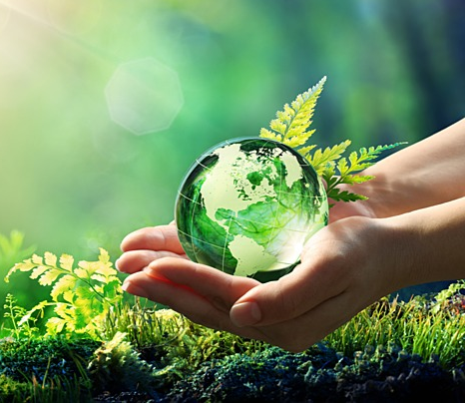
Unit seven: Environment
Part 2

Slide 3
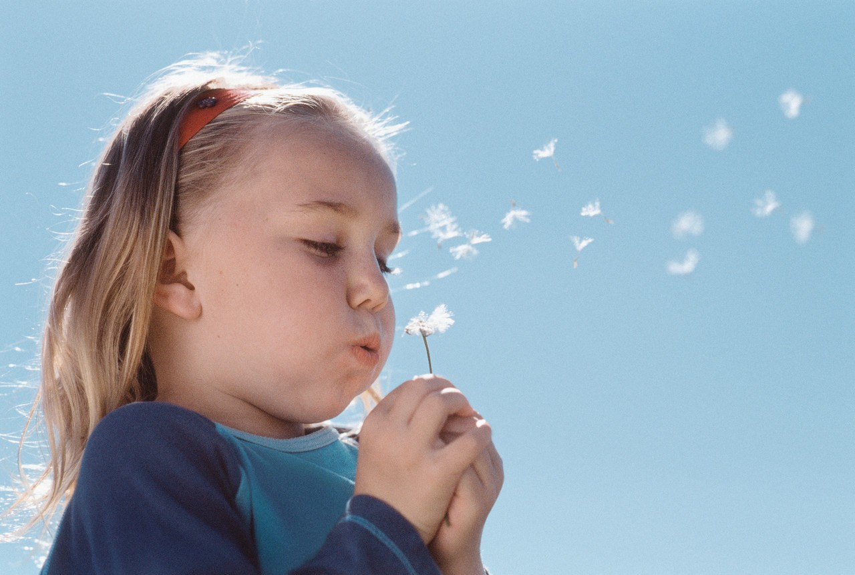
Blow

Slide 4

Breathe

Slide 5
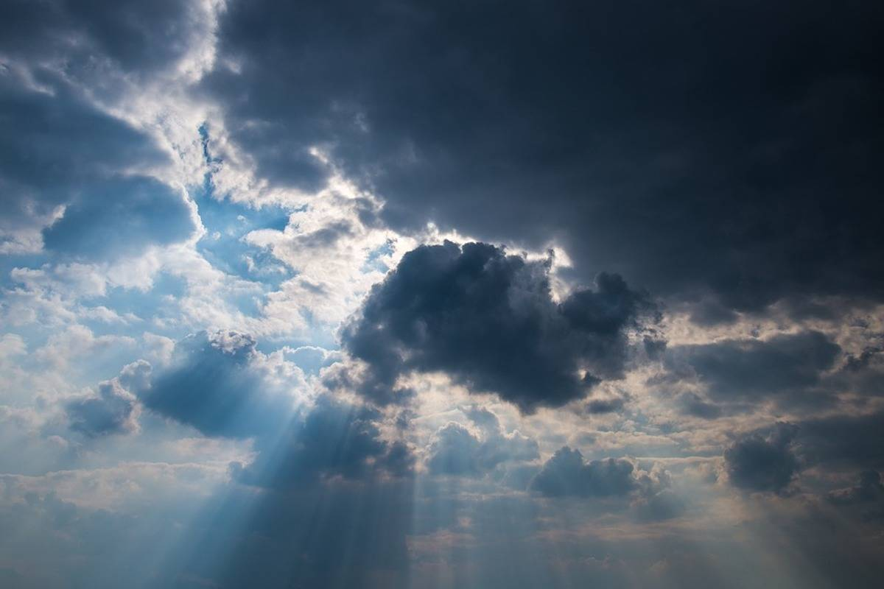
Cloudy

Slide 6

Day

Slide 7

Fall

Slide 8
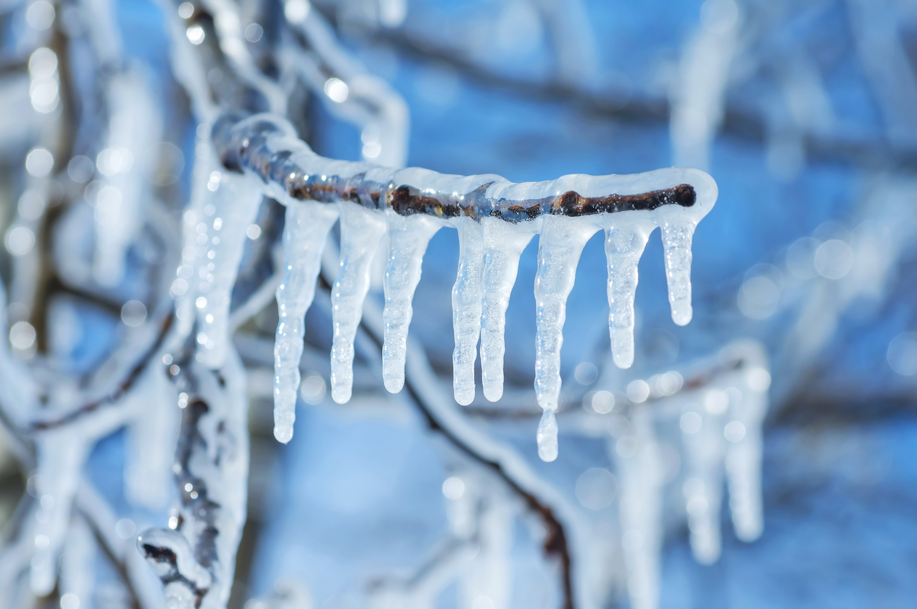
Freeze

Slide 9
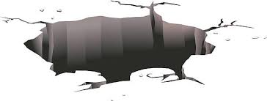
Hole

Slide 10
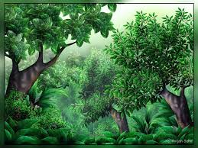
Jungle

Slide 11
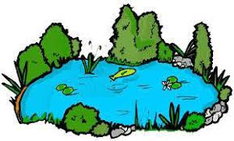
Lake

Slide 12
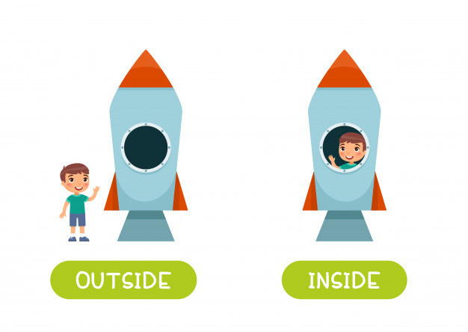

Slide 13
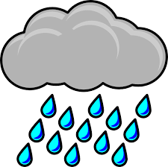
Rain

Slide 14

Shade

Slide 15

Sunshine

Slide 16

Sky

Slide 17

Sneeze

Slide 18
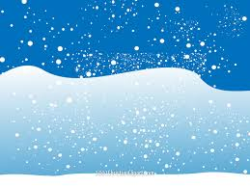
Snow

Slide 19
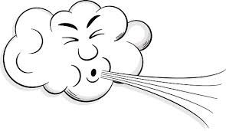
Wind

