Slide 1

English Vocabulary Beginners

Slide 2
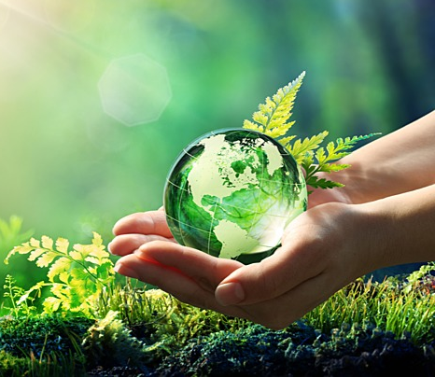
Unit seven: Environment
Part 3

Slide 3

air

Slide 4

branch

Slide 5

experiment

Slide 6
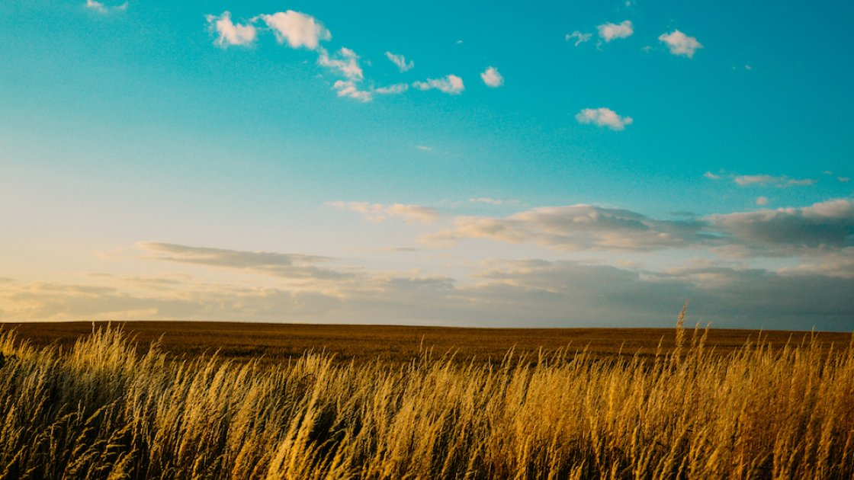
Field

Slide 7


Float

Slide 8

fog

Slide 9
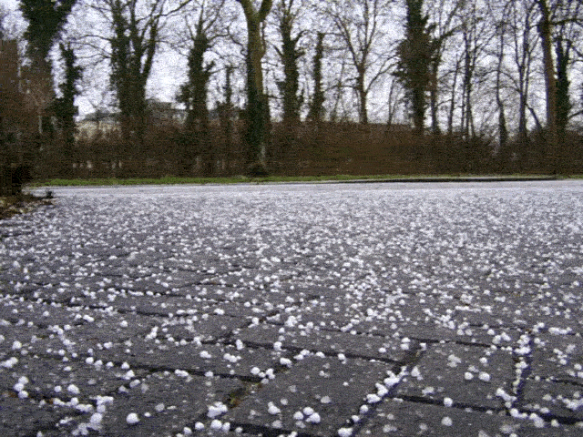
hail

Slide 10
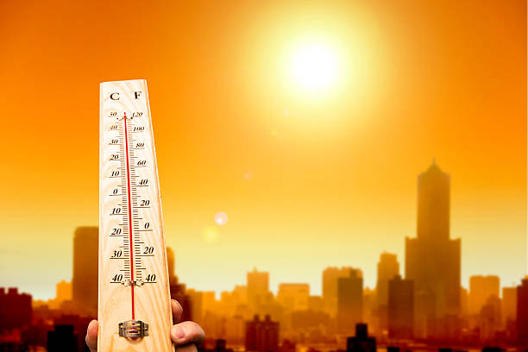
heat

Slide 11
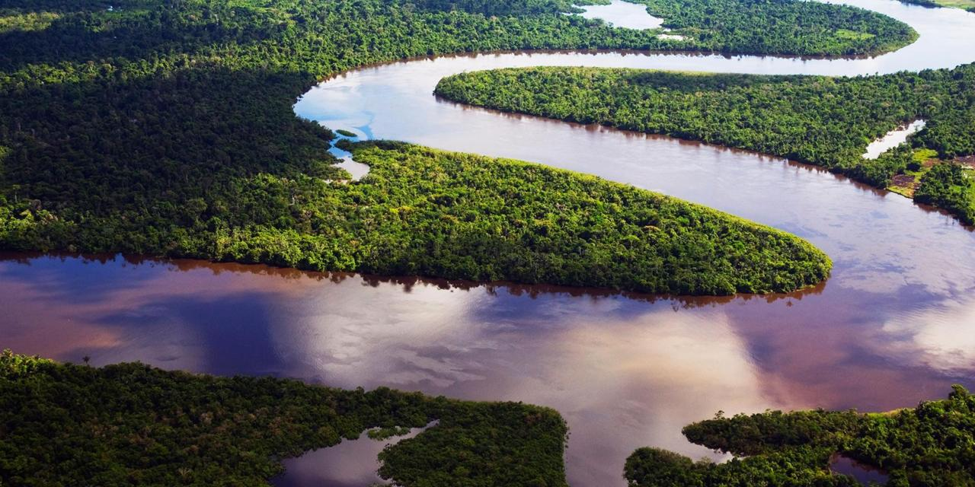
river

Slide 12
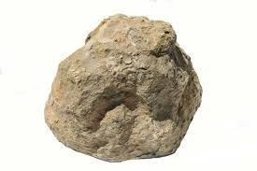
rock

Slide 13
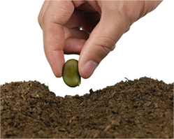
seed

Slide 14
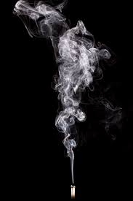
smoke

Slide 15

soft

Slide 16
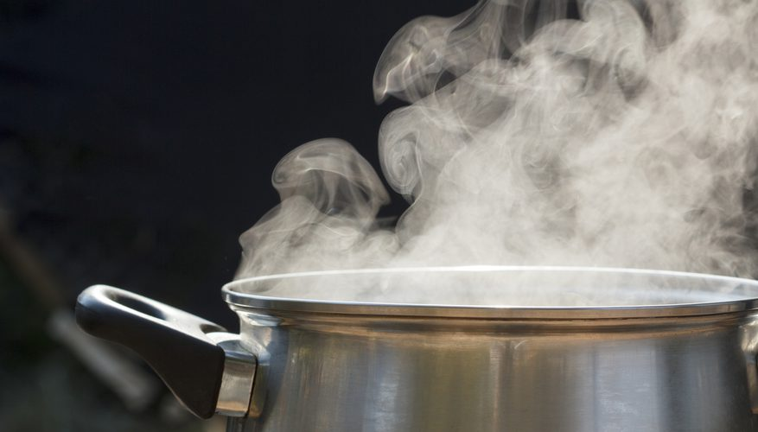
steam

Slide 17
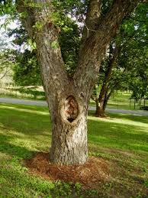
trunk

Slide 18
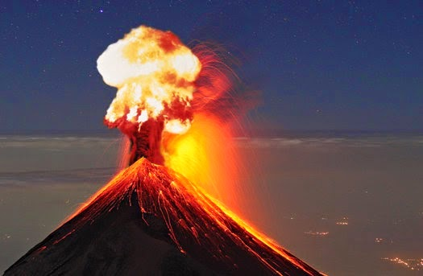
Volcano

