Slide 1

English Vocabulary Beginners

Slide 2

Unit seven: Environment
Part 5

Slide 3

Between

Slide 4
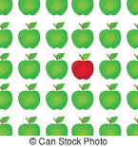
Difference

Slide 5

Edge

Slide 6
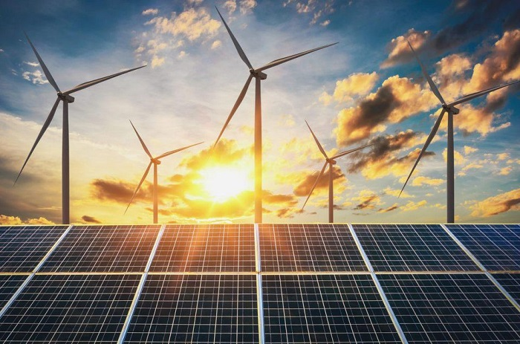
Energy

Slide 7


Flow

Slide 8

Ground

Slide 9

Plastic

Slide 10

Poor

Slide 11
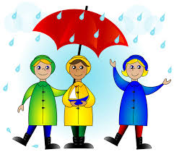
Rainy

Slide 12

Season

Slide 13

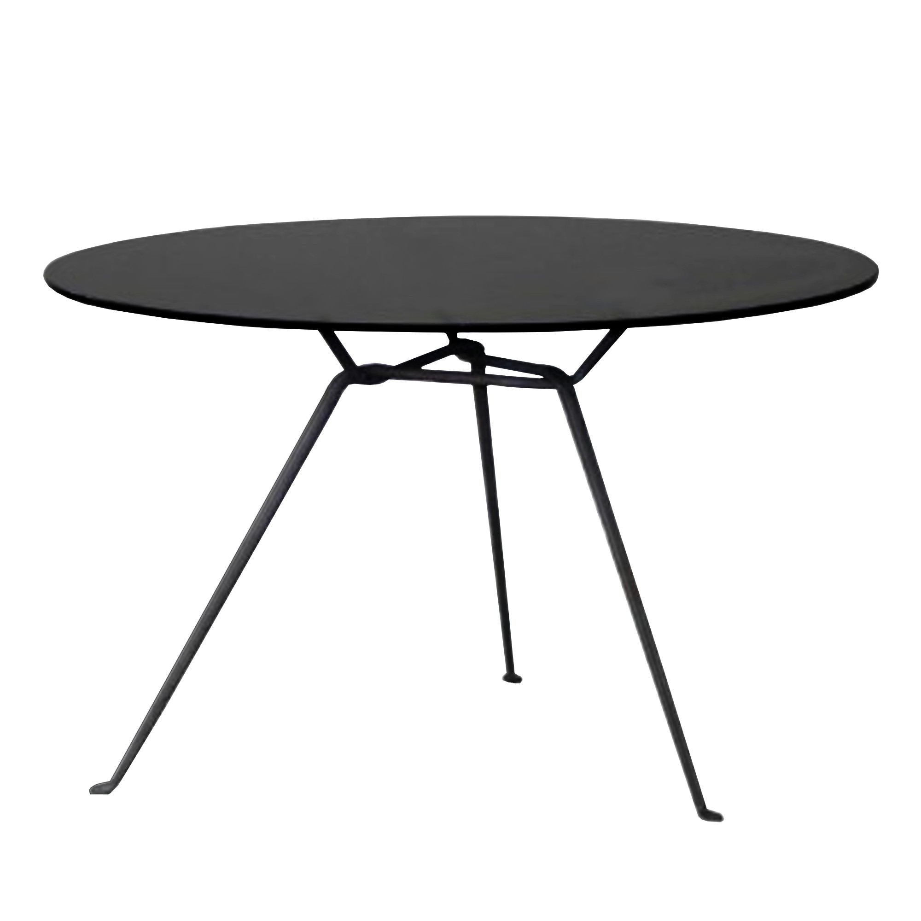
Round

Slide 14
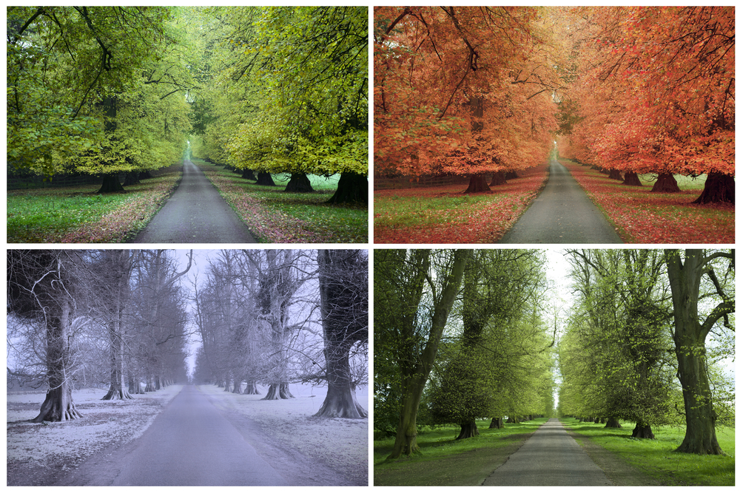
Seasons

Slide 15

Storm

Slide 16

Tool

Slide 17
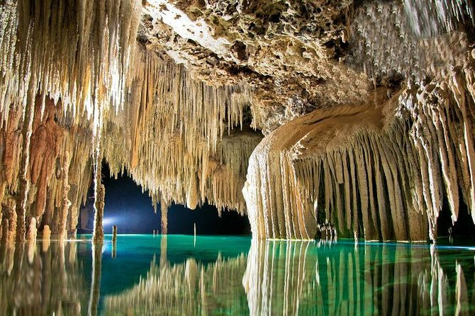
Underground

Slide 18
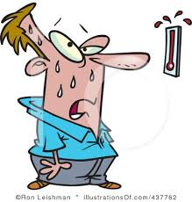
Warm

Slide 19
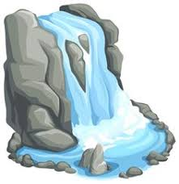
Waterfall

Slide 20

Windy

