Slide 1

English Vocabulary Beginners

Slide 2
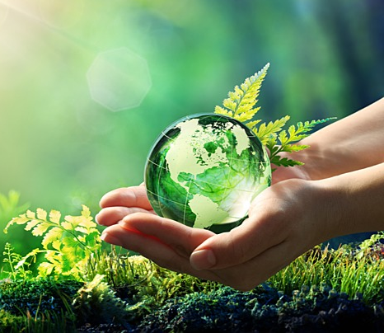
Unit seven: Environment
Part 6

Slide 3
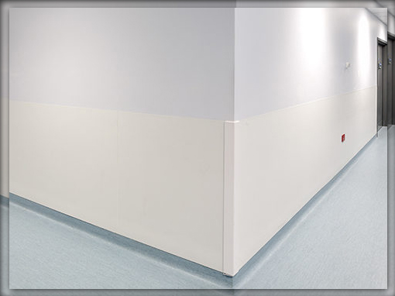
Corner

Slide 4
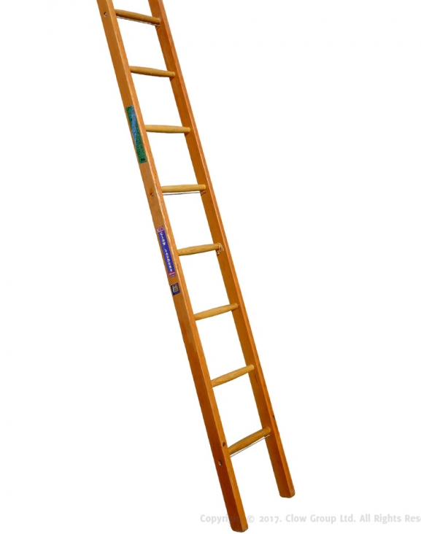
Ladder

Slide 5
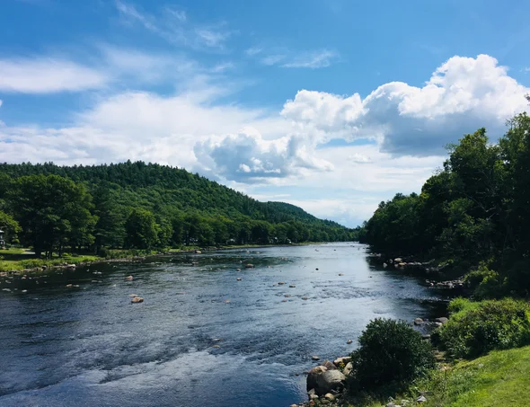
Nature

Slide 6

Oxygen

Slide 7
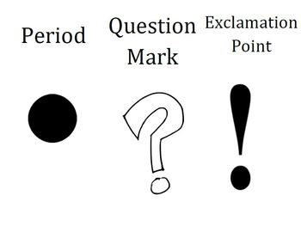
Period

Slide 8

Prepare

Slide 9
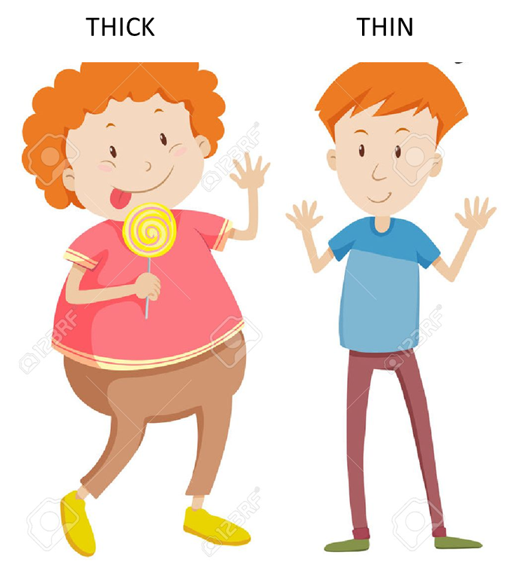
Thick / Thin

Slide 10
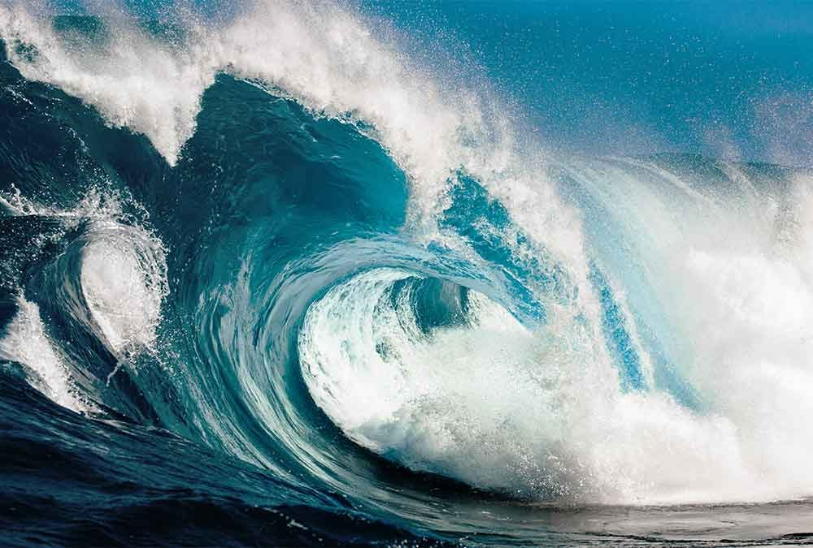
Wave

Slide 11

Weather

Slide 12
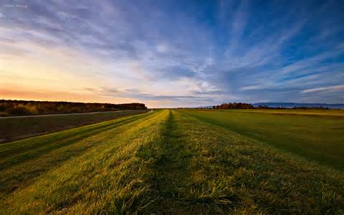
Wide

Slide 13
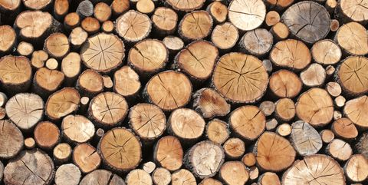
Wood

Slide 14

World

