Slide 1

English Vocabulary Beginners

Slide 2

Unit eight: Adventure
Part 1

Slide 3

Bell

Slide 4
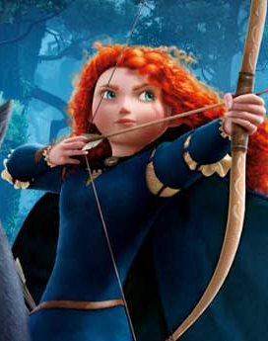
Brave

Slide 5

Dance

Slide 6
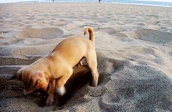
Dig

Slide 7

Down

Slide 8
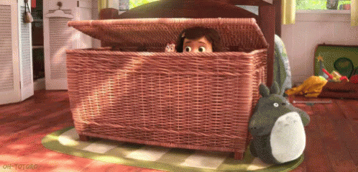
Hide

Slide 9
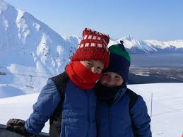
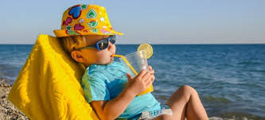
Hot Cold

Slide 10
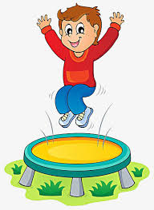
Jump

Slide 11
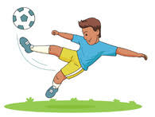
Kick

Slide 12

Look

Slide 13

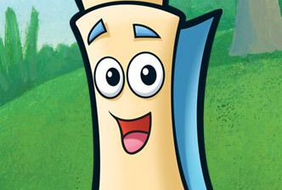
Map

Slide 14
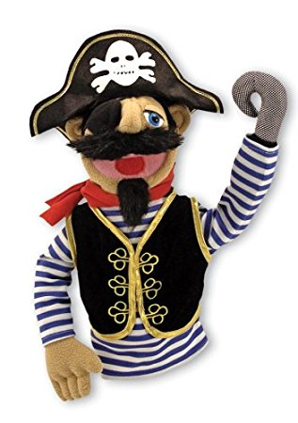
Pirate

Slide 15
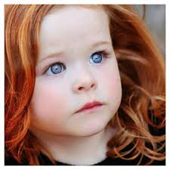
Pretty

Slide 16
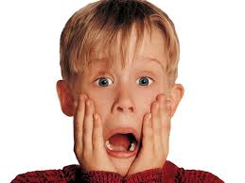
Scared

Slide 17
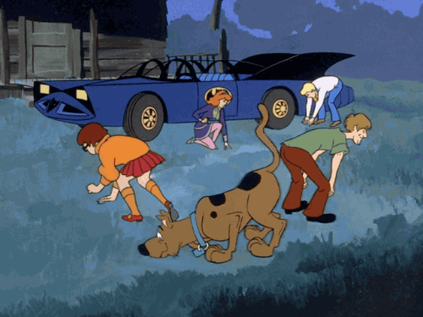
Search

Slide 18
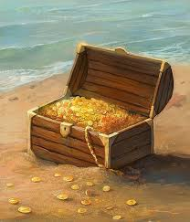
Treasure

Slide 19
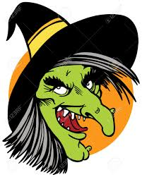
Ugly

Slide 20

Roof

Slide 21
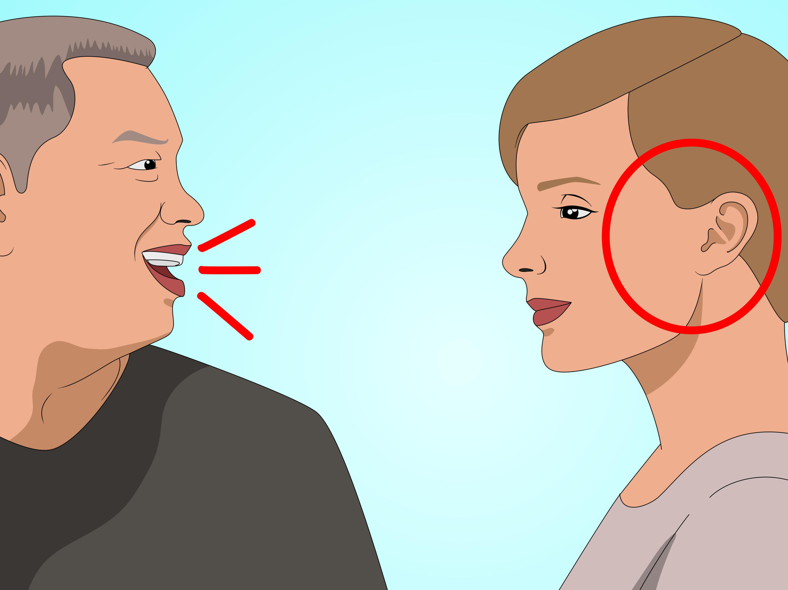
Say

Slide 22
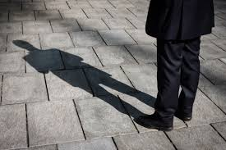
Shadow

Slide 23
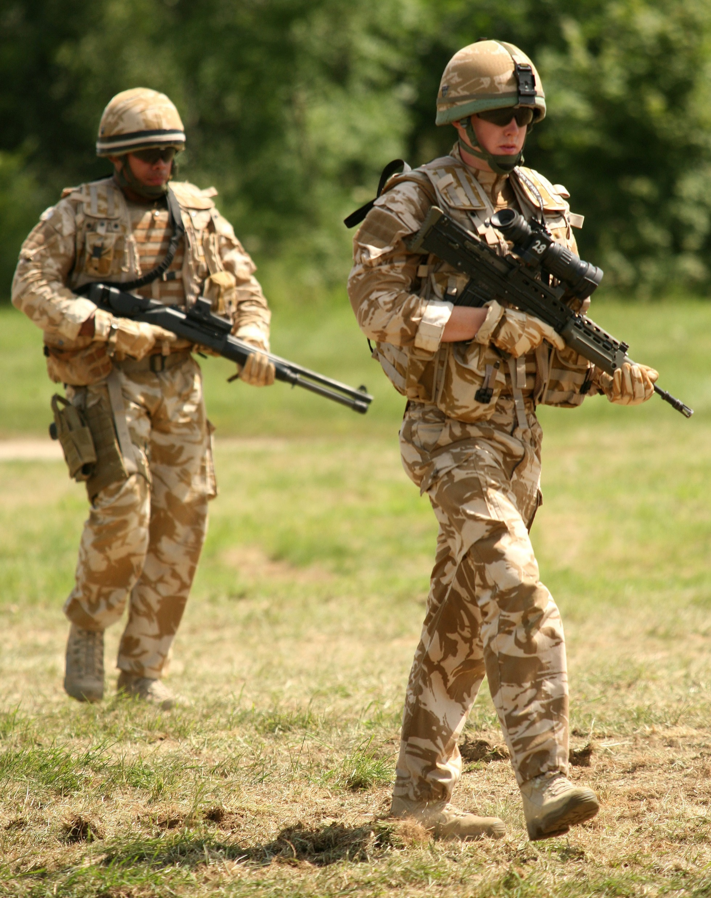
Soldier

Slide 24

Splash

