Slide 1

English Vocabulary Beginners

Slide 2

Unit eight: Adventure
Part 2

Slide 3
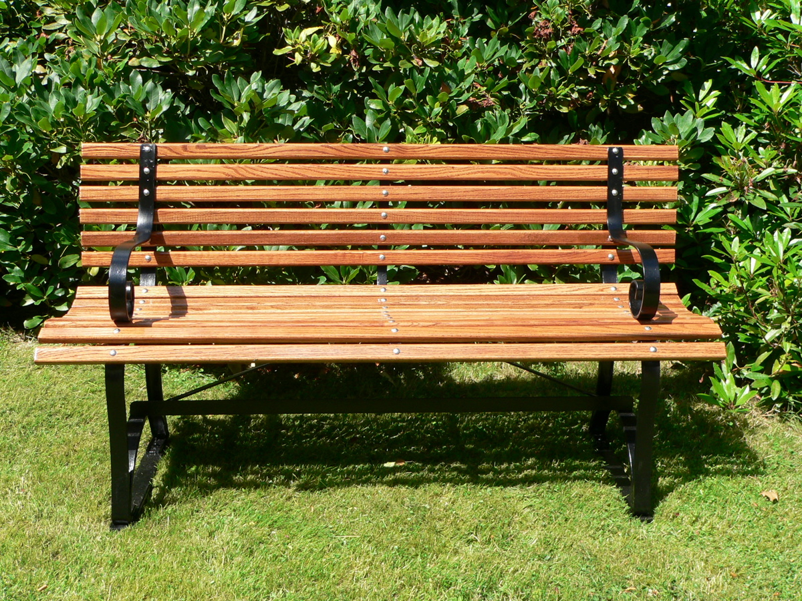
Bench

Slide 4
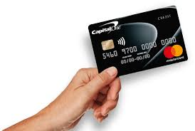
Card

Slide 5

Crown

Slide 6

Dark

Slide 7

Fire

Slide 8

Hear

Slide 9

Hop

Slide 10

Invite

Slide 11
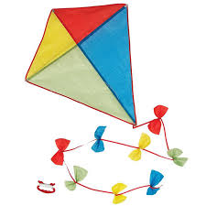
Kite

Slide 12
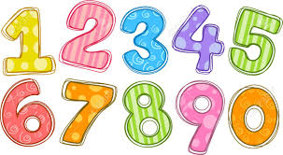
Numbers

Slide 13

Loud

Slide 14
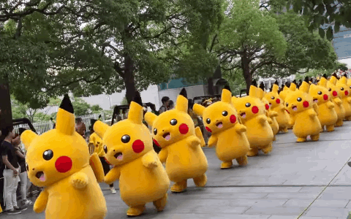
March

Slide 15


Prize

Slide 16

Robot

Slide 17


Slide 18


Slide 19


Slide 20


Slide 21


Slide 22


Slide 23


Slide 24
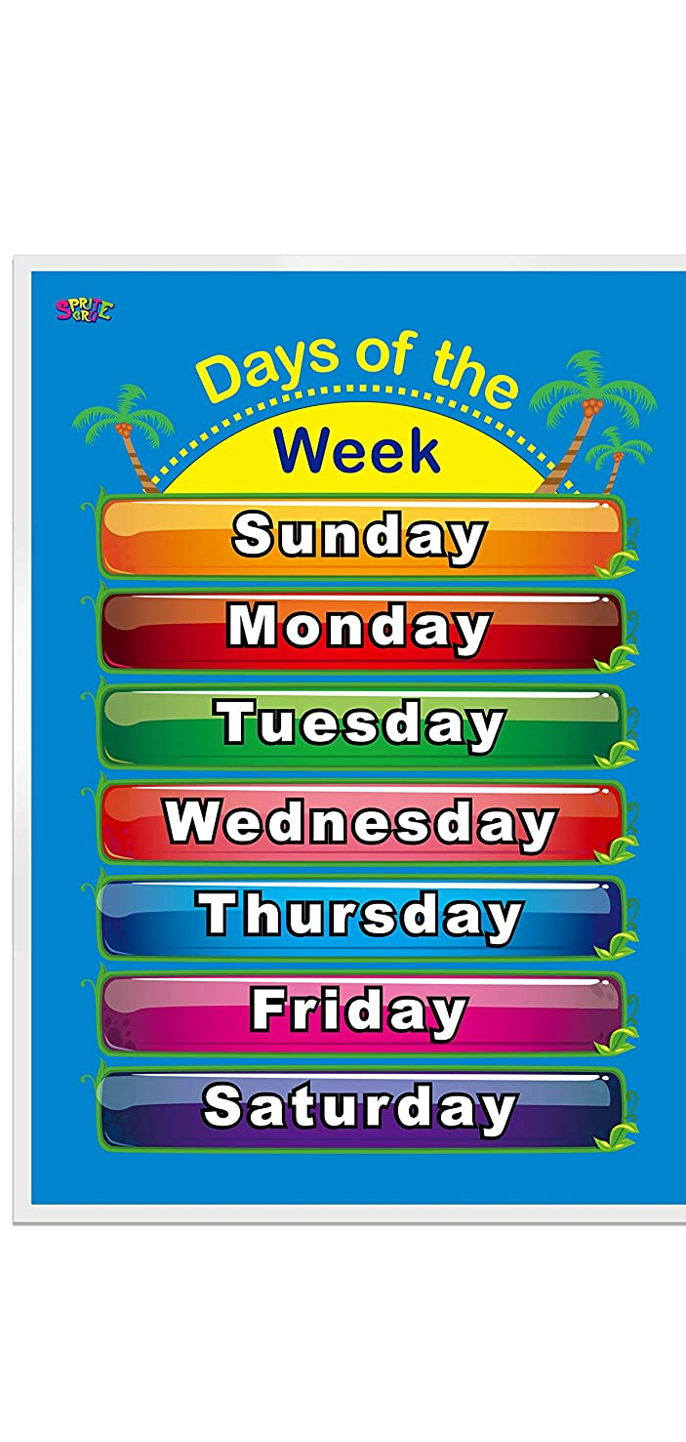
Week

Slide 25
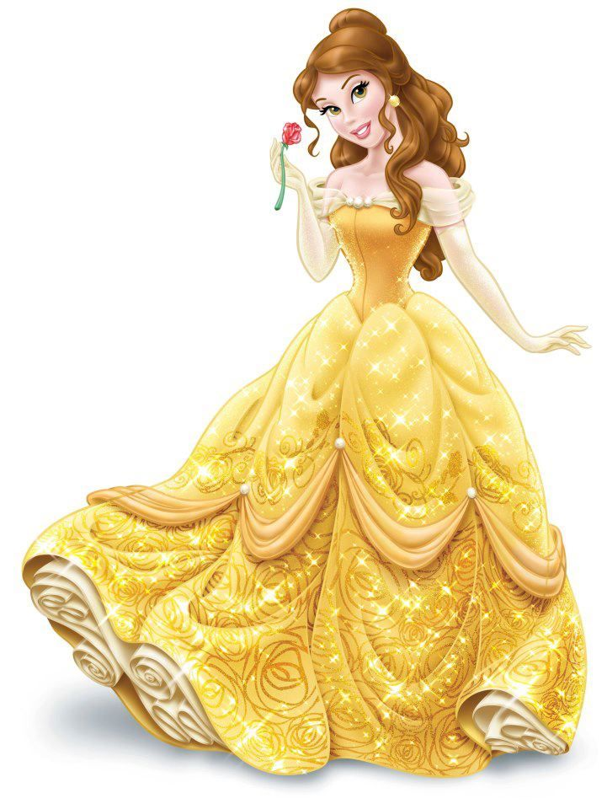
Princess

Slide 26
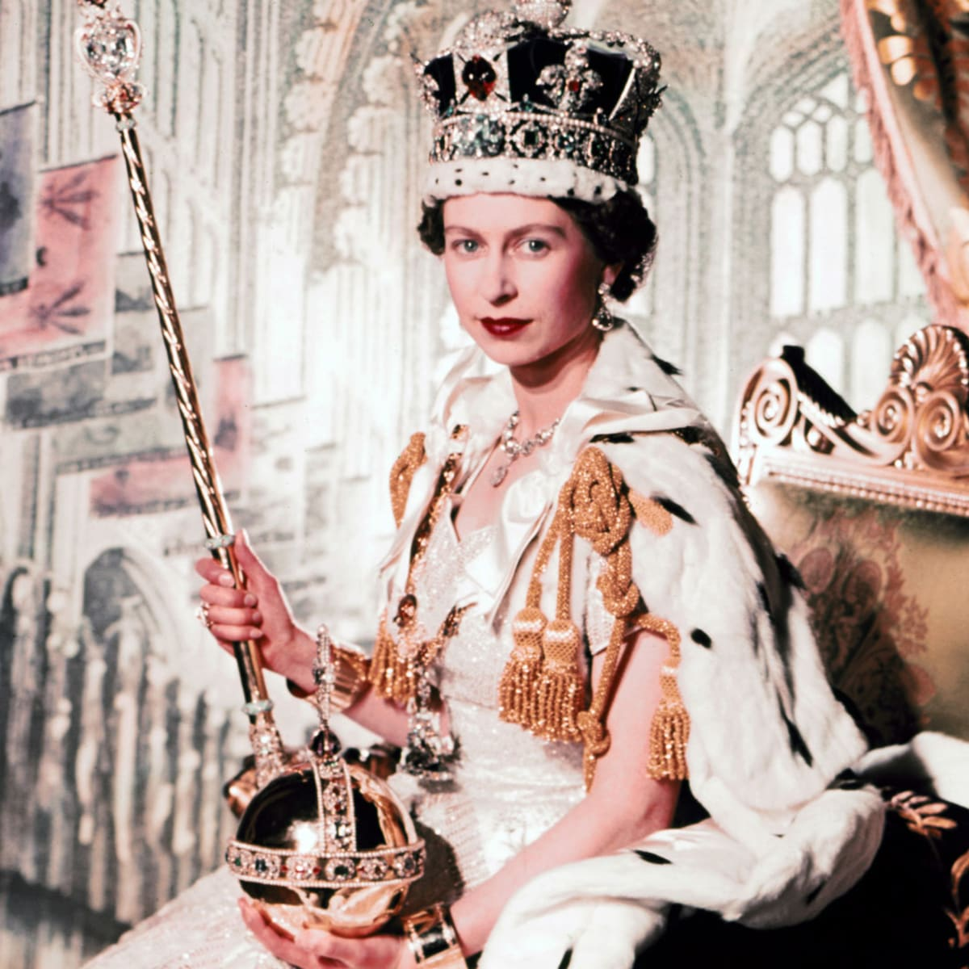
Queen

Slide 27
Silver

Slide 28
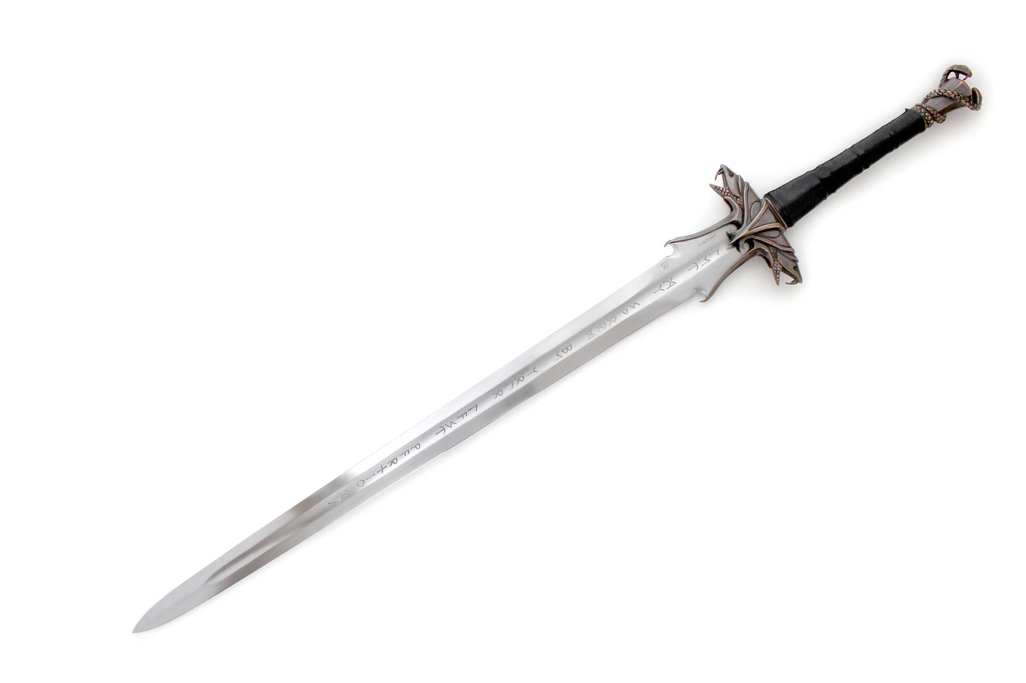
Sword

Slide 29
Copper

Slide 30
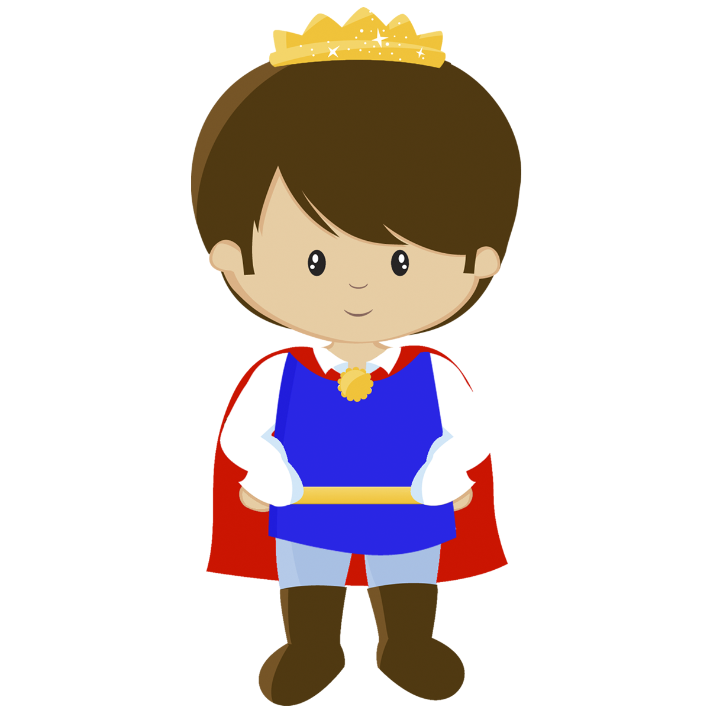
Prince

