Slide 1

English Vocabulary Beginners

Slide 2

Unit eight: Adventure
Part 3

Slide 3
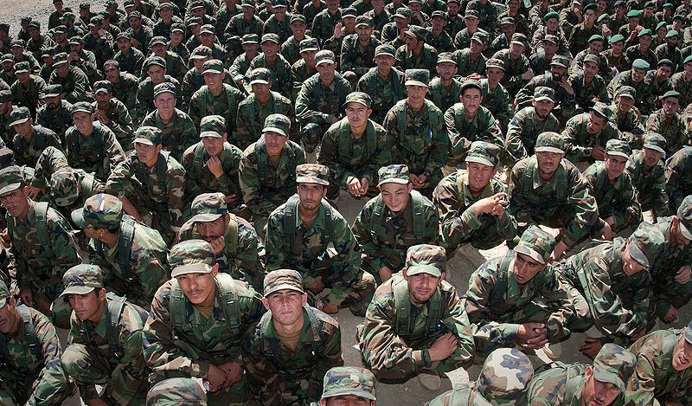
Army

Slide 4

ceiling

Slide 5
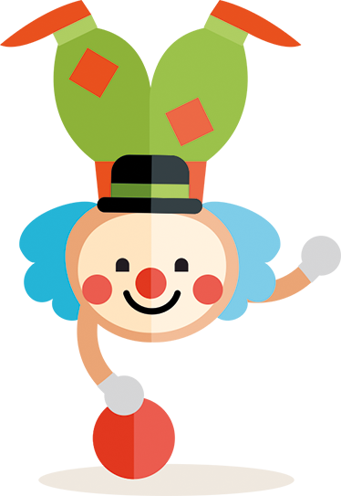
clown

Slide 6
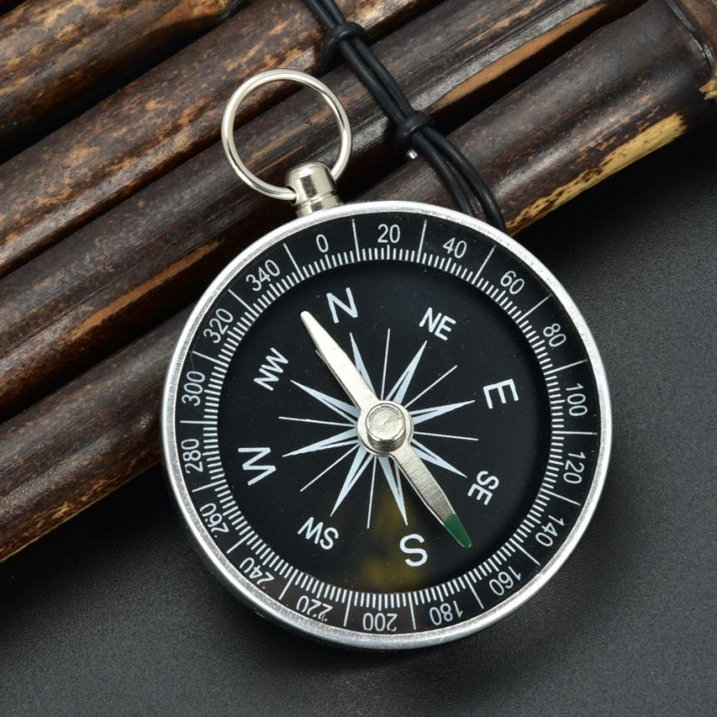
Compass

Slide 7

afraid

Slide 8

Diamond

Slide 9

gold

Slide 10


Slide 11


hold

Slide 12
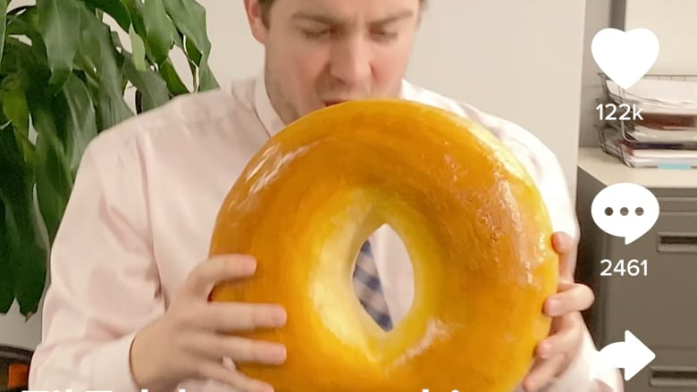
Huge

Slide 13
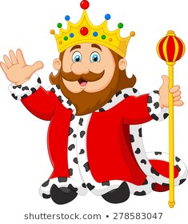
king

Slide 14
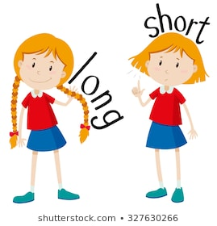

Slide 15
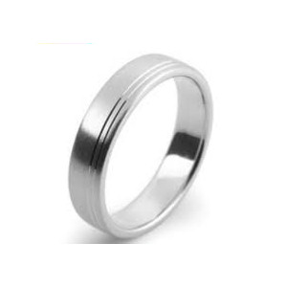
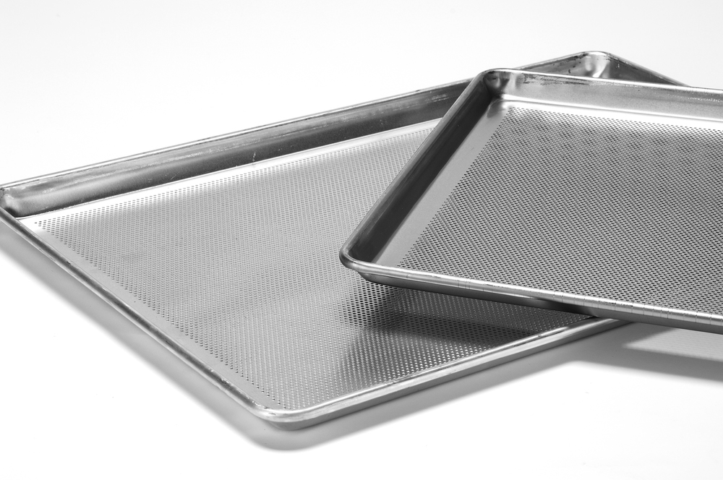
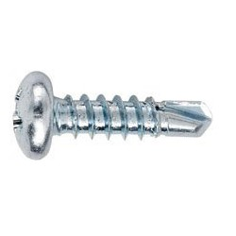
Metal

Slide 16
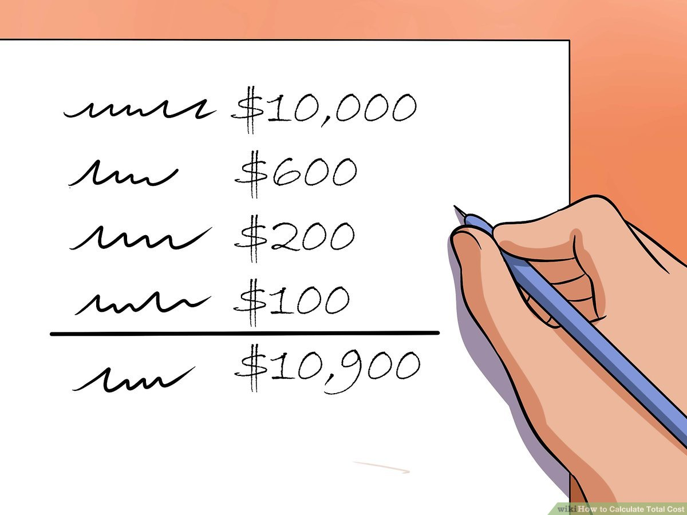
Total

Slide 17

Robber

Slide 18

See

Slide 19
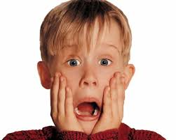
Terrible

