Slide 1

English Vocabulary Beginners

Slide 2

Unit eight: Adventure
Part 4

Slide 3

Artist

Slide 4

Audience

Slide 5

couple

Slide 6
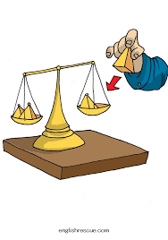
add

Slide 7
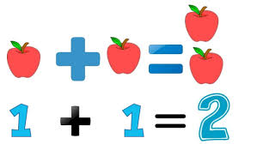
addition

Slide 8

adventure

Slide 9
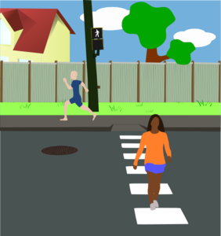
cross

Slide 10

empty

Slide 11

Dangerous

Slide 12

Deep

Slide 13
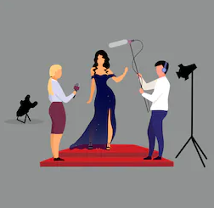
Famous

Slide 14

fear

Slide 15

first

Slide 16
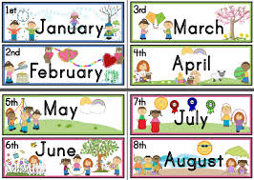

month

Slide 17

Invent

Slide 18
nothing

Slide 19

Soon

Slide 20

Middle

Slide 21
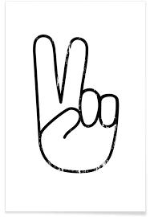
Peace

Slide 22

Some

Slide 23
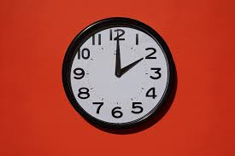
Time

Slide 24
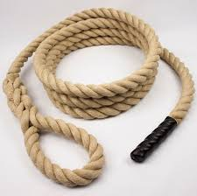
Rope

Slide 25
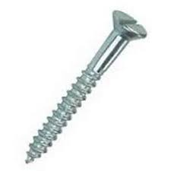
Screw

Slide 26

Similar

