Slide 1

English Vocabulary Beginners

Slide 2

Unit eight: Adventure
Part 5

Slide 3
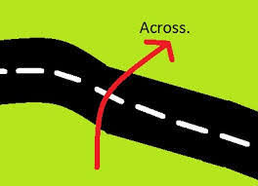
Across

Slide 4
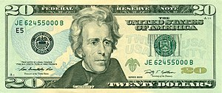
Bill

Slide 5
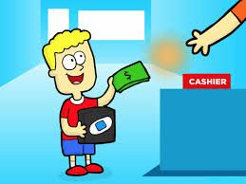
Buy

Slide 6
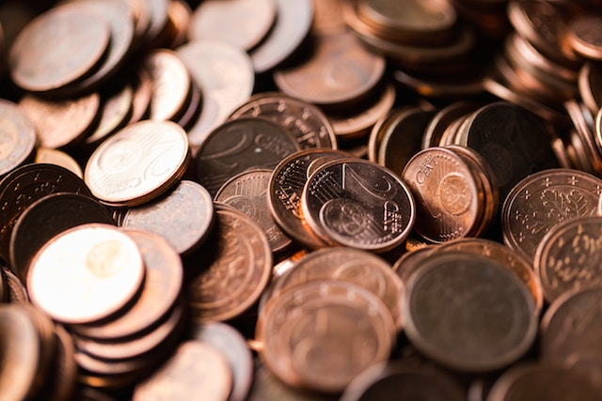
Cents

Slide 7
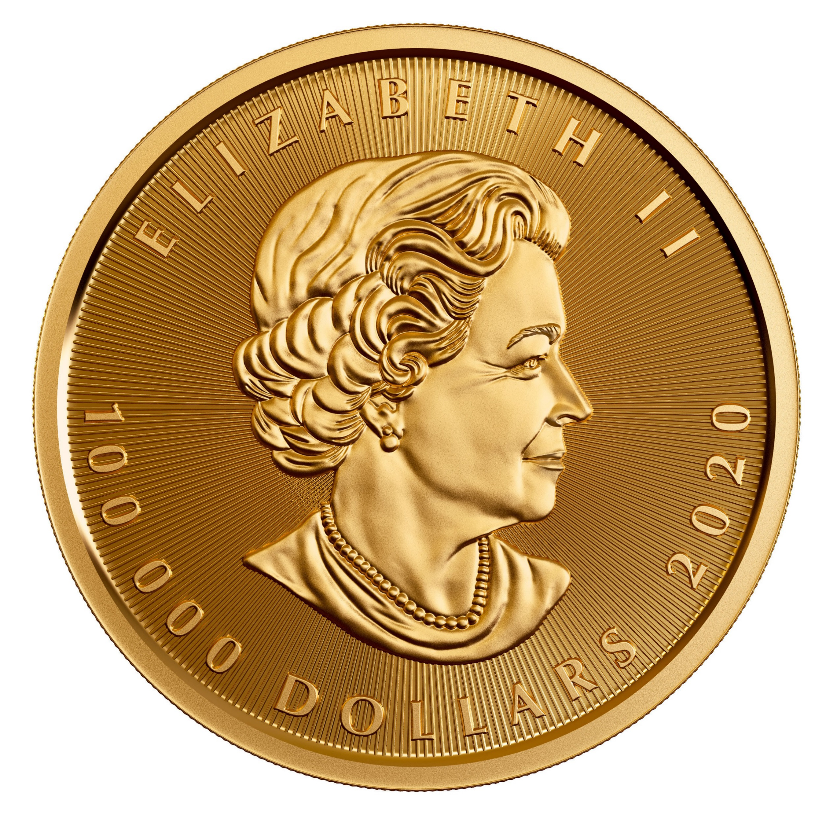
Coin

Slide 8
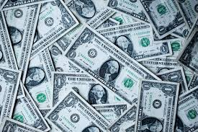
Dollars

Slide 9
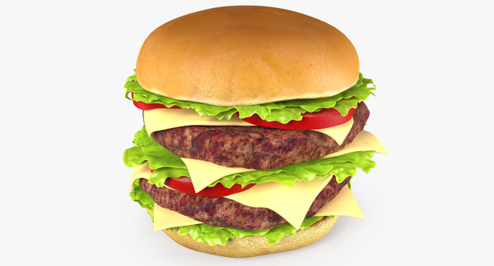
Double

Slide 10

Equal

Slide 11

Fix

Slide 12
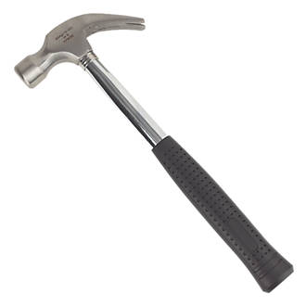
Hammer

Slide 13
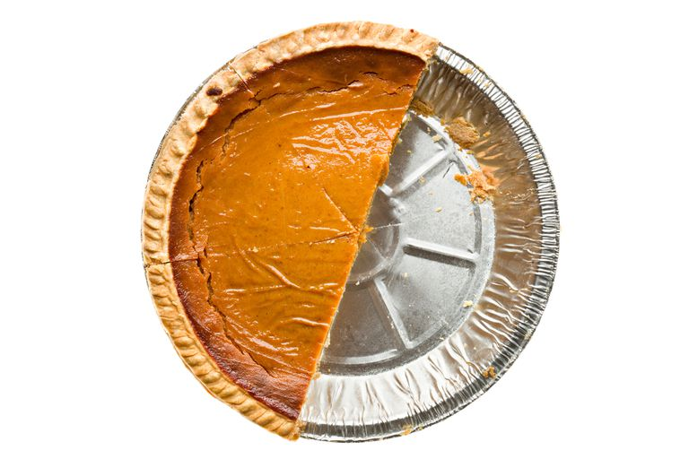
Half

Slide 14
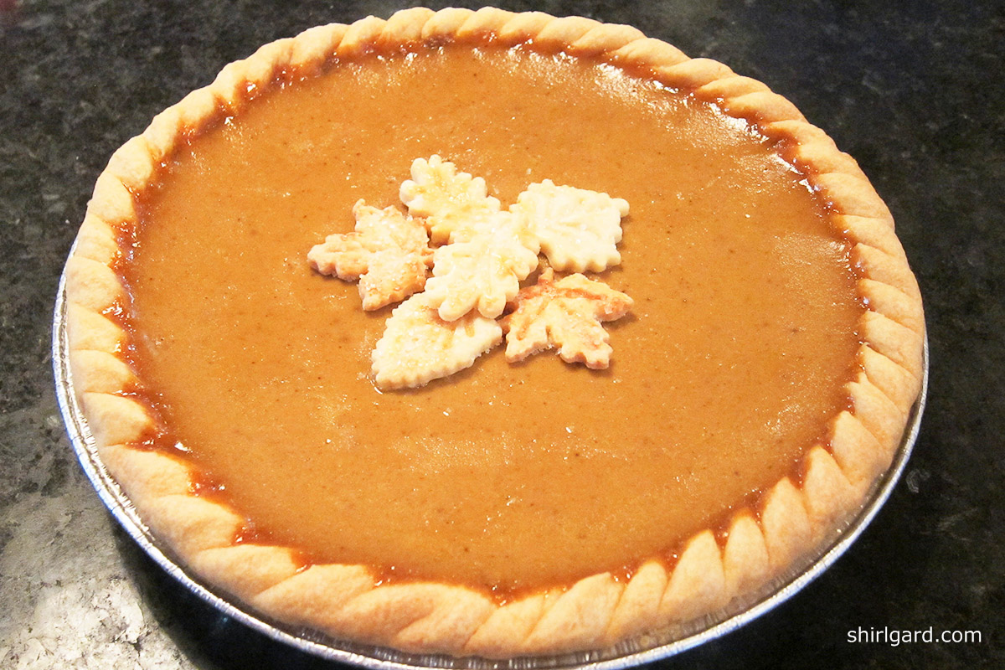
Whole

Slide 15

Minutes

Slide 16
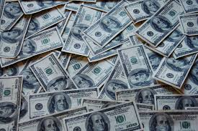
Money

Slide 17

Order

Slide 18

Second

Slide 19

side

Slide 20

Rich

Slide 21

Space

Slide 22
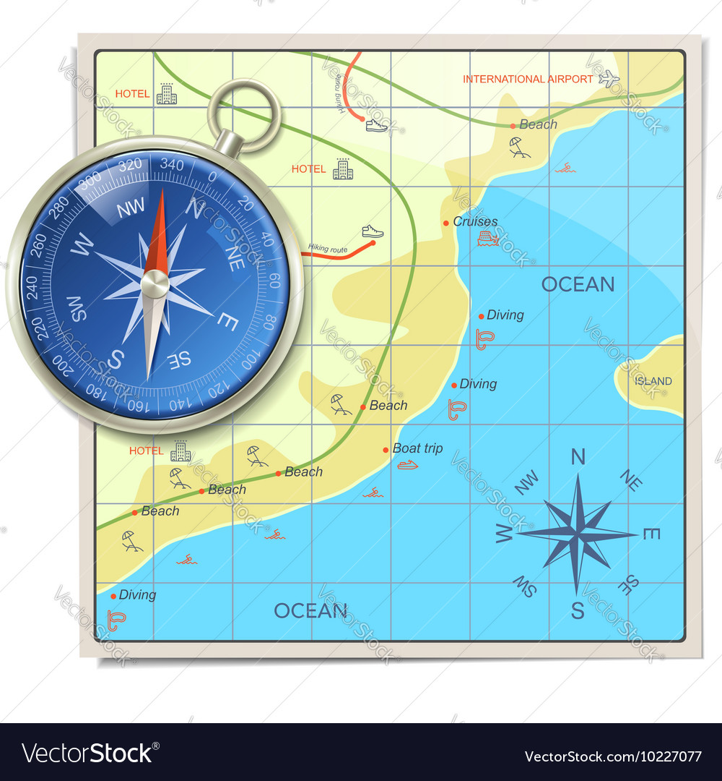
North / South / East / West

