Slide 1

English Vocabulary Beginners

Slide 2

Unit eight: Adventure
Part 6

Slide 3
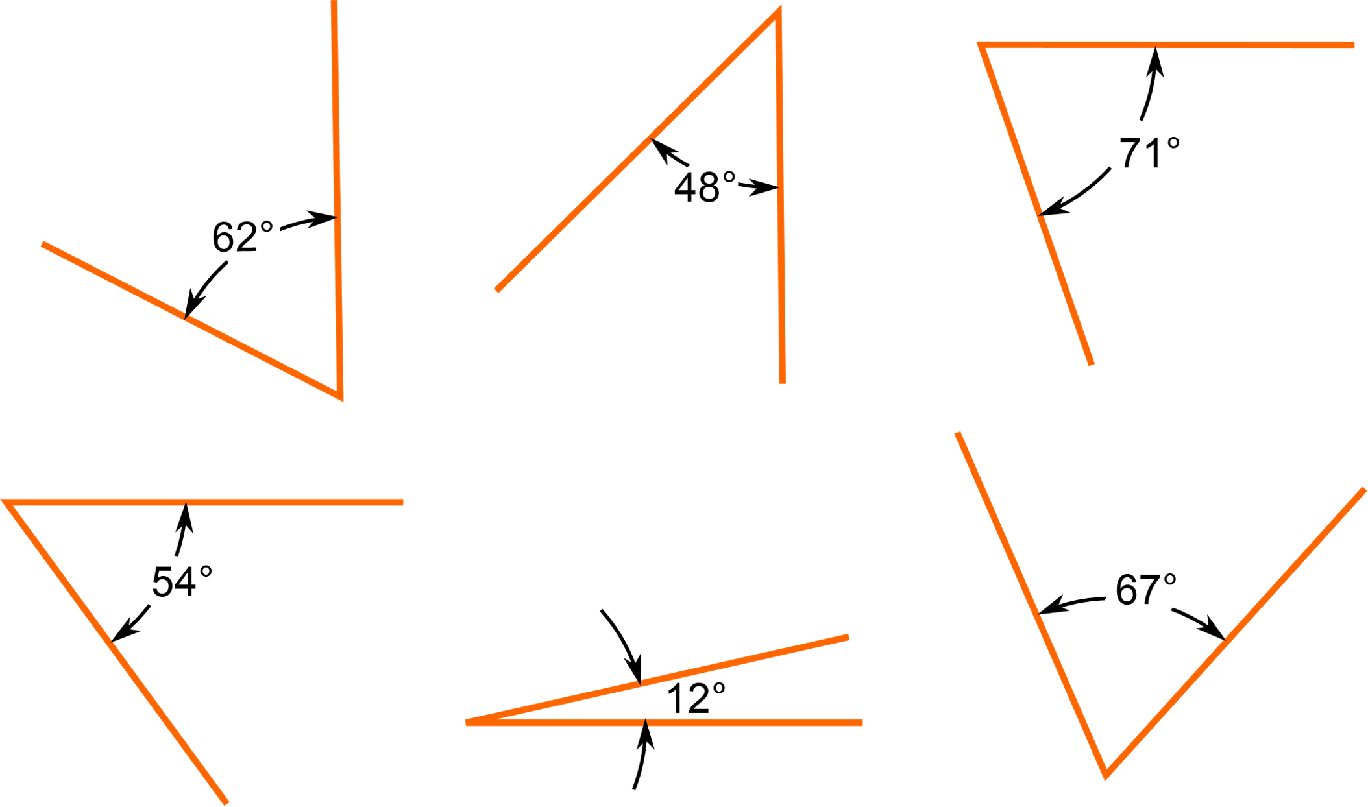
Angle

Slide 4
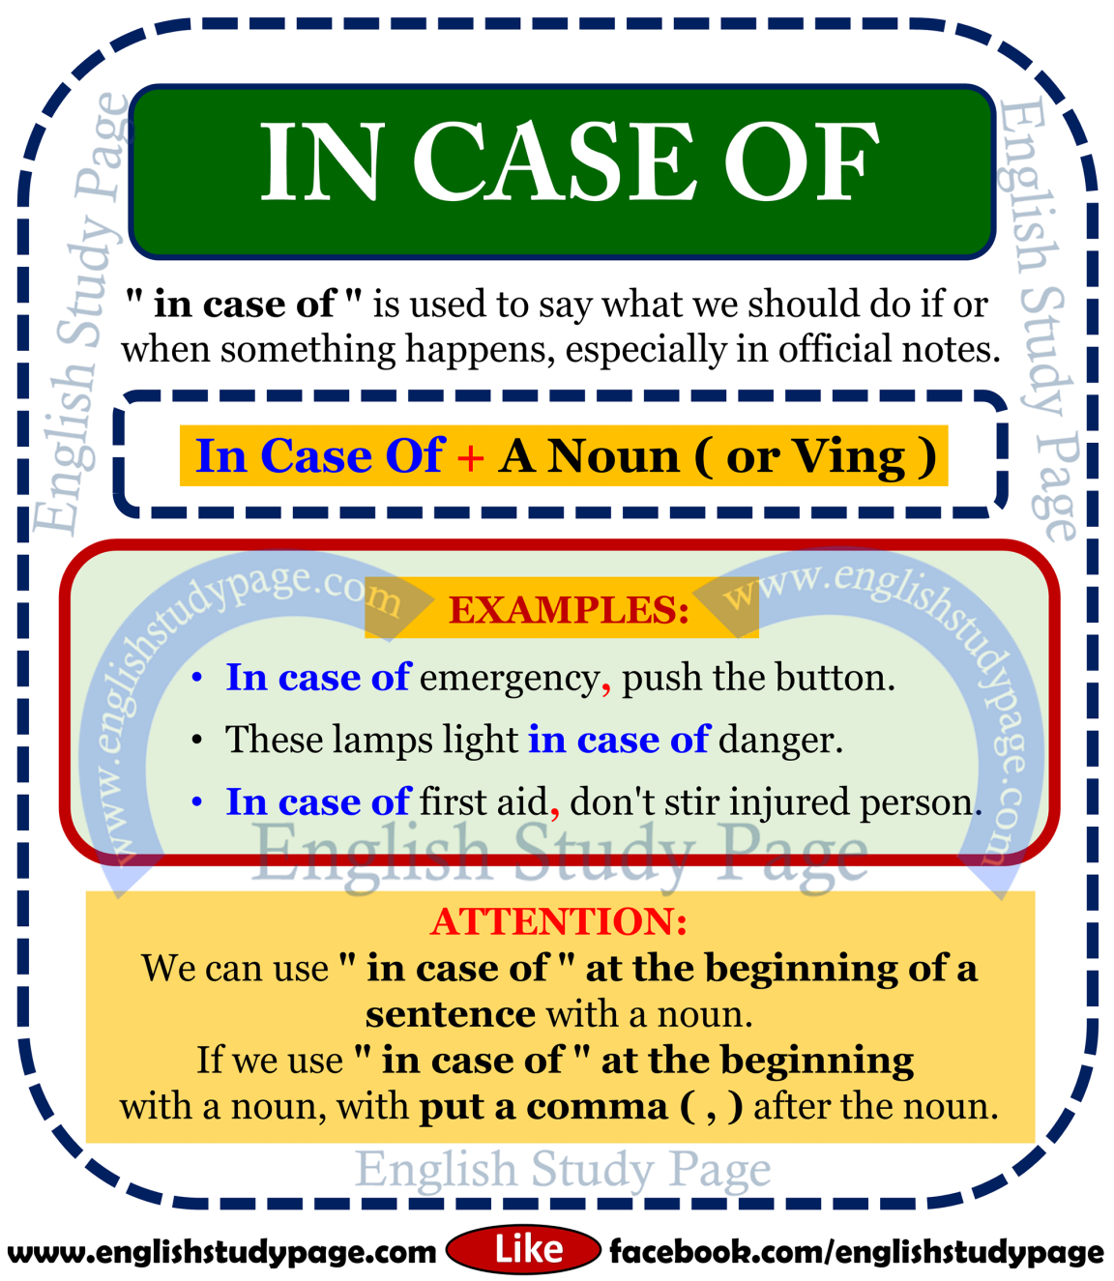
Case

Slide 5
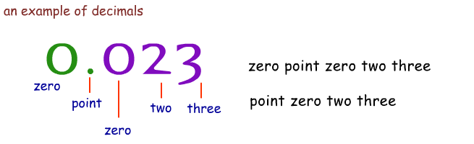
Decimal

Slide 6

Decrease

Slide 7
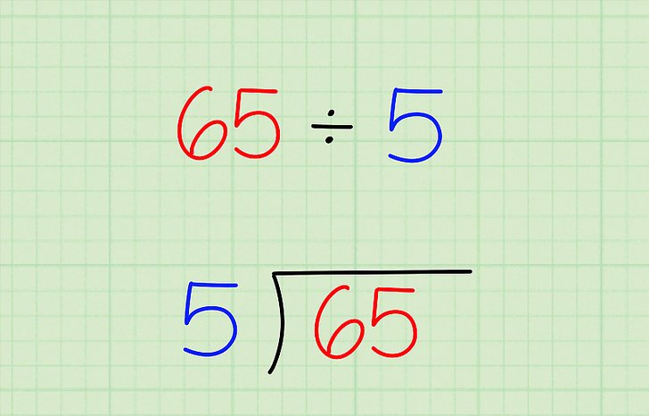
Division

Slide 8

Expensive

Slide 9
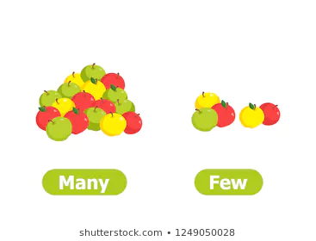
Few

Slide 10

Decade

Slide 11

Enemy

Slide 12

Front

Slide 13

Grave

Slide 14
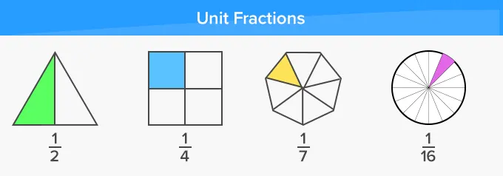
Fraction

Slide 15
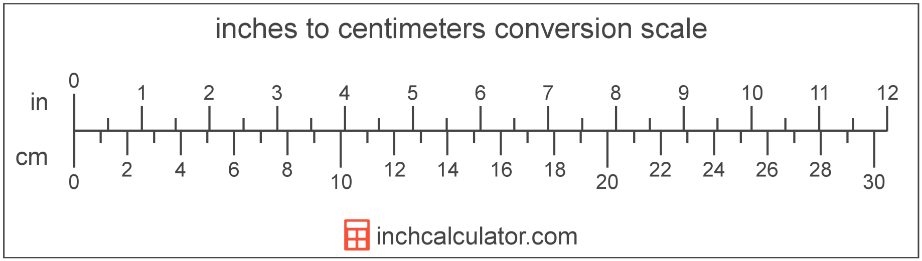
Inches

Slide 16
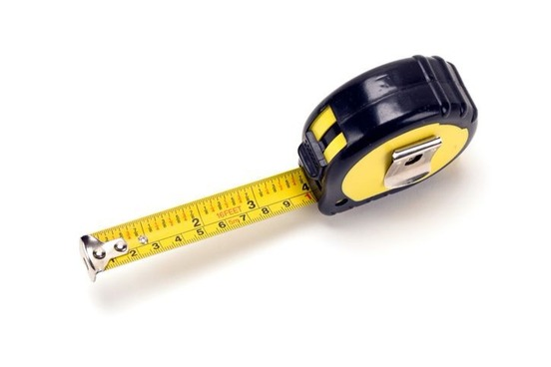
Measure

Slide 17
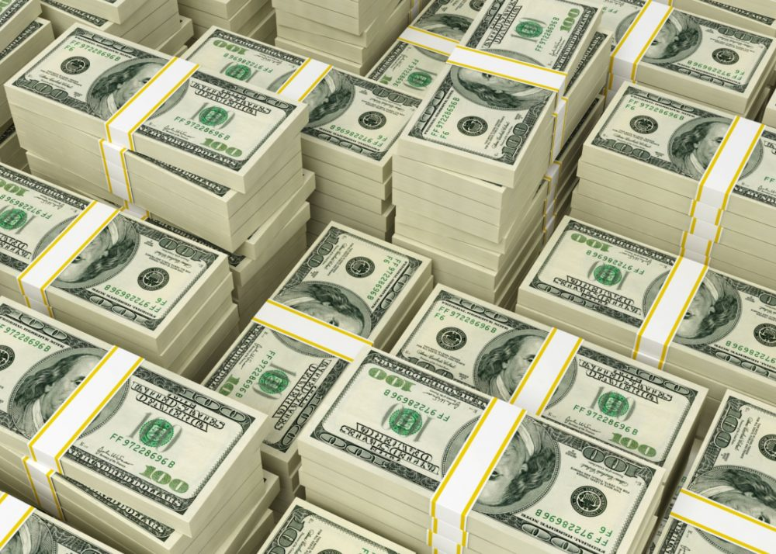
Million

Slide 18

Life cycle

Slide 19

None

Slide 20

Pattern

Slide 21
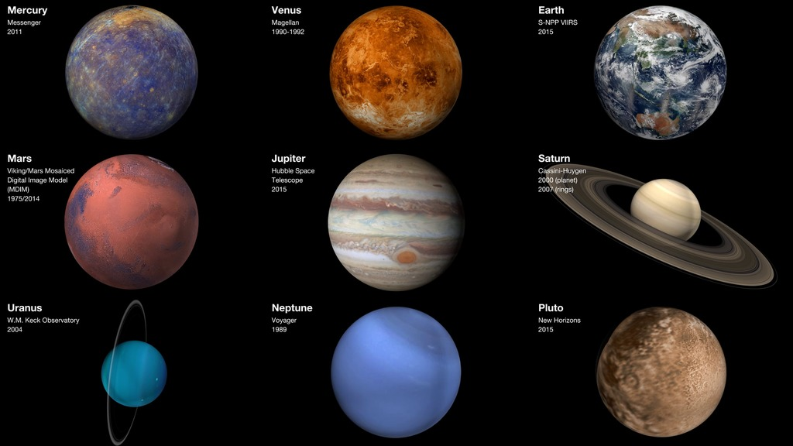
Planets

Slide 22
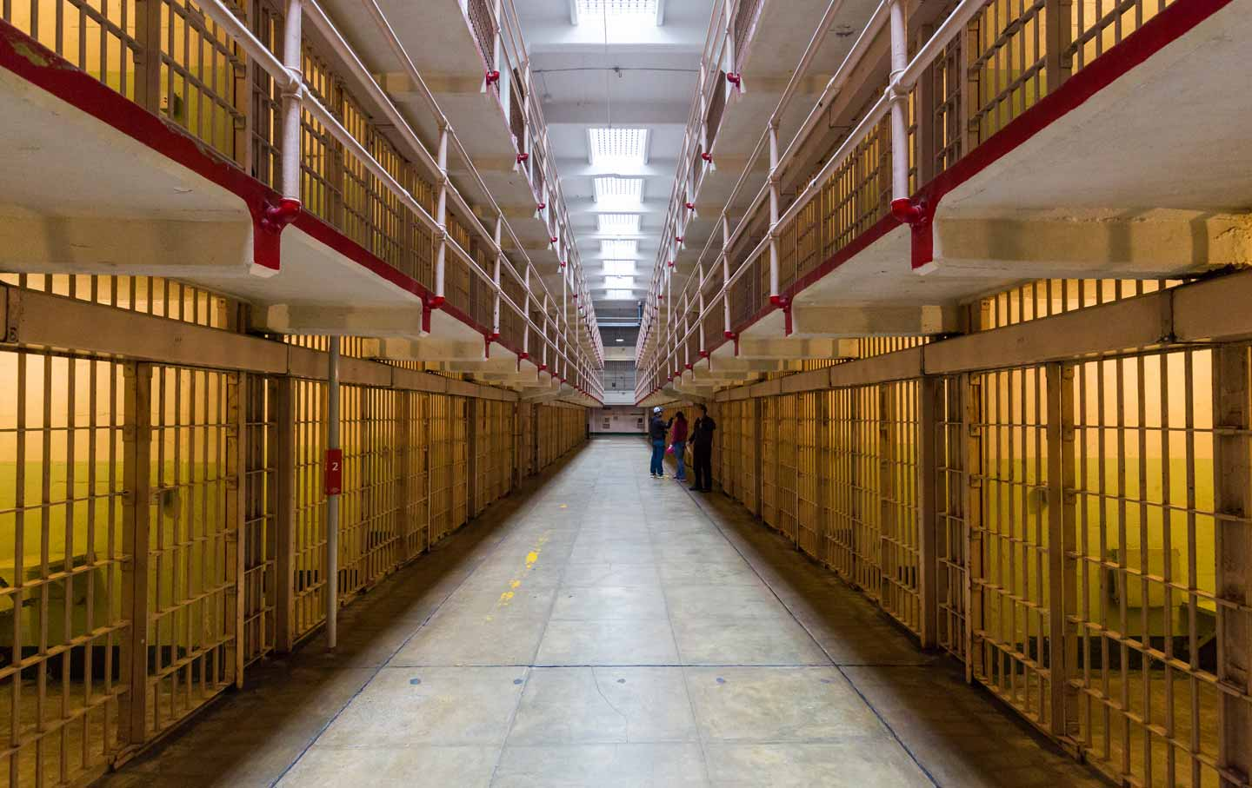
Prison

Slide 23

Reach

